Slide 1
Notes:
During the next two lessons, we will learn about Russia’s Global Information War on Ukraine. In this first lesson we will focus on Propaganda about Ukraine in the Western countries and we’ll also look at more local examples – propaganda used to target people in the Baltics and in Latvia.

Slide 2
Goals of the lesson
- To learn what propaganda is
To learn about common propaganda techniques
To understand the goals of Russian propaganda on the war in Ukraine as it appears in Western countries and Latvia
To learn simple fact-checking techniques
Notes:
During the first lesson we will talk about different types of manipulative information and learn what propaganda is. Then we will look at commonly used propaganda techniques. We will also look at particular propaganda messages spread about the war in Ukraine by Russia and learn some simple information verification techniques.

Slide 3
How would you define disinformation? What about propaganda? Do you think there’s a difference between the two? What about misinformation?
Notes:
To start, I’d like to ask you: How would you define disinformation? What about propaganda? Do you think there’s a difference between the two? What about misinformation?
[Allow a few students to answer, 2 min]

Slide 4
Definitions:
Disinformation: Disinformation is false information that is deliberately created or disseminated with the express purpose to cause harm. Producers of disinformation typically have political, financial, psychological, or social motivations
Misinformation: Misinformation is information that is false, but not intended to cause harm. For example, individuals who don’t know a piece of information is false may spread it on social media in an attempt to be helpful.
Propaganda: Propaganda is true or false information spread to persuade an audience, but often has a political connotation and is often connected to information produced by governments.
What do disinformation and propaganda have in common?
Source: https://firstdraftnews.org/wp-content/uploads/2018/07/infoDisorder_glossary.pdf
Notes:
Now we will look the definitions of these terms.
Disinformation: Disinformation is false information that is deliberately created or disseminated with the express purpose to cause harm. Producers of disinformation typically have political, financial, psychological, or social motivations
Misinformation: Misinformation is information that is false, but not intended to cause harm. For example, individuals who don’t know a piece of information is false may spread it on social media in an attempt to be helpful.
Propaganda: Propaganda is true or false information spread to persuade an audience, but often has a political connotation and is often connected to information produced by governments. In the case of the Kremlin’s information war in Ukraine, propaganda often overlaps with disinformation.
Note that these definitions and terms are highly debated even among experts.
Ask students what does disinformation and propaganda have in common (answer: intent to persuade or mislead). Misinformation is spread by people who believe it’s true.)

Slide 5
Notes:
Now we will hear from Aliona Romaniuk, a Ukrainian fact-checker, founder of NotaEnota. Afterwards, I will ask some questions about what she says. https://youtu.be/jLL91SmapHo

Slide 6
Which types of false information we just discussed were also brought up in the video with the fact-checker Aliona Romaniuk?
Notes:
What types of false information mentioned previously (disnformation, propaganda, misinformation) were brought up by the expert?
Answer: Propaganda on biolabs in Ukraine to justify the war, misinformation people spread around about the virus on WhatsApp.

Slide 7
Propaganda:
Propaganda is biased information designed to shape public opinion and behavior. Its power depends on the following:
○ message
○ technique
○ means of communication
○ environment
○ audience receptivity
Propaganda uses one or more common techniques:
○ Uses truths, half-truths, or lies
○ Omits information selectively
○ Simplifies complex issues or ideas
○ Plays on emotions
○ Advertises a cause
○ Attacks opponents
○ Targets desired audiences
Source: https://www.ushmm.org/m/pdfs/USHMM-Teacher-Guide-State-of-Deception.pdf
Notes:
Give participants a printout of this slide!
Since we are mostly focused on propaganda today, we will discuss it more in a bit more depth before we turn to particular examples.
Propaganda is biased information designed to shape public opinion and behavior.
Its power depends on the following: ○message; ○ technique; ○means of communication or where and how the messages is spread; ○ environment; ○ audience receptivity. We have to consider the environment because the events in the country might help propaganda sound more believable. For example, when Russian propaganda outlets talk about independent former Soviet states as failed states, it will be easier to spread when there’s an economic crisis in the country, people are angry, struggling and upset. Then the audience receptivity would be higher. These last two points are essential for propaganda to be successful. What people are experiencing during a particular time makes them more receptive to a specific message. Propaganda only works when the audience is already receptive to the message.
It’s also worth paying attention to particular techniques that make the propaganda more interesting, eye-catching, easier to understand and accept if the person is receptive. ○ Uses truths, half-truths, or lies ○ Omits information selectively ○ Simplifies complex issues or ideas ○ Plays on emotions ○ Advertises a cause ○ Attacks opponents ○ Targets desired audiences
You can use the paper copy of this slide you are given to follow along the information on particular messages and notice the techniques that are used.

Slide 8
Goals:
Undermine the truth
Erode public support for Ukraine
Present Russia as powerful and treated unfairly
Notes:
The IREX staff in Ukraine identified three large groups of messages used in the context of war when Western countries are targeted:
messages that undermine the truth and confuse people
messages that erode public support for Ukraine and make it seem like it is not a country worthy of support, that they deserved the attack and the war isn’t unjust.
Messages that present Russia as powerful, a country you shouldn’t challange and at the same time – often victimized.
We will look at particular stories that are told to pass on these messages.
Additional reading:
https://www.bbc.com/news/world-europe-66113460
https://www.delfi.lv/atmaskots/taisnigums-krievijas-gaume-jeb-ka-krievija-megina-attaisnot-aneksiju.d?id=54826888

Slide 9
1. Undermine the truth
Shooting down a passenger plane
The Russian Foreign Ministry proves: MH17 was shot down with a Ukrainian missile
The target of those who shot down the Malaysian Boeing could be the plane of the President of Russia
Ukrainian dispatchers forced the downed airliner to descend
Notes:
First we will look at particular examples of how Kremlin propaganda has tried to undermine the truth. Often the Kremlin makes multiple contradictory and inconsistent claims to confuse audiences about the reality of contested events. One such example is the myriad of explanations offered for the downing of Malaysia Airlines Flight 17, the passenger plain shot down over eastern Ukraine in 2014, killing nearly 300 civilians. We can see multiple contradictory examples here. The attack was targeted at the plane of the Russian president but also it was an airliner that Ukrainian dispatchers forced to descend. Kremlin has said it was a Ukrainian missile that downed the plane, that it was an Israeli missile and also that it was a Ukrainian fighter jet, not a missile. A court in the Netherlands found that it was downed by a missile by two Russians and a Ukranian seperatist
Additional reading about the court ruling for background information:
https://edition.cnn.com/2022/11/17/europe/mh17-trial-verdict-intl/index.html
https://archive.ph/kHKF9
https://archive.ph/9rUdA
https://archive.ph/Avd1z https://archive.ph/2015.07.16-231051/http://www.rt.com/news/310039-mh17-israeli-missile-version/
http://web.archive.org/web/20140806180616/http://www.rt.com/news/174412-malaysia-plane-russia-ukraine

Slide 10
1. Undermine the truth
The rationale behind the war in Ukraine
Notes:
This firehose of falsehoods type of messaging is happening more often than just on this occasion. The same thing happened when Russia was trying to define the rational for invading Ukraine. Let’s hear what Mariia Sahaidak, Head of the Strategic Communication department at the Centre for Strategic Communication and Information Security has to say.
https://youtu.be/sJAKL6bh8j0
Mariia Sahaidak
Head of the Strategic Communication department at the Centre for Strategic Communication and Information Security, Ukraine

Slide 11
2. Erode public support for Ukraine
Ukrainians painted as not worthy of support
The fact that Ukraine has been at war for eight years has often been diminished or even ignored as the war was presented as an internal problem ("Ukraine crisis"), rather than one created from abroad by the Kremlin​.
Drawing on Western efforts to combat right-wing extremism to promote narratives centering on neo-Nazis and ultranationalists in Ukraine, as well as other stories to paint Ukrainians as unworthy of support.
Why Ukraine turned out to be defenseless against demons of Nazism
Is there any evidence for Russian claims about Nazism in Ukraine?
Notes:
The Kremlin has worked extensively over the past decade to discredit the image of Ukraine among its western partners. For example, the war in Donbas was referred to by many experts as the Ukrainian “crisis,” distracting attention from the real problem — Russia’s occupation of those territories. Ukraine was also depicted as a failed state, an impoverished, corrupt puppet of its Western allies. The fact that the country has been at war for eight years has been often diminished or even ignored as the war was presented as an internal problem, rather than one created from abroad by the Kremlin. Ukrainians are also painted as extremists or corrupt to emphasize that they are not worthy of support.
https://www.france24.com/en/tv-shows/truth-or-fake/20220322-photos-of-nazi-symbols-in-ukraine-are-shared-out-of-context%20%E2%80%8B%20
https://www.tvnet.lv/7664477/faktomats-vai-krievijas-apgalvojumiem-par-nacismu-ukraina-ir-pamats

Slide 12
2. Erode public support for Ukraine
Discrediting Ukrainian refugees
No evidence that transport controller was attacked by a Ukrainian
German fact checkers traced the graffiti to fans of the football team FC Augsburg
"German driver shows the train in which refugees from Ukraine were brought in horror"
Source: https://correctiv.org/faktencheck/2022/03/23/nein-dieser-zug-wurde-nicht-von-gefluechteten-aus-der-ukraine-verunreinigt/
Notes:
Kremlin propaganda often weaponizes the likelihood of social media users taking visuals online at face value. For example, a video filmed by a man inside a littered, defaced train went viral on German social media. Accompanied by a caption claiming the litter was left by Ukrainian refugees, the video was widely shared – and later refuted by independent fact-checkers from the German non-profit Correctiv. The culprits were in fact football fans, and it was later confirmed the train was not used to transport Ukrainian refugees.
There are similar claims made it to Latvian social media users too including untrue stories about Ukrainians starting fights and otherwise acting in an aggressive, disagreeable manner.
https://correctiv.org/faktencheck/2022/03/23/nein-dieser-zug-wurde-nicht-von-gefluechteten-aus-der-ukraine-verunreinigt/ https://rebaltica.lv/2022/05/nav-pieradijumu-ka-rigas-satiksmes-kontrolierim-butu-uzbrucis-ukrainis/
Other examples:
https://rebaltica.lv/2022/03/ar-veciem-video-censas-nomelnot-ukrainu-beglus/
https://rebaltica.lv/2022/12/vaciesi-vairs-negrib-palidzet-ukrainai-vai-latvijas-mediji-parpublice-krievijas-propagandu/
https://rebaltica.lv/2022/03/donbasa-berni-un-nepateicigie-ukrainu-begli-vienadie-vestijumi-rada-aizdomas-par-kampanu/
https://rebaltica.lv/2022/03/agresivais-virietis-nav-beglis-no-ukrainas-bet-gan-jaunietis-no-plavniekiem/
https://rebaltica.lv/2022/03/ne-ukraini-nav-piekavusi-zivju-fabrikas-darbinieci-vecmilgravi/

Slide 13
2. Erode public support for Ukraine
Support for Ukraine comes at the expense of Latvians
Medicine is dead: NATO's appetites buried the healthcare sector in Latvia
Tighten your belts: Latvia sponsors the Armed Forces of Ukraine in the face of a gigantic budget deficit
Source: https://www.delfi.lv/atmaskots/punktu-pa-punktam-ka-krievijas-propaganda-skaidro-latvija-notiekoso.d?id=55736536
Notes:
Another narrative that is targeted at Latvia is that Latvia is not doing well economically and supporting Ukraine is a big strain on the country. The articles say that Latvia is providing a lot of support, but the refugees are a big strain on the country, are not eager to find work and don’t learn the Latvian language. The standard of living for Latvians is falling and medical services are failing. It’s worth remembering what we discussed about the environment and audience receptivity in order to make propaganda seem reasonable and worth paying attention to – since the country is experiencing high inflation, it is easier to indetify with the story and believe that the propaganda target is the real scapegoat.
https://web.archive.org/web/20230511163716/www.rubaltic.ru/article/ekonomika-i-biznes/20230407-zatyanut-poyasa-latviya-sponsiruet-vsu-v-usloviyakh-gigantskogo-defitsita-byudzheta/
https://web.archive.org/web/20230424165752/baltnews.com/V_Latvii/20230424/1025943469/Meditsina-prikazala-dolgo-zhit-appetity-NATO-pokhoronili-sferu-zdravookhraneniya-Latvii.html

Slide 14
3. Present Russia as powerful, yet treated unfairly
The threat of WW3
Kremlin propaganda has been using its nuclear capabilities as a fearmongering tactic to push the idea that Western countries are provoking escalation to World War III through their support for Ukraine
To any point on Earth. What are the new Russian missiles capable of?
Notes:
The next large group of messages is about Russia – on the one hand it is depicted as powerful and threatening, but on the other – as the actual victim.
For many years, Kremlin propaganda has been using its nuclear capabilities as a fearmongering tactic to push the idea that Western countries are provoking escalation to World War III through their support for Ukraine. State propaganda TV shows in Russia regularly discuss the looming potential for World War III and the weaponry Russia possesses.
https://www.reuters.com/article/ukraine-crisis-russia-kiselyov-idUSL6N0MD0P920140316
https://archive.ph/MYFRg
https://web.archive.org/web/20230817161702/www.baltnews.com/nato-v-pribaltike/20230108/1025809277/Pribaltika--odnorazovyy-material-kotoryy-nuzhen-Zapadu-chtoby-obeskrovit-Rossiyu.html

Slide 15
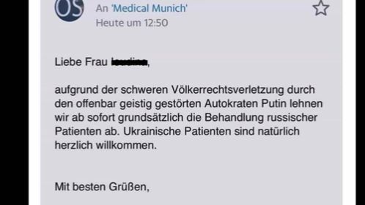
3. Present Russia as powerful, yet treated unfairly
Russians presented as victims
Kremlin propagandists present Western institutions, schools, banks, and healthcare providers as actors that discriminate against Russians.
After one Italian university cancelled a course on 19th-century Russian novelist Fyodor Dostoevsky (the course was quickly reinstated after backlash), Kremlin media jumped on the idea that Russian culture was being discriminated against in the West.
A fake email claiming a hospital in Munich, Germany, no longer serves Russian patients.
Source: https://correctiv.org/faktencheck/2022/03/07/doch-das-klinikum-muenchen-behandelt-russische-patienten/
Notes:
By emphasizing the victimization of Russians abroad, the Kremlin attempts to shift attention from atrocities in Ukraine, reversing the moral paradigm to one where the West, and implicitly Ukraine, are the aggressors. Kremlin propagandists present Western governments, schools, banks, and health institutions as actors that discriminate against Russians. Debunked claims included that the University Hospital of Munich (LMU) no longer wants to treat Russian citizens, that Deutsche Bank and Postbank sanctioned all their Russian clients, or even that Russian children were kicked out of German schools. These fakes target Germany specifically due to the large amount (around 2.5-3 million) of Russian immigrants living in the country, many of whom have limited German language skills.
https://correctiv.org/faktencheck/2022/03/07/doch-das-klinikum-muenchen-behandelt-russische-patienten/

Slide 16
How to fact-check emotional and suspicious claims?
Who made the claim? Do they have the expertise and information to know that?
Google the author of the claim, the organization and the media outlet. Who are they? Do they have a good reputation? Do a little investigation on their background!
What evidence and sources did they provide to back up their claim? Does the source actually say what they claim it does?
If there is no source for the claims, it is a red flag! If the source is indicated, check it too.
What are other sources saying?
Google keywords related to the claim. Are there reliable sources of information saying the same thing?
Do you know about some other information verification tricks you would like to share with others?
Notes:
We also want to eave you with some practical tips, not just information that there is a lot of falsehoods out there. Here are some questions to ask yourself to check information.
Who made the claim? Do they have the expertise and information to know that?
Google the author of the claim, the organization and the media outlet. Who are they? Do they have a good reputation? Do a little investigation on their background!
What evidence and sources did they provide to back up their claim? Does the source actually say what they claim it does?
If there is no source for the claims, it is a red flag! If the source is indicated, check it too.
What are other sources saying?
Google keywords related to the claim. Are there reliable sources of information saying the same thing?
Do you know about some other information verification tricks you would like to share with others?

Slide 17
How to fact-check? Exercise
Social media users are saying they have video evidence that some of the war footage from Ukraine was actually filmed using crisis actors.
Which of the previously discussed tactics would you use to fact-check this claim?
Notes:
Show participants the video and while it's playing, explain that this video has been used on social media to claim that it shows crisis actors filming war footage in Ukraine. Ask which of the previously discussed fact-checking tactics would they use to verify this video. Suggest that they should think about keywords to look up. For suggested steps, go to the next two slides.
https://youtu.be/X-gwn1698S4
https://www.factcheck.org/2022/03/video-shows-climate-protest-in-austria-not-crisis-actors-in-ukraine/

Slide 18
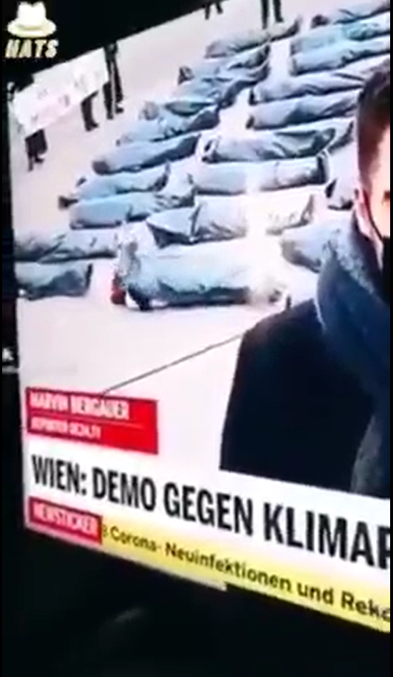
How to fact-check? Exercise
Step 1: Although sometimes you have to think about keywords that characterize the video/image/text and look up those, this time there is something to look up in the video itself. Try to see what comes up when you type "Wien demo gegen klimap" on Google.
Notes:
Tell participants that they can try to look up words that are visible in the video, although often they would have to try to generate keywords that characterize the video, image or text they are fact-checking.

Slide 19
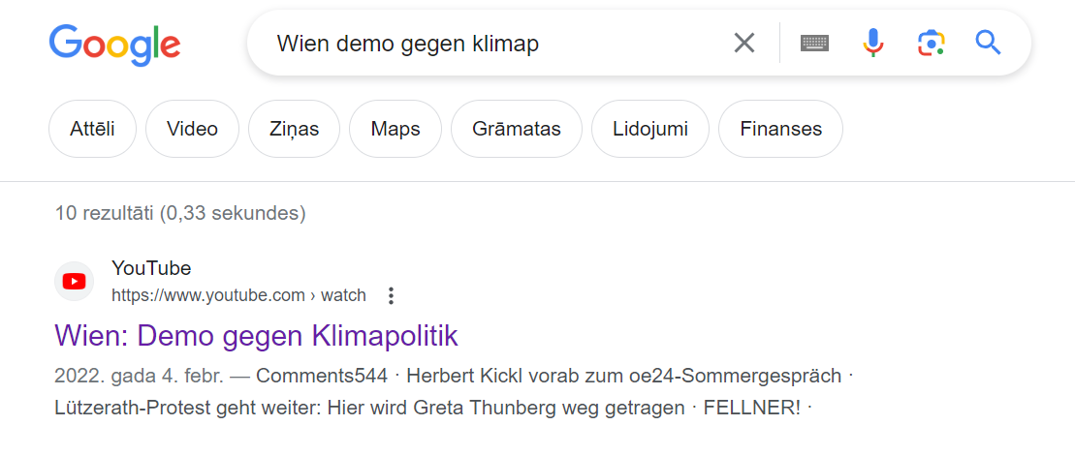
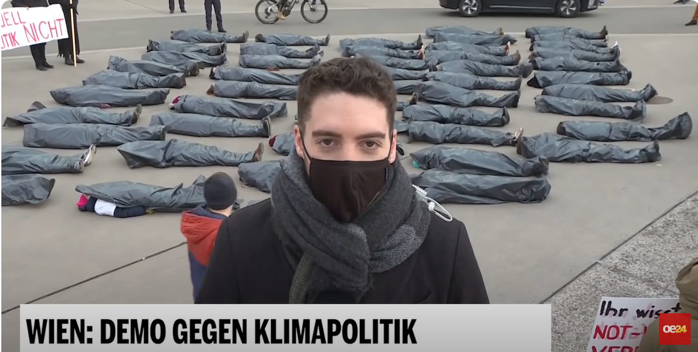
How to fact-check? Exercise
Step 2: One of the first results that appear on search results should be a video titled "Wien: Demo gegen Klimapolitik"
Step 3: After making sure the fragment on social media came from the same video, you can translate the original title using tools like Google Translate. It means "Vienna: Demo against climate policy" and has nothing to do with Ukraine.
Notes:
After finding a video with the same title, it's important to check whether the videos match. Afterwards, you can translate the tittle of the video and look at the source that posted it – it's a report from a Austrian channel about a climate protest, not about Ukraine.

Slide 20
How to fact-check emotional and suspicious claims?
Build up your information verification skills by learning more about manipulative information and fact-checking using the online course on media literacy VeryVerified.eu
Notes:
In conclusion, encourage participants to polish their information verification skills by taking a course that with tools and techniques described
https://veryverified.eu/units/unit-4/part-b-manipulation/fact-checking-tools

Slide 21
Optional extra content for the lesson

Slide 22
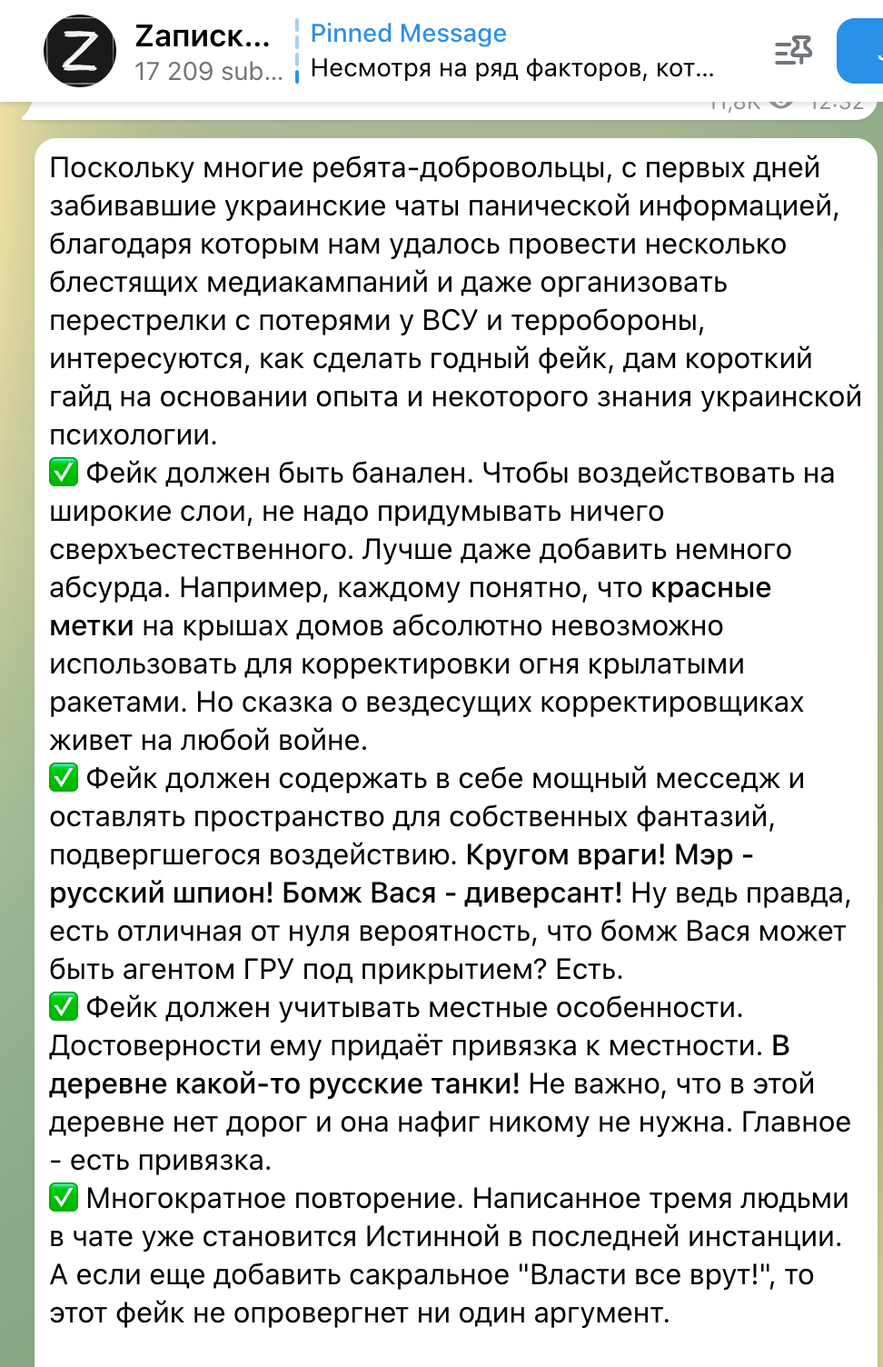
Russian Telegram channels sharing instructions on how to create fakes and spread disinformation in Ukraine
“How to create a good fake. Here is a short guide based on my experience and knowledge of Ukrainian psychology.
✅ Fake should be banal. In order to influence masses, it is not necessary to invent anything extraordinary. Better even if it is a little absurd.
✅ A fake should contain a powerful message and leave space for the victim's own fantasies. Enemies are all around! The mayor is a Russian spy! Homeless Vasya is a saboteur!
✅ Fake should take into account local details. Mention the names of concrete villages. There are some Russian tanks in the village N!
✅ Multiple repetition. Written by three people in the chat, the message already becoming the Ultimate Truth. And if you add the sacred "The authorities are all lying!", this is a win.”
filter.mkip.gov.ua
fb./inst. @filter.info
Notes:
If you would like to include more information about propaganda techniques as discussed in the beginning of the lesson, you can use this example uncovered by the Ukrainian Center for Combating Disinformation.
A Telegram channel with over 25,000 subscribers at the time it was last active, “Notes of Veterans,” was sharing instructions on how to create fakes and spread false information in Ukraine.
You can see that the advice given on spreading fakes is very much in line with what researchers have found to be common propaganda techniques.

Slide 23
2. Erode public support for Ukraine
Ukrainians are painted as not worthy of support
Has Ukraine passed laws to allow selling organs?
The story of the boy crucified in Ukraine has no evidence
Concentration camps, medical experiments and stolen children: how Russian propaganda lies about Ukrainian refugees
Notes:
If you want to include more media examples related to eroding public support for Ukraine, you can also discuss these.
These are some of the headlines of fact-checkers who have researched false claims. They include Ukraine allowing to sell organs, a boy getting crucified, as well as medical experiments on people, including children that are stolen in the country. Those stories have been popular on social media among users in Latvia. When journalists check those stories, they turn out to be false.
https://rebaltica.lv/2023/06/ukraina-nav-atlauts-pardot-organus/
https://rebaltica.lv/2022/06/stasts-par-ukraina-krusta-sisto-puisenu-bez-pieradijumiem/
https://www.delfi.lv/atmaskots/koncentracijas-nometnes-medicinas-eksperimenti-un-atnemti-berni-ka-krievijas-propaganda-melo-par-ukrainu-begliem.d?id=54888120
https://www.bbc.com/news/world-europe-66113460

Slide 24
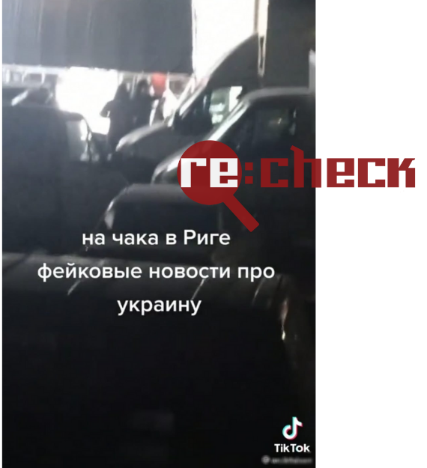
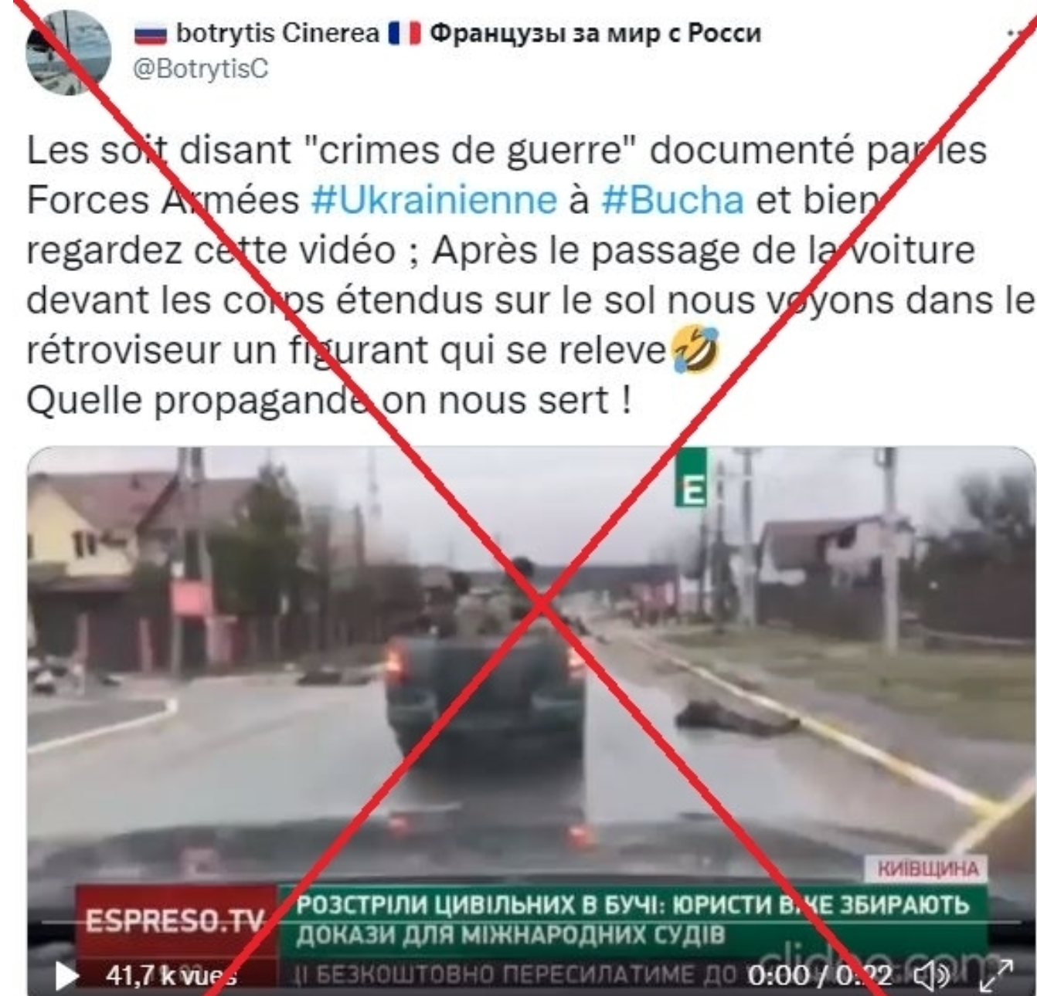
2. Erode public support for Ukraine
The most tragic events are staged
Source: https://factcheck.afp.com/doc.afp.com.327R8KF; https://rebaltica.lv/2022/03/ukrainas-kars-piesaista-melu-izplatitajus-un-krapniekus-tiktok/
Notes:
Another message used to suggest that Ukraine actually should not receive support, is that a lot of the war footage we are seeing is faked.
In April, Ukraine accused withdrawn Russian troops of massacring over 450 civilians in the small town of Bucha outside of Kyiv. The Kremlin denied it, calling it a “heinous provocation,” and claiming the evidence was staged with actors by the Ukrainian government. Pro-Russia social media users spread this narrative, citing a video which seemed to show one of the corpses raising his hand. The Russian Defense Ministry itself shared the video on April 3 on its official Telegram channel, claiming that one of the corpses can be seen moving his arm and another standing up in the rear-view mirror. Several users on social networks pointed out that the corpse in view was not moving (it was just a drop of rain on the windshield of the car in which the video was filmed), and journalists from AFP confirmed that the body in the video was the same they had photographed upon visiting Bucha on April 2.
Such stories also have become popular on social media in Latvia. One example is a shooting of an ad that was filmed by a by-passer and posted on TikTok with a claim that fake footage about the war in Ukraine was being shot there. Ukrainian flag hanging on a nearby house were used as supposed evidence. The director of the shooting said that they were just filming a commercial that had nothing to do with Ukraine.
https://factcheck.afp.com/doc.afp.com.327R8KF
https://rebaltica.lv/2022/03/ukrainas-kars-piesaista-melu-izplatitajus-un-krapniekus-tiktok/

