Slide 1
Notes:
In the second lecture in our series, we will talk about propaganda but from a different angle – instead of discussing how is the war portrayed in Kremlin propaganda to foreign audiences, we will see what messages are targeted to Ukrainians.

Slide 2
Goals of the lesson
To understand the goals of Russian propaganda in Ukraine
To learn about the means used to spread propaganda
To discuss what each of us can do to reduce the spread of false information
Notes:
In this lesson we will talk about Kremlin propaganda in Ukraine and in Latvia, we will learn about means used to spread propaganda, as well as discuss what we can do to reduce the spread of false information

Slide 3
You have learned about the goals of propaganda that focuses on Ukraine as it appears in Western countries.
What do you think are the main goals of Kremlin propaganda in Ukraine for Ukrainian citizens?
Notes:
Ask the students two questions (Answers can be given verbally, in chat, or through Jamboard)
After learning about propaganda and its goals in the Western countries, what do you think are the main goals of Kremlin propaganda in Ukraine for Ukrainian citizens?

Slide 4
Goals:
Divide Ukrainians
Undermine trust in Western partners
Demoralize the population
Notes:
The Ukraine program at IREX has again identified several goals or main messages of propaganda:
To divide Ukrainians, cause tension within the country
Make the Western partners seem less reliable
And demoralize the population so that they are less interested in resisting

Slide 5
Use of highly emotional narratives or images often signals an attempt to manipulate. Slow down, take a deep breath, name the emotion you're feeling, and try to get the full picture.
Notes:
Before we discuss these propaganda goals and messages used in more detail, I'd like to introduce a very important idea often referred to as Name It to Tame It.
Strong emotions are a key factor in making viral online content and effective propaganda. Getting us angry drives up clicks, shares, comments and keeps us interested. Checking whether a story made you emotional is the first step to getting a sense of whether you are being manipulated. Not all stories using emotional language are untrue, of course. But it’s one of the signs that something could be wrong – the use of highly emotional narratives and graphic images often signals an attempt to manipulate. It means that you should learn to pause, understand what you’re feeling, and check the facts to see if the reality is as dramatic as the story.

Slide 6
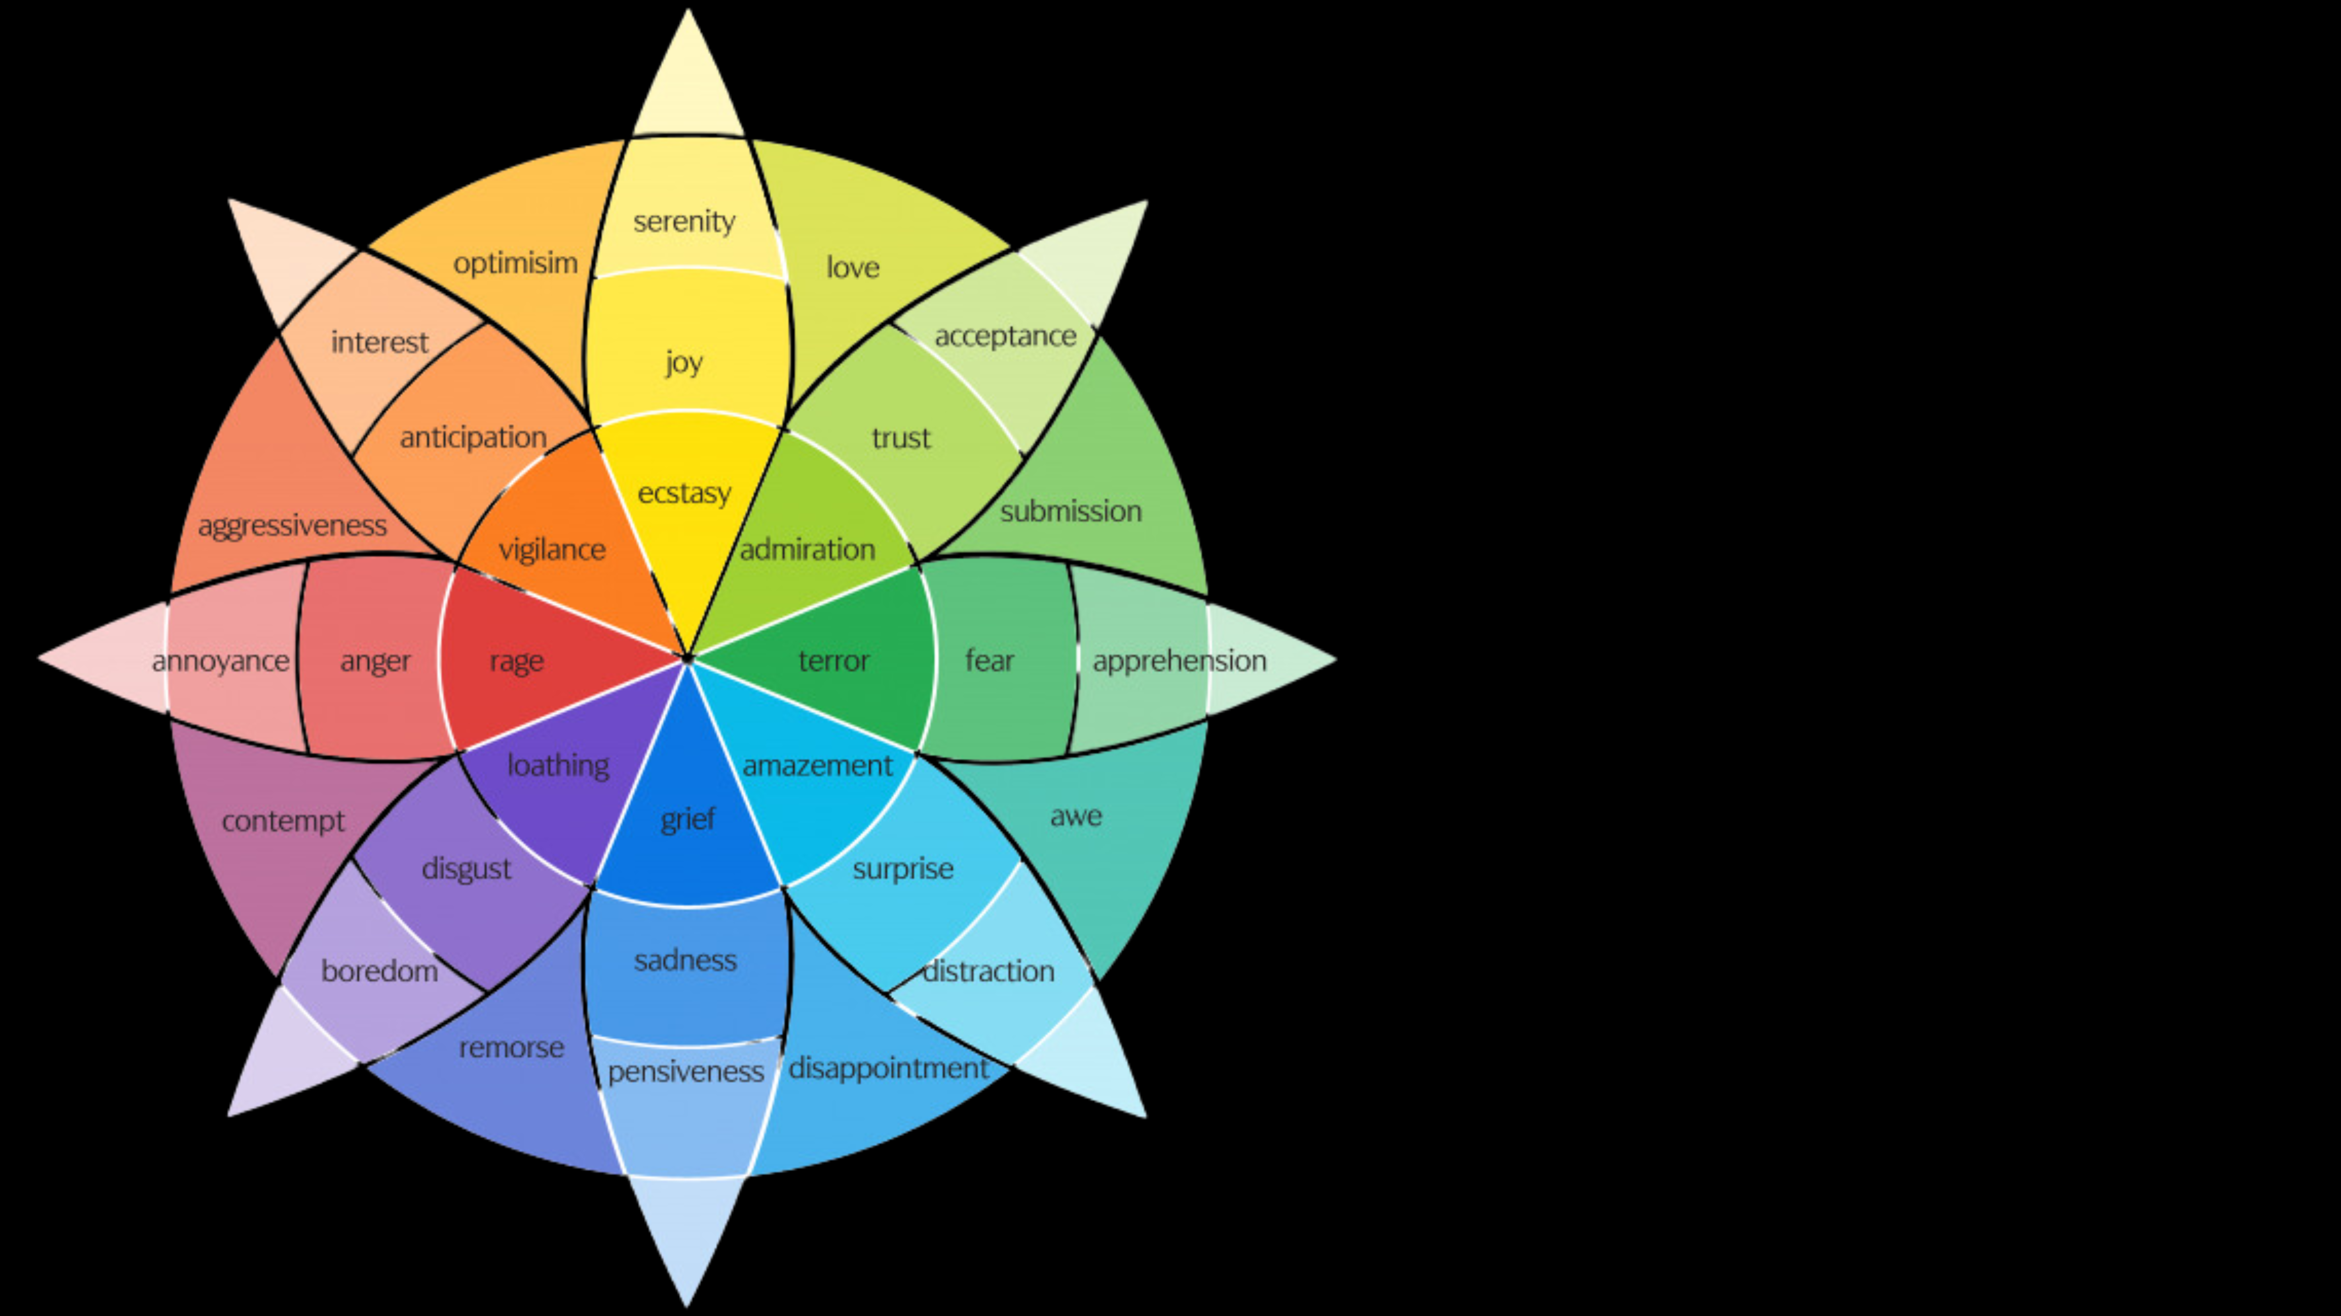
Pause: Turn your head away from the screen after viewing an image or article that provokes you.
Take a deep breath: Ask yourself: How am I feeling?
Say: Name and accept your emotion – regain control of your logical brain!
Notes:
Here's how to do it in practice
Pause: Turn your head away from the screen after viewing an image or article that provokes you.
Take a deep breath: Ask yourself: How am I feeling?
Say: Name and accept your emotion – regain control of your logical brain!

Slide 7
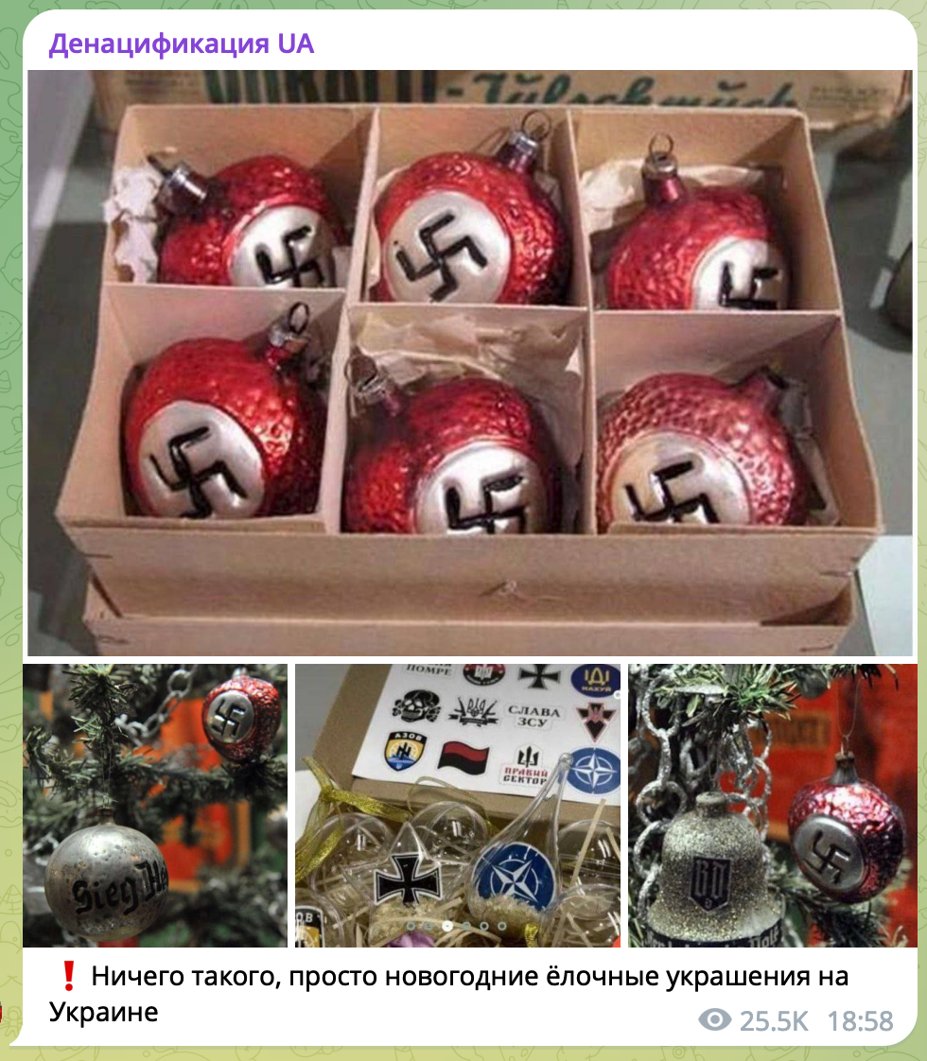
"Nazism is flourishing in Ukraine. Toys for children, clothes, souvenirs and now — Christmas decorations. Enemy ideology is increasing. It dominates all spheres of life and absorbs children’s consciousness."
Notes:
Now, let's try it out. Imagine you stumble upon this post on Telegram. Use "Name It to Tame It" tactic and identify what you feel.
(Ask a few participants to share)
https://www.stopfake.org/en/fake-ukrainians-decorate-christmas-trees-with-swastikas/

Slide 8
"Nazism is flourishing in Ukraine. Toys for children, clothes, souvenirs and now — Christmas decorations. Enemy ideology is increasing. It dominates all spheres of life and absorbs children’s consciousness."
Fact-checking outlet StopFake journalists uncovered that photos showing Christmas decorations with Nazi symbols were taken at an exhibit in a museum in Germany, others were taken from ads trying to sell such ornaments.
Notes:
Explain that this post was discovered to be fake. Say: "Fact-checking outlet StopFake journalists uncovered that photos showing Christmas decorations with Nazi symbols were taken at an exhibit in a museum in Germany, others were taken from ads trying to sell such ornaments."
https://www.stopfake.org/en/fake-ukrainians-decorate-christmas-trees-with-swastikas/

Slide 9
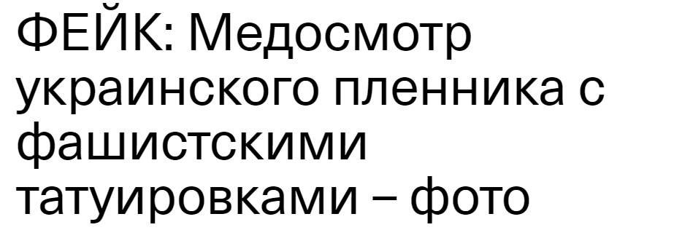
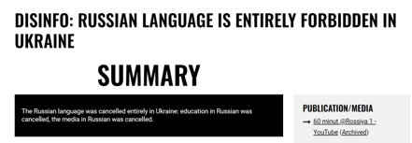
1. Divide Ukrainians
FAKE: Medical examination of a Ukrainian prisoner with fascist tattoos
Dividing Ukrainians along linguistic, political and cultural lines
False story about Russian being forbidden in Ukraine (restrictions apply to communication of state institutions and media, not communication in private life)
Trying to divide Ukrainians in "Little Russians" (a group with a loyalty to Russia, a common identity with it) and nationalists who are supposedly ruled by politicians corrupted by Western influence
Notes:
The example discussed previously fits in with a narrative that has been used a long time to sow division within Ukraine. For decades, the Kremlin has been trying to divide Ukrainians along linguistic, political, and cultural lines. During most of the Soviet period, the Russian language was promoted over the Ukrainian language, which was associated with lower social status, just like it was in Latvia. Before and during the full-scale war, Russia reignited the language issue in Ukraine, claiming that the rights of the Russian-speaking population were being violated. The language issue has also been used to support a radical narrative about Ukrainian nationalists or “Nazis” who, according to Kremlin propaganda, make up most of western Ukraine. The Kremlin thus divides Ukrainians into a loyal majority of “Little Russians,” conveying the imperialist view that Ukrainians belong to one larger Russian nation, and a perverse minority of “nationalists” ruled by politicians corrupted by Western influence.
https://voxukraine.org/ru/fejk-medosmotr-ukraynskogo-plennyka-s-fashystskymy-tatuyrovkamy-foto

Slide 10
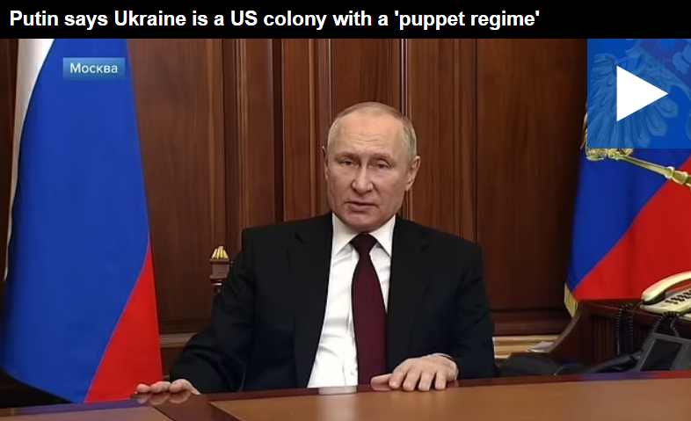
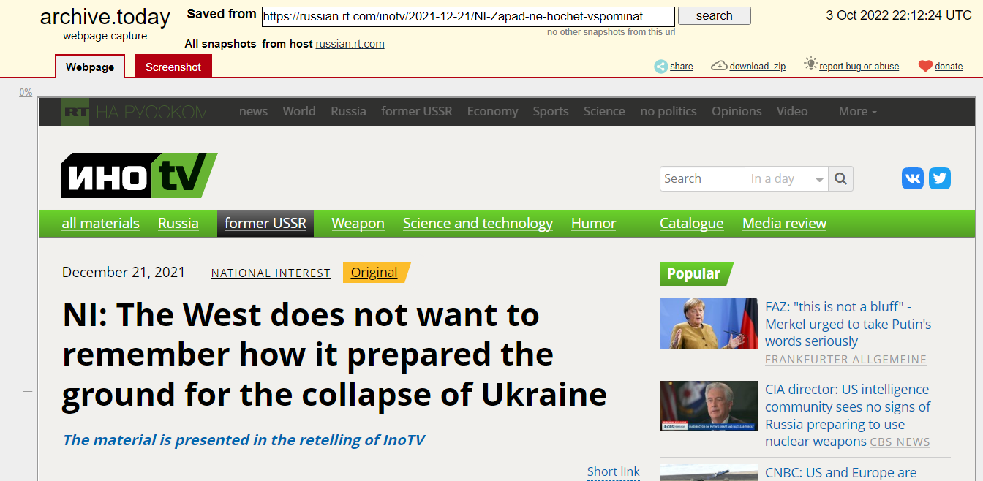
2. Undermine trust in Western partners
Ukraine as a country exists only as a “puppet” of its Western partners
One of the goals of the network of pro-Kremlin TV channels which operated in Ukraine until their ban in 2021 was to undermine public trust in the EU and NATO.
During the war, the Kremlin has simultaneously attempted to sow despair and frustration among Ukrainians by convincing them of Western partners’ betrayal
Sources: https://www.dailymail.co.uk/video/news/video-2619849/Video-Putin-says-Ukraine-colony-puppet-regime.html, https://archive.ph/gOFes
Notes:
A key narrative in Kremlin propaganda is the idea that Ukraine as a country exists only as a “puppet” of its Western partners, entirely dependent on the West and subservient to their political goals. For example, one of the goals of the network of pro-Kremlin TV channels which operated in Ukraine until their ban in 2021 was to undermine public trust in the EU and NATO. Putin himself echoed these narratives just before the start of the war on Feburary 21, 2022, when he described Ukraine as a “colony with a puppet regime.” During the war, the Kremlin has simultaneously attempted to sow despair and frustration among Ukrainians by convincing them of Western partners’ betrayal. This includes the idea that the West is willing to abandon Ukraine on a moment’s notice once it no longer suits its foreign policy objectives.

Slide 11
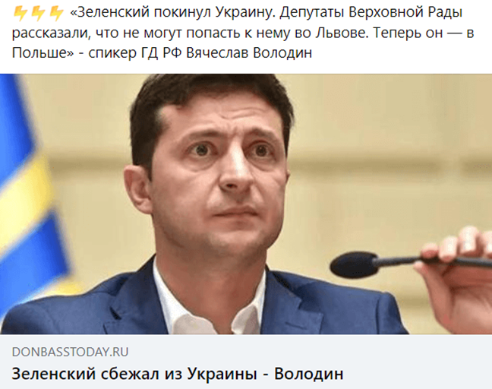
3. Demoralize the population
At the beginning of the full-scale war, the Kremlin tried to convince Ukrainians that they had been abandoned by their president and that he has fled the country.
False accusations of war crimes allegedly committed by Ukrainian forces on Ukrainian soil
Overplaying energy and food crises and blaming them on the shortcomings of the Ukrainian government
“Zelensky fled Ukraine. A deputy of Ukrainian parliament said they could not reach him in Lviv. Now he is in Poland. – State Duma speaker Vyacheslav Volodin”
Source: https://voxukraine.org/en/fake-volodymyr-zelensky-fled-ukraine-after-russian-invasion/
Notes:
Another important tactic by Kremlin propagandists has been to instill fear and hopelessness in Ukrainians.
At the beginning of the full-scale war, the Kremlin tried to convince Ukrainians that they had been abandoned by their president and government. There were various false statements of such nature, for example, that the president has committed suicide or that he has fled the country. Attempts to demoralize Ukrainians also include false accusations of war crimes allegedly committed by Ukrainian forces on Ukrainian soil. Kremlin propagandists also exploit the economic vulnerabilities of Ukrainians, overplaying energy and food crises and blaming them on the shortcomings of the Ukrainian government.

Slide 12
Means of communication
State-owned traditional media
Manipulated visuals and deepfakes
Inauthentic social media accounts
Notes:
We have talked about specific messages, over-arching narratives, goals and propaganda techniques. Now we will also briefly discuss means of communication or platforms that are used to spread propaganda messages.

Slide 13
Verify before you trust; even if the content aligns with your opinions and makes you feel good about your choices. Everyone plays a part in our online environment. Never share information if you don't know it is true.
Notes:
Before we discuss these in more depth, it's worth remembering another slogan – Care Before You Share.
You have to remember that all of us are responsible for the information environment we live in. If you don't want to live in a world where a lot of fakes are shared around and people have a hard time knowing what's really true or not, you also have to verify before you trust information even if the content aligns with your opinions and makes you feel good about your choices. Never share information you don't know is true.
Refer to the fact-checking tips in the first lesson when encountering emotional content about divisive, controversial topics.

Slide 14
State media
The majority of the media in the Baltic countries are private or commercial. Private media are owned by businesses. They get funding from advertising, their audiences (for example, subscribers), donations, or grants.
State media is financed by the state budget. State-owned media sometimes mimic independent outlets while actually serving as an instrument for promoting state policy. An example of this is Russia, where the main national networks are either run by the state or companies with close ties to the Kremlin.
Notes:
The largest media outlets in Russia are run by the state or companies with close links to the state. It allows a more direct control and oversight to make sure the massaging of the outlets is in line with the state policy.
If you want to go into more details you can tell students:
The government controls several channels like Rossiya 1, Rossiya 24, Rossiya Kultura, the childrens' channel Carousel, and others. The international channel is known as RTR Planeta. The second most popular channel, Pervii Kanal, is owned by a set of companies controlled by or associated with the state. Another popular channel, NTV, is owned by the state-controlled energy company Gazprom. The Russian government has an international reach with cable news channel RT. If you would like to show a slightly more in-depth explanation, there is a video available at the optional content section at the end of the presentation of this lesson.
You can also use the video in the optional slides or encourage students to take VeryVerified.eu course where different types of media ownership are discussed in more detail. The second VeryVerified blended learning lesson is on this topic.

Slide 15
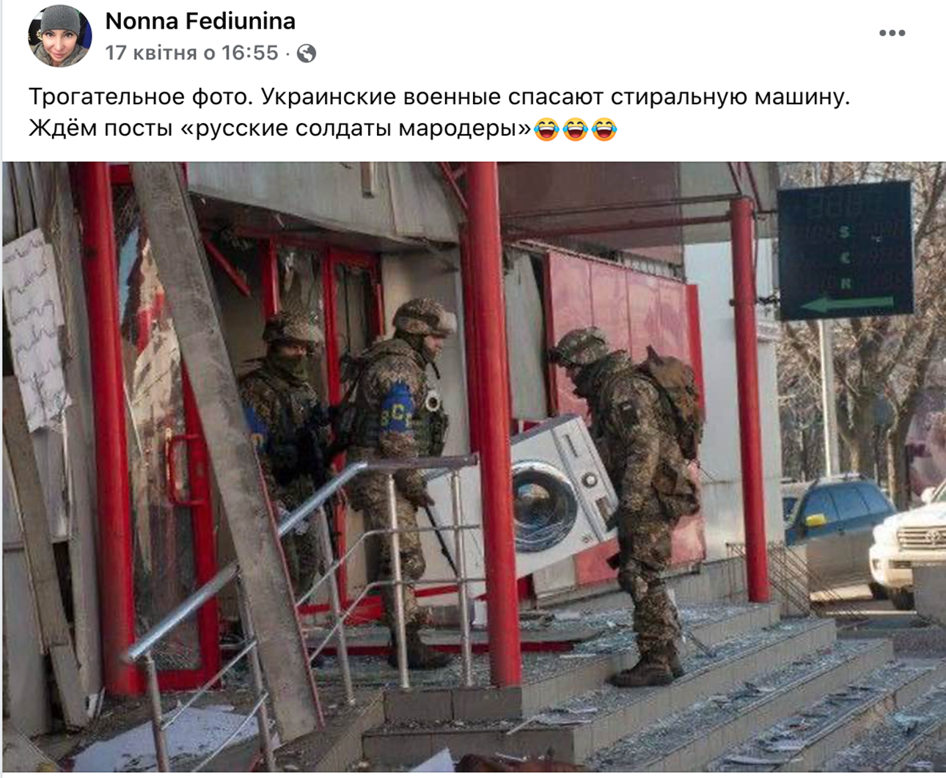
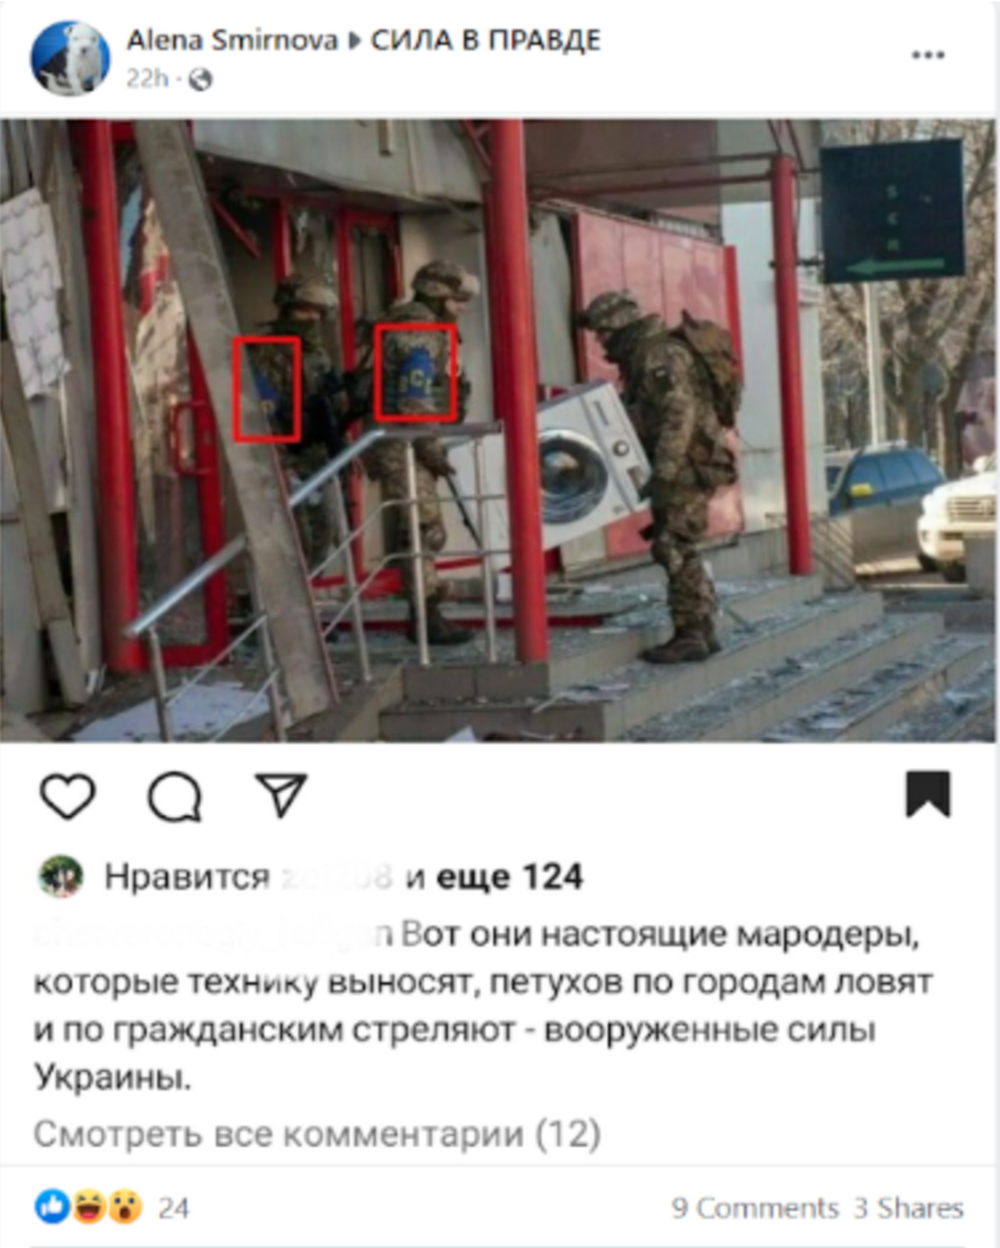
Manipulated visuals
"Here are the real looters, who are stealing appliances...shooting at civilians—the armed forces of Ukraine."
Notes:
Another way to attempt to spread more convincing false stories is by using manipulated photos or videos because people often see visuals as evidence. It can include very simple manipulations as taking a real photo and lying about the context.
Here’s an example: There were messages about Ukrainian soldiers looting Ukrainian homes during the war. Russian accounts began distributing this photo right after numerous reports about Russian soldiers looting Ukrainian houses started appearing online. In fact, this photo had been taken and posted a month before Russian propaganda used it. It was taken by a news agency AP and, as reported by the outlet, actually shows Ukrainian soldiers helping to relocate goods from a market in Kharkiv, which had been destroyed by shelling.
First screenshot: “Here they are, the real looters, that take out the appliances, … and shoot civilians – the armed forces of Ukraine.”
Second screenshot: “What a touching photo. Ukrainian soldiers are stealing the washing machine. Looking forward to the posts like “Russian soldiers are looters.”
https://apnews.com/article/russia-ukraine-zelenskyy-kyiv-business-moscow-d357f90e5a332e10abd8e2b7c7be67c7
https://mythdetector.ge/en/looting-or-helping-what-does-the-photo-of-the-ukrainian-servicemen-depict/

Slide 16
Manipulated visuals - deepfakes
Notes:
There are also more sophisticated manipulations used at times. They’re called deepfakes. Let’s watch this video to learn what this means.
https://youtu.be/D1mvaT9ZBLs

Slide 17
Manipulated visuals - deepfakes
On March 2, the Ukrainian government’s Center for Strategic Communication warned the Kremlin was likely preparing a “deepfake” video
A few days later, a fake and heavily manipulated video depicting Zelensky appearing to tell his soldiers to lay down their arms started circulating on social media and was placed on a Ukrainian news website by hackers.
Notes:
On March 2, the Ukrainian government’s Center for Strategic Communication warned the Kremlin was likely preparing a “deepfake” video that will appear to show president Volodymyr Zelensky surrendering to Russian forces. A few days later, a fake and heavily manipulated video depicting Zelensky appearing to tell his soldiers to lay down their arms started circulating on social media and was placed on a Ukrainian news website by hackers.

Slide 18
Manipulated visuals - deepfakes
Notes:
Let’s watch a short fragment from the deepfake video (play 0:42- ..and I will do the same 1:12). Pause after 1:12 before the news anchor starts commenting the video.
If embedded video doesn't work, click the link to watch on YouTube.
https://www.youtube.com/watch?v=2tgqX5WVhr0&t=41s

Slide 19
What signs did you notice that show the video might be faked?
Notes:
Did you notice something that would make you suspicious about whether this video is real?
(Answers: the body and the background are static and look like a photo, only the head moves, the head is larger than the body, the color of the skin on the fact and neck differs)

Slide 20
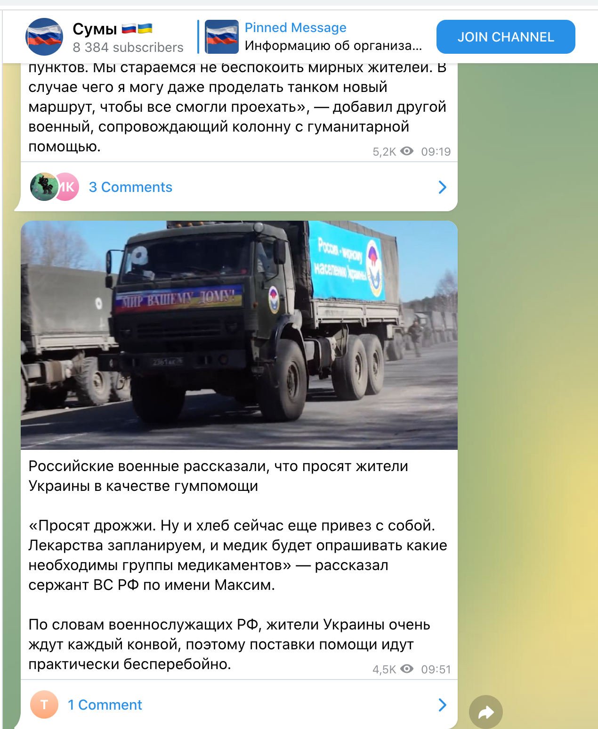
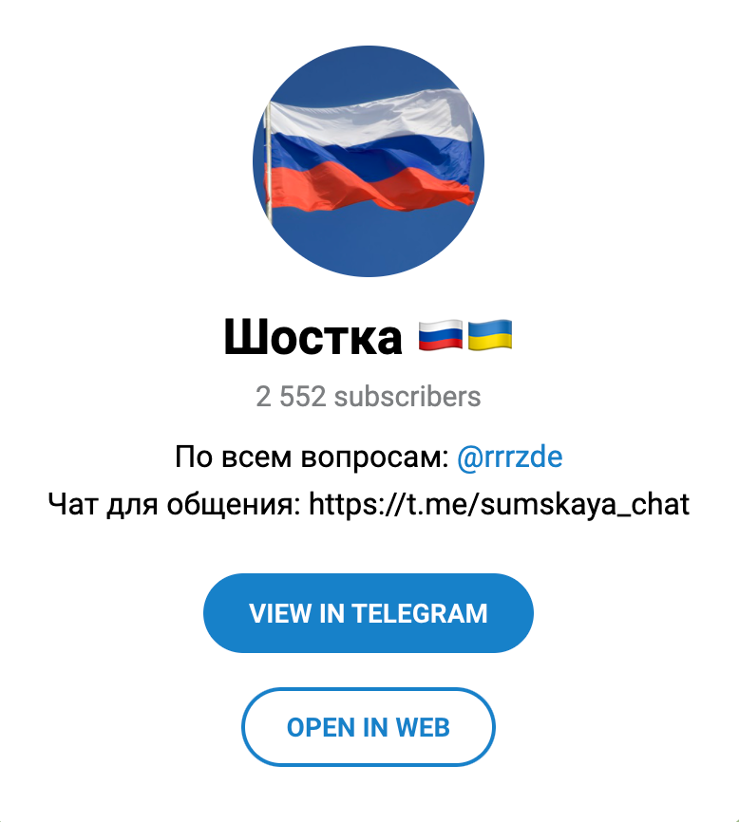
Inauthentic social media accounts
1.) Fake Telegram Channels
“Russian soldiers said what locals in Ukraine ask for in humanitarian aid.
They ask for yeast. Well and I've brought some bread with me now. We're planning to bring medicine, and a medic will examine what groups of medicine are needed – said a Sergeant of the Russian army named Maksim"
Another fake channel, for the city of Shostka
Notes:
Other ways how propaganda is spread is through inauthentic social media accounts.
Those can be fake Telegram channels posing as channels dedicated to local news.
This slide shows two screenshots of fake Telegram channels (channels posting Kremlin disinformation while posing as local Ukrainian news sources) representing towns in the Sumy region in northeastern Ukraine. These channels post news as if the towns were already occupied by Russia, pushing the narrative that the Ukrainian army has abandoned them and that Russia will protect them.

Slide 21
Inauthentic social media accounts
2.) Bots and trolls in local Facebook groups
Post made-up stories about violence or death, personal tragedy.
Argue the Ukrainian government is responsible for ordinary people’s suffering
Notes:
One of the reasons that these channels are effective is due to the thousands of Kremlin bots and trolls tasked with amplifying their messages. Since the start of the war alone, the Ukrainian government has reported 1,500 Telegram channels and another 1,500 fake Facebook, Instagram, and TikTok accounts, including bots, for spreading Kremlin propaganda. The primary aim of these bots is to demoralize Ukrainians and diminish trust in Ukrainian leadership. Ukrainian experts observed that they post made-up stories about violence or death, promoting the message that the Ukrainian government is responsible for the suffering of ordinary citizens. The goal of these comments is to sow panic and provoke an emotional reaction, more importantly redirecting blame for atrocities from the Kremlin onto the Ukrainian government.

Slide 22
Facebook closes another fake account network affiliated with Russian authorities
«Andrejs Perovskis, lives in Riga, patriot». Writes a blog on the Russian based platform cont.ws. Talks about NATO bases in Eastern Europe and the railway line Rail Baltica as strategically important for NATO but a threat to Kaliningrad.
Kristin Liinar spread disiformation in Estonia about the way the EU has supposedly harmed Estonia, as well as the dissatisfaction by the locals about the life in the EU.
Antanas Petrauskas, who supposedly lives in Lithuania but doesn't exist in reality, writes negative publications about Ukraine. The account also shared an article that blamed the US for the murder of the ambassador of Russia in Turkey at the end of 2016.
Source: https://rebaltica.lv/2020/02/facebook-sledz-fake-profilus/
Notes:
Such accounts have been spotted in the Baltics too. Here are some examples that were detected when Facebook removed fake accounts.
«Andrejs Perovskis, rīdzinieks, patriots». Blogs Krievijā bāzētā interneta platformā cont.ws. Runā par NATO bāzu izvietošanu Austrumeiropas valstīs un aliansei “stratēģiski svarīgo” dzelzceļa līniju Rail Baltica kā apdraudējumu Kaļiņingradai.
Kristin Liinar Igaunijā izplatījis dezinformāciju par Eiropas Savienības it kā nodarīto kaitējumu Igaunijai un iedzīvotāju neapmierinātību ar dzīvi ES
Lietuvā it kā dzīvojošais, bet realitātē neeksistējošais Antanas Petrauskas raksta negatīvas publikācijas par Ukrainu. Šis profils dalījies arī ar rakstu, kas vainoja ASV Krievijas vēstnieka Turcijā nogalināšanā 2016.gada beigās.
https://rebaltica.lv/2020/02/facebook-sledz-fake-profilus/
https://medium.com/dfrlab/networks-of-pro-kremlin-telegram-channels-spread-disinformation-at-a-global-scale-af4e319bd51e
https://medium.com/dfrlab/russia-based-facebook-operation-targeted-europe-with-anti-ukraine-messaging-389e32324d4b

Slide 23
Take stock of how much media you consume and limit your exposure to platforms that push increasingly more engaging content. Turn off autoplay. Resist clickbait. Delete addictive apps from your phone. Take control.
Notes:
When thinking of how to deal with all of this false information, I'd like to share another tip that is important. Think about your media consumption habits long-term. Limit how much time you spend on social media apps and take control of what you consume and how. Be very conscious of what you expose yourself to. Resist the urge to click on catchy headlines, turn off autoplay on video platforms and delete addictive apps.

Slide 24
What can YOU do to reduce the spread of false information?
Notes:
Ask the students what they think they can do to reduce the spread of falsehoods.

Slide 25
Notes:
Now, we will listen to the final message by Aliona Romaniuk, fact-checker, founder of NotaEnota who will talk about the ways the orgnanization has worked with Ukrainian people to contain the spread of propaganda.
https://youtu.be/2jSz-EGEG1Y

Slide 26
Do you check information before sharing? Are falsehoods often spread in chats (for example, on WhatsApp, Facebook Messenger or Telegram) in Latvia?
Notes:
To conclude, if the time allows, ask the participants:
Do you check where information comes from before sharing? If not will you do so now? Are falsehoods often spread in chats (for example, on WhatsApp, Facebook Messenger or Telegram) in Latvia? Why is that? How can this information be checked?

Slide 27
Optional extra content for the lesson

Slide 28
1. Divide Latvians
Latvia turns into a Nazi state, but Nuremberg is just around the corner
Notes:
If you want to add in examples about Latvia, you can tell that just like in Ukraine there are divisive narratives in Russian media about Latvia. Latvians, just like Ukrainians, are frequently referred to as Nazis, especially in relation to the deconstruction of Soviet-era monuments, sanctioning Russia and the parliamentary vote for the resolution to designate Russia as a "state sponsor of terrorism".
http://web.archive.org/web/20220930105034/https://www.rt.com/news/560648-latvia-sponsor-terrorism-zakharova/
http://web.archive.org/web/20230906112404/https://baltnews.com/V_Latvii/20230825/1026076926/Latviya-prevraschaetsya-v-natsistskoe-gosudarstvo-no-Nyurnberg-ne-za-gorami.html
https://www.reuters.com/world/europe/moscow-condemns-latvias-designation-russia-state-sponsor-terrorism-2022-08-11/
https://medium.com/dfrlab/pro-kremlin-telegram-channels-try-to-convince-latvians-their-government-is-fascist-3103301e79bd

Slide 29
1. Divide Latvians
«Riga is closing a Russian theater for a gay club»
«"Rainbow club" instead of a Russian theater. The mayor of Riga has set his priorities»
In reality, the former mayor attended an opening of one LGBTQ+ friendly nightclub but never discussed opening more or that it is a priority. The Russian theater in Riga is not getting closed.
https://rebaltica.lv/2023/03/riga-krievu-teatra-vieta-geju-klubs-jeb-ka-fantaze-krievijas-propaganda/
Notes:
For even more stories related to Latvia, you can consider using this.
The mayor of Riga at the time attended an opening of a LGBTQ+ friendly nightclub. Afterwards, stories appeared suggesting that such clubs will now be a priority for the municipality and mayor of Riga, while, at the same time, Russian theater is getting closed. Neither story is true – the mayor or other municipal leaders or spokespeople have not discussed LGBTQ+ firendly nightclubs as a priority for the city and the Russian theater is not getting closed.
https://rebaltica.lv/2023/03/riga-krievu-teatra-vieta-geju-klubs-jeb-ka-fantaze-krievijas-propaganda/

Slide 30
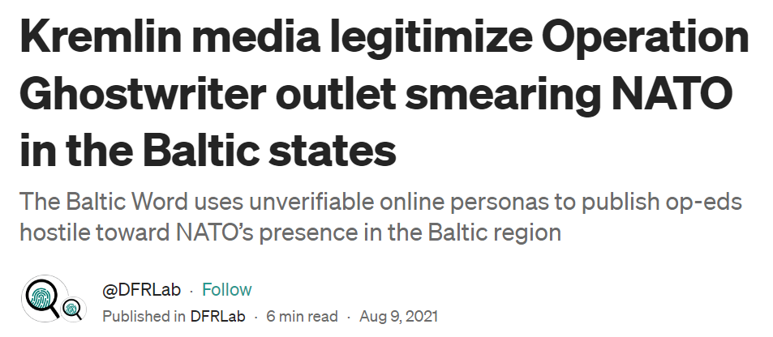
2. Undermine trust in Western partners
Notes:
The same kind of narratives trying to undermine trust in the Western partners are spread in Latvia too.
Researchers at the Atlantic Council Digital Forensic Research Lab conducted research on narratives spread in Kremlin media. You can see the most frequent narratives related to NATO on the slide – that the Baltic states are spending too much on defense and that being in NATO is actually not good or useful for the countries.
«Kremlin-owned media outlets (like Baltnews and Sputnik, along with Kremlin-affiliated outlets Riafan.ru, Ekonomika Segodnya, and Fondsk.ru), recently started to amplify fringe disinformation outlet The Baltic Word, which has previously been linked to the cyber-enabled influence operation known as Operation Ghostwriter. The Baltic Word publishes articles by anonymous online personas with Latvian and Lithuanian sounding names. These articles are usually hostile toward NATO and critical of the Baltic state governments.»
https://medium.com/dfrlab/kremlin-media-legitimize-operation-ghostwriter-outlet-smearing-nato-in-the-baltic-states-2d175d8a4d8

Slide 31
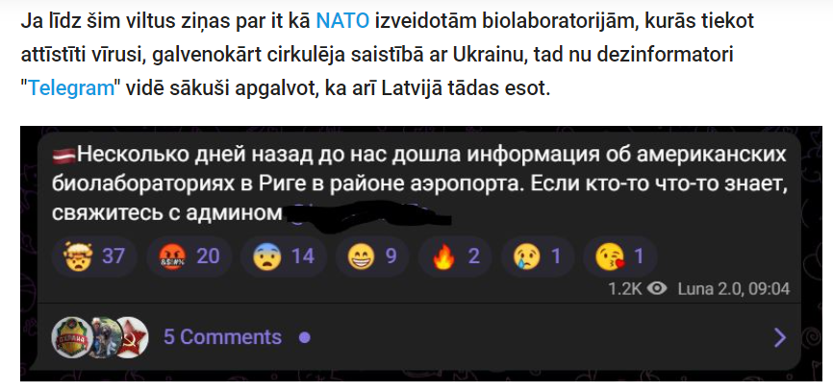
2. Undermine trust in Western partners
There are propaganda stories claiming there are Western biolabs for developing viruses in Latvia
Source: https://www.delfi.lv/atmaskots/faktu-parbaude-ari-lidz-latvijai-atnakusi-krievijas-pekstini-par-biolaboratorijam.d?id=55786482
Notes:
The stories about dangerous biolabs have been spread about Latvia too with no evidence, as Latvian fact-checkers found – in the previous lesson it was mentioned how the same story has spread in reference to Georgia and Ukraine.
https://www.delfi.lv/atmaskots/faktu-parbaude-ari-lidz-latvijai-atnakusi-krievijas-pekstini-par-biolaboratorijam.d?id=55786482
https://www.delfi.lv/news/national/criminal/vdd-baltijas-antifasistiem-inkrimine-noziedzigas-organizacijas-vadisanu.d?id=55639102

Slide 32
3. Demoralize the population
Retribution for the "isolation" of Russia: how the Baltic states live today
The prices of consumer goods have risen in Lithuania, Latvia and Estonia by more than 20% since the beginning of the year. Residents are desperately saving money, and politicians are justifying themselves by the global economy, hoping for help from the EU. No one sees it's only a crisis in the Baltics.
Source: https://www.delfi.lv/atmaskots/faktu-parbaude-vai-tiesam-krievija-var-palidzet-baltijas-valstu-ekonomikam.d?id=55082156
Notes:
If you would like to include examples from Latvia to compare on the topic about demoralizing the population, again, there are similarities to Ukraine. Propaganda targeted towards the Baltic states emphasizes economic difficulties and attributes them to the Latvian government. It is said that we expect help from the EU but it won’t come. There are also stories on how the Baltics are suffering without Russian gas and that the Russian president could help.
https://web.archive.org/web/20230817151107/https://baltnews.com/v-mire/20221219/1025828295/Rasplata-za-izolyatsiyu-Rossii-kak-segodnya-zhivet-Pribaltika.html
https://www.delfi.lv/atmaskots/faktu-parbaude-vai-tiesam-krievija-var-palidzet-baltijas-valstu-ekonomikam.d?id=55082156

Slide 33
State and Kremlin-owned media
Notes:
If you want to include more detailed information on what state media are and how do they differ from privately owned media, you can include this video in the lesson.
https://youtu.be/7w6bYoL1fP0

Slide 34
Manipulated visuals - deepfakes
Notes:
A short video on spotting deepfakes
https://youtu.be/Je5aETF75rg

Slide 35
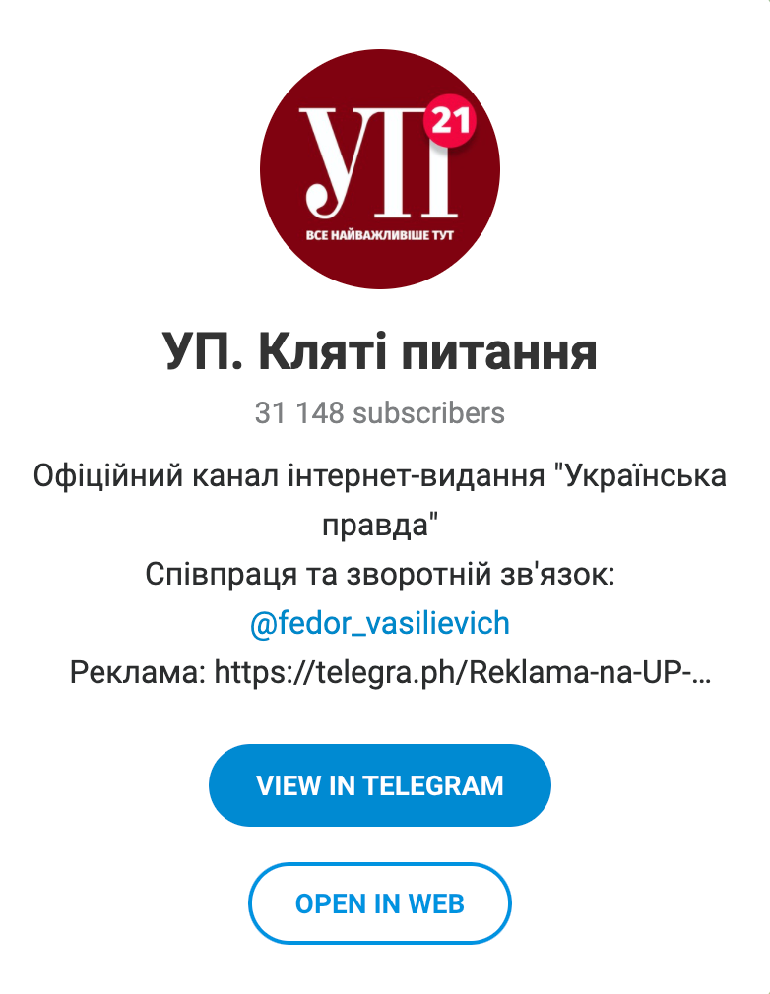
Inauthentic social media accounts
Telegram channels imitating reputable media
Fake
Real
Notes:
If you have the time, you can add this information abou fake social media channels.
Some of the fake channels were imitating the social media accounts of real news media. Ukrainska Pravda Official is a fake account which is imitating reputable media outlet in Ukraine Ukrainska pravda. It's useful to note that impersonation is a frequently used tactic. U.S. media outlets like the Washington Post and Fox News have also been impersonated to pass on anti-Ukrainian messages and make them seem more believable.
ttps://therecord.media/russians-fake-news-anti-ukraine

Slide 36
What are bots and trolls?
Notes:
In case you want to provide students with an explanation on what bots and trolls are, show them this video.
https://youtu.be/cc-7YrTapEI

