Slide 1
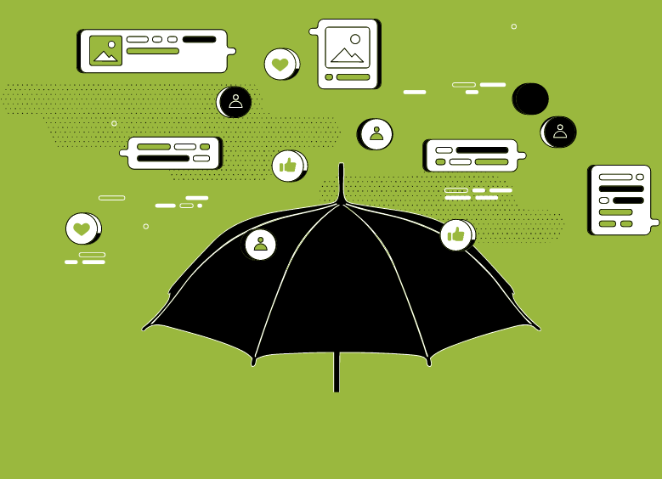
Lesson 9. WRAPPING UP Unit 5

Slide 2
GROUP WORK
BRAINSTORMING SESSION:
List all the media literacy/fact checking tips and suggestions mentioned throughout the course or anything that you think of additionally as a helpful tip for resilience to disinformation.

Slide 3
VIDEO - Tips to Protect Yourself From Disinformation
REMEMBER:
Pay careful attention while watching the video and identify tips you missed during the brainstorming session.

Slide 4
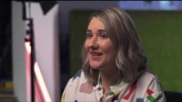
Notes:
Tips to Protect Yourself From Disinformation https://youtu.be/n1LZYI5ZI4A

Slide 5
DISCUSSION
Did you miss any tips mentioned in the video during your brainstorming session?

Slide 6
DISCUSSION
Which of the tips would you prioritize as top 3 and teach to your friends and family members to help them become more resilient to disinformation?

Slide 7
FINAL PROJECT
CHOOSE ONE:
CREATE A POSTER for people who fall into your media landscape category
CREATE A SOCIAL MEDIA POST that teaches followers about media literacy
CREATE A LESSON PLAN for your family members or friends to teach them on social media behavior/media literacy
DEVELOP A SPEECH for adults on how to use media and what they should look out for.

Slide 8
CARE BEFORE YOUR SHARE!
REMEMBER!
1. Name It to Tame It!
2. Take responsibility. Know that YOU are the information gatekeeper. Don’t spread misinformation!
3. Acknowledge what you may not know.
4. If you have time, check it out! Do what you can to verify information.
5. If you’re still not sure it’s true, don’t share it.

Slide 9
Conclusion

