Slide 1
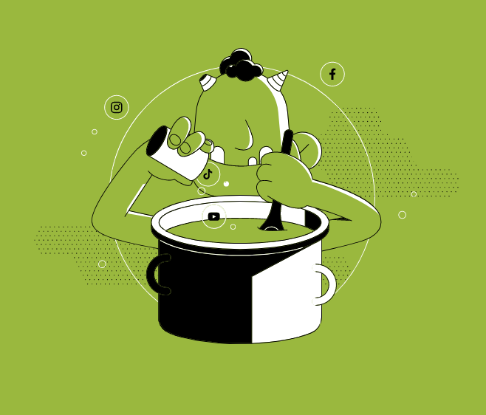

Lesson 8. Stereotypes and Hate Speech
Unit 4 Part C

Slide 2
Discussion
QUESTION 1:
What is hate speech and where does it come from?

Slide 3
Discussion
QUESTION 2:
Where is the boundary between freedom of speech and hate speech?

Slide 4
Discussion
QUESTION 3:
How is stereotyping connected to hate speech?

Slide 5

Notes:
https://youtu.be/dxrPeFKtUwQ

Slide 6
Discussion
QUESTION 4:
How can stereotyping lead to violence and hate?

Slide 7

VIDEO
Notes:
https://www.youtube.com/watch?v=LbB28T3fIWg

Slide 8
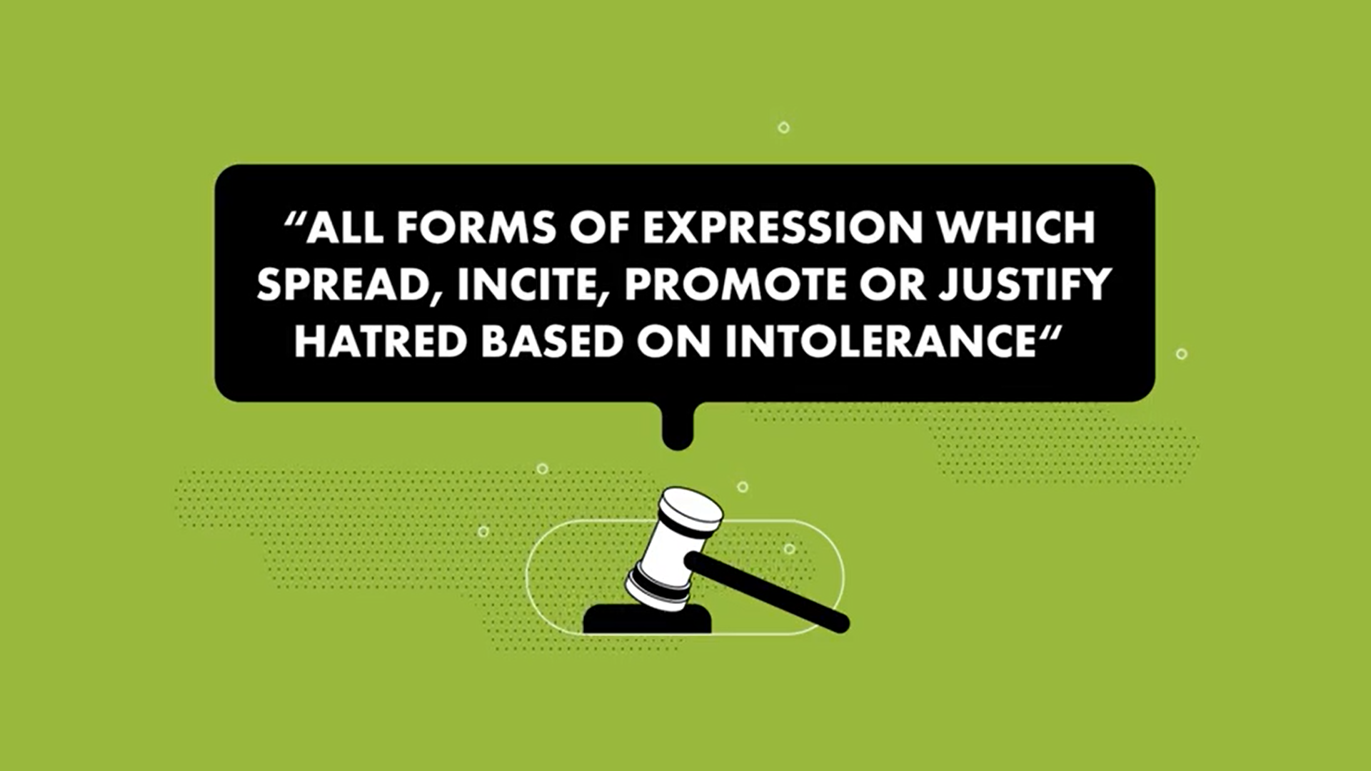
Hate speech
According to the European Court of Human Rights

Slide 9
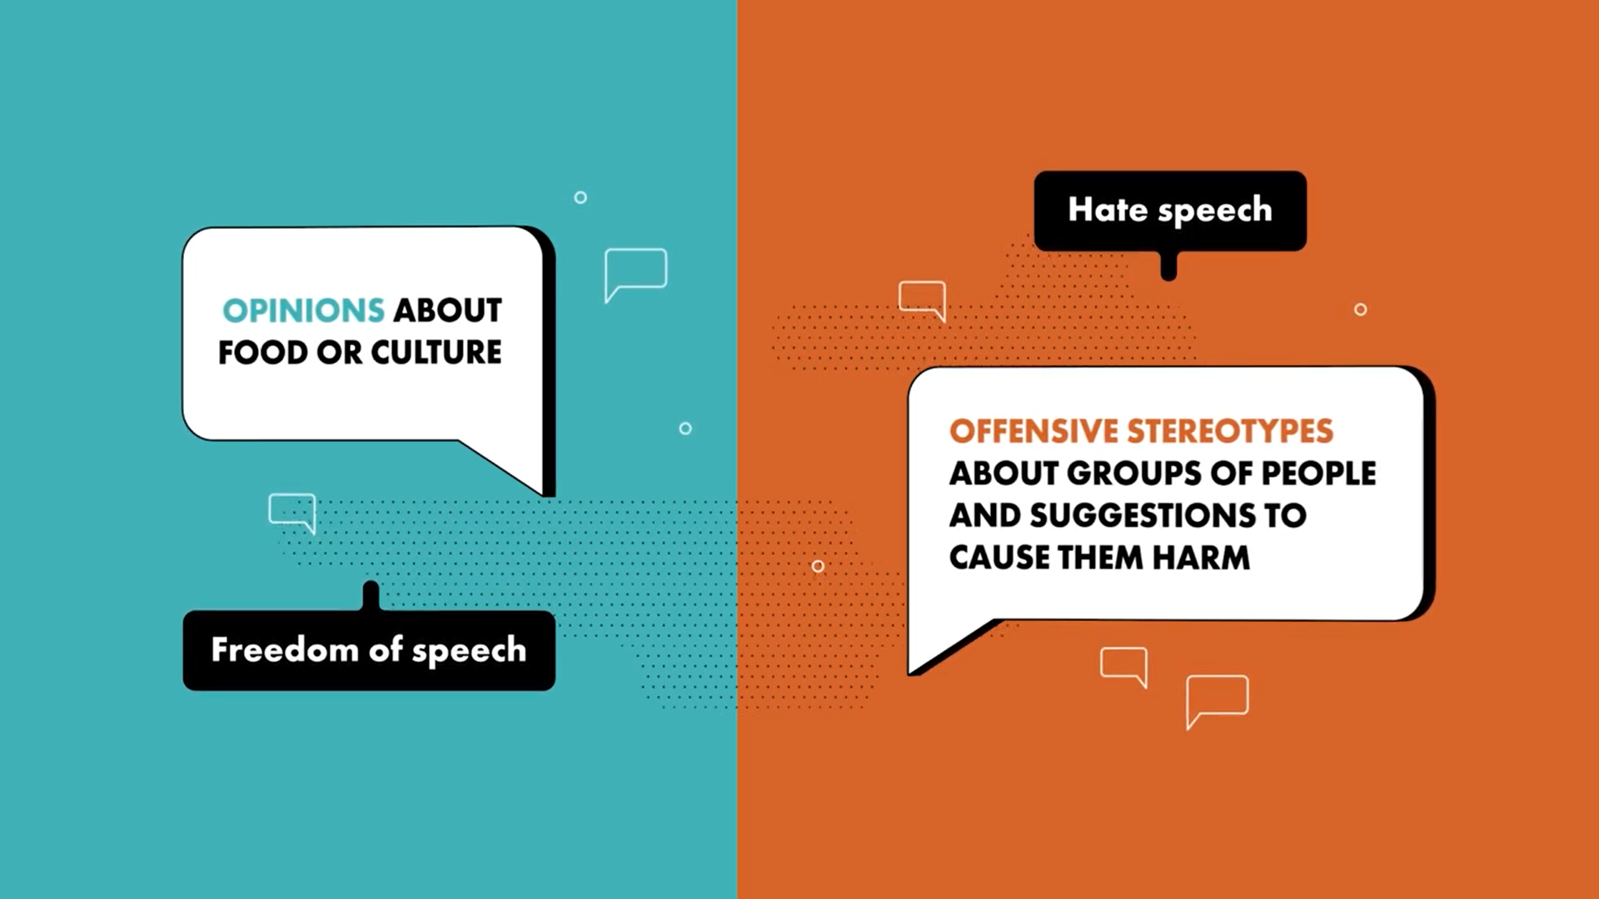

Slide 10
WHEN IN DOUBT ASK:
Freedom of speech vs. hate speech
?
What is the purpose?
What does it encourage?
How does it effect society?
What attitude does it show towards minority populations?
Is it humane?
Does it encourage hate crime?

Slide 11
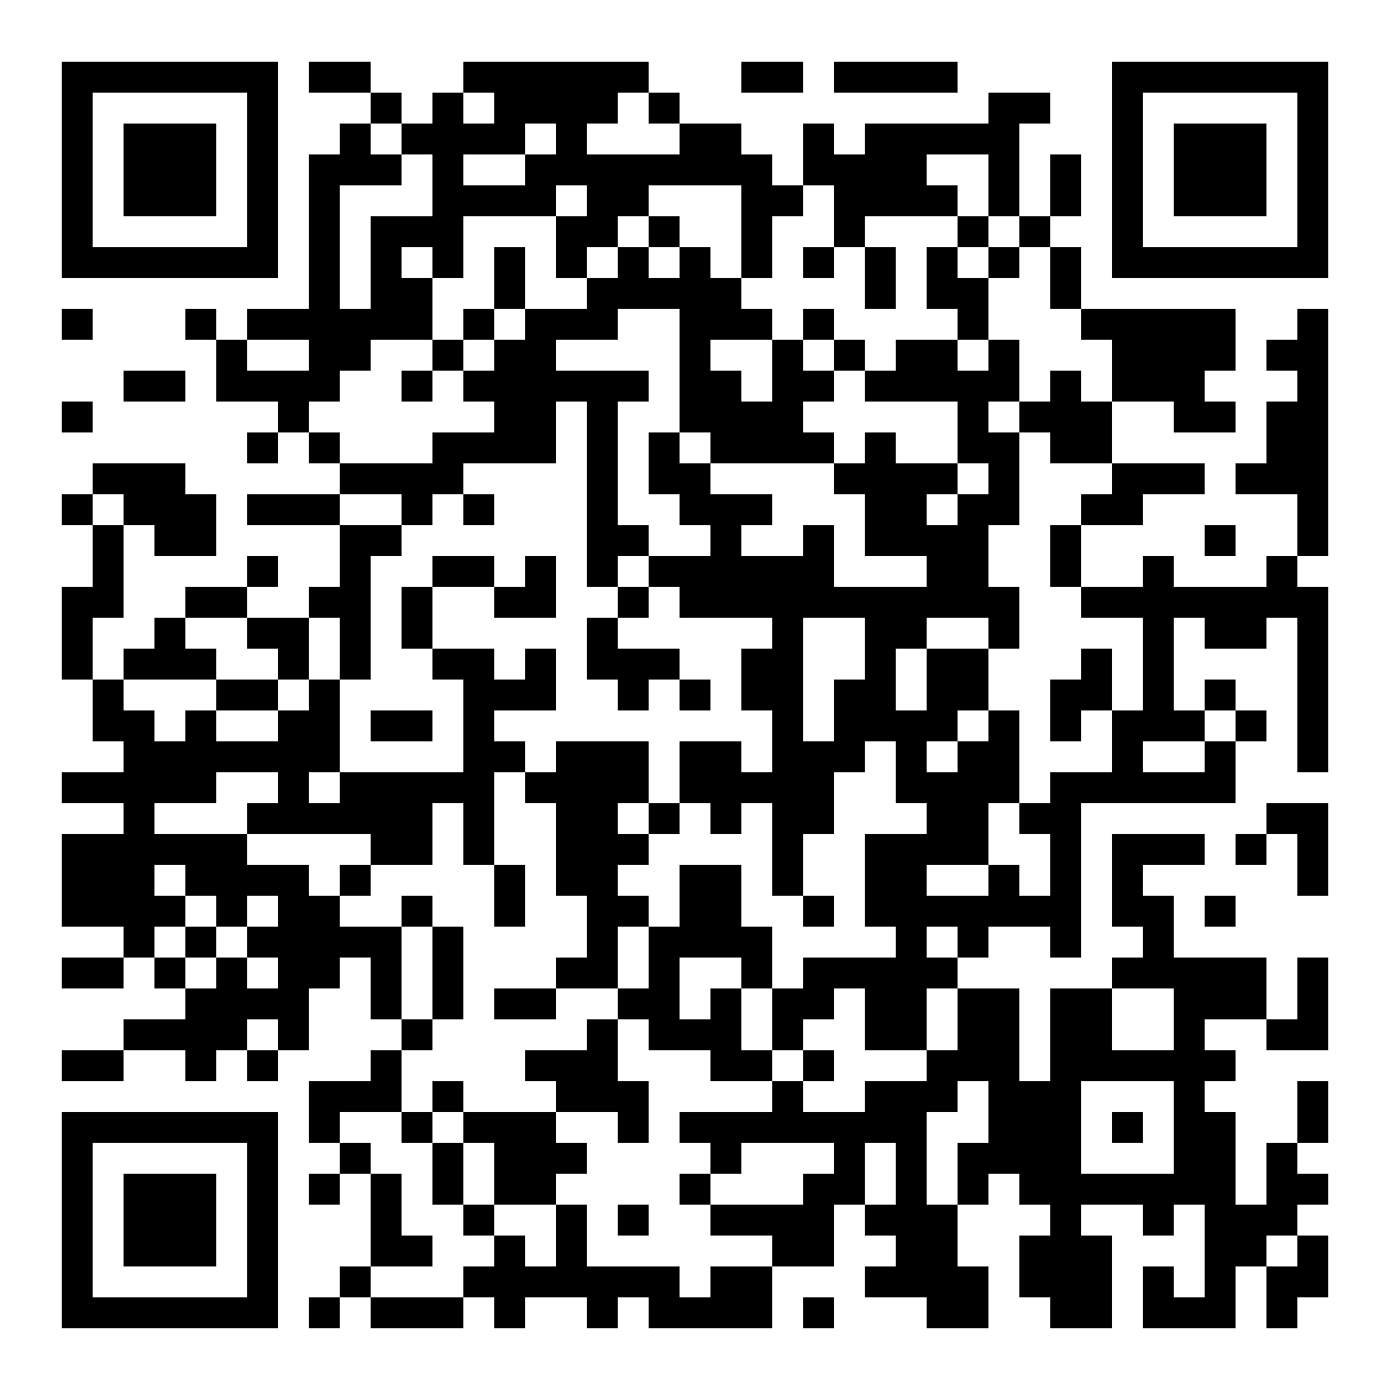
Quiz: Inclusive Language
Please take the quiz! QR code:

Slide 12
Conclusion

Slide 13


