Slide 1


Lesson 7. Manipulation: Bots, Trolls, Fake Experts and Fact-Checking
Unit 4 Part B

Slide 2
Introduction
In this lesson, we will keep talking about manipulation in the media. Not all social media users are who they pretend to be – there are trolls and bots. Do you know who they are?

Slide 3

Notes:
Bots and Trolls https://youtu.be/IUHLkng2GcI
If needed, before watching the video you can name the most important questions addressed in the video:
What are bots, trolls and sock puppets? What are the differences between them?
For what goals bots and trolls can be used for?
How to spot bots and trolls?

Slide 4
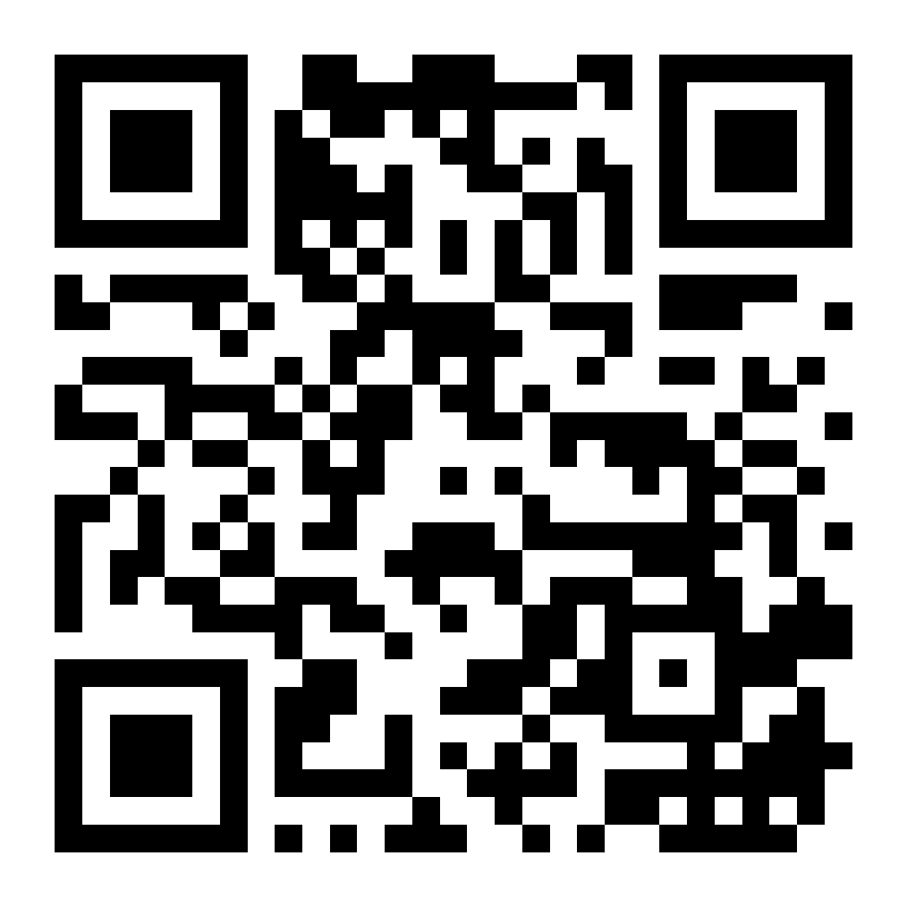
Fake photo challenge: can you tell if these people are real?
Try playing three rounds. Can you guess which of the two images are real?
Notes:
whichfaceisreal.com

Slide 5
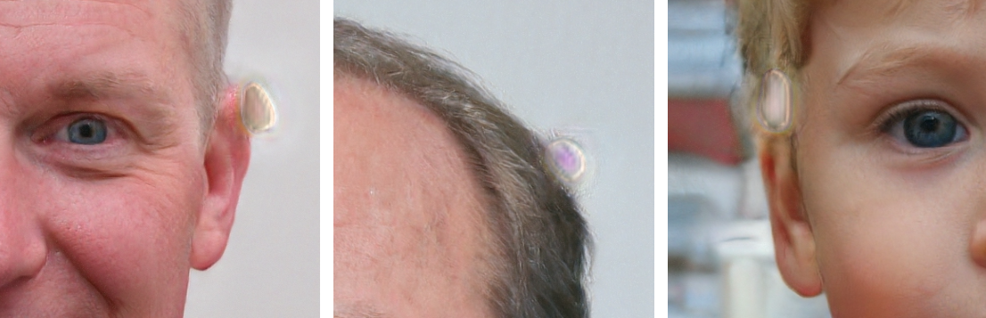
What are the signs that an image is automatically generated? (source: whichfaceisreal.com)
Water splotches

Slide 6
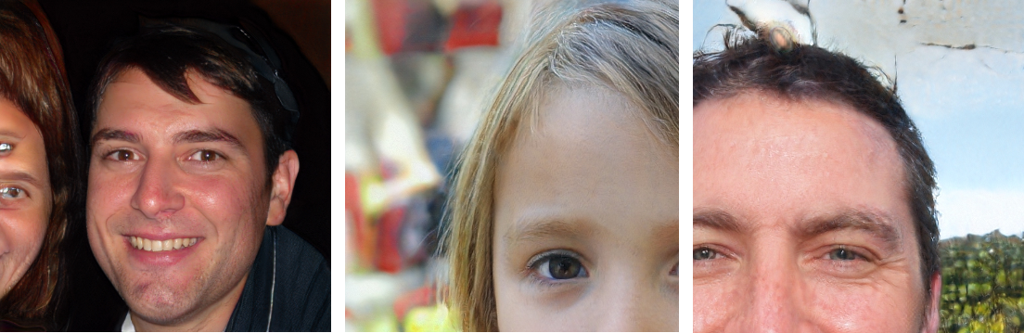
Background problems

Slide 7
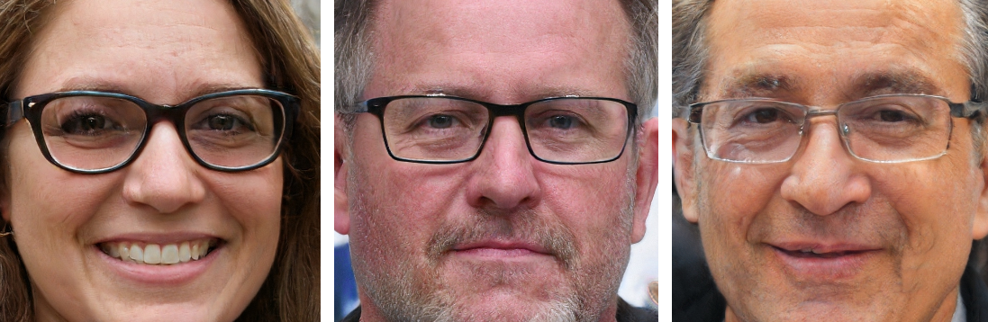
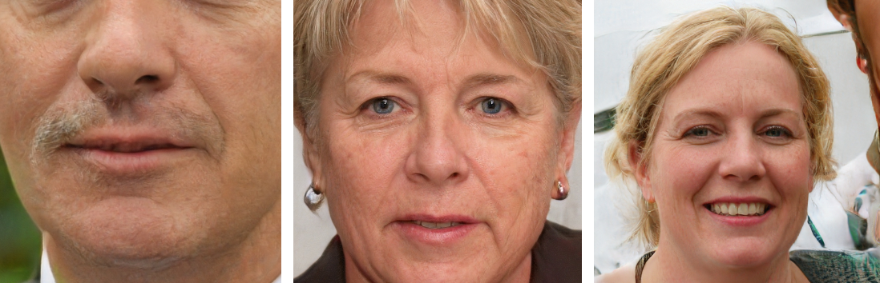
Asymmetric eyeglasses and other asymmetries

Slide 8
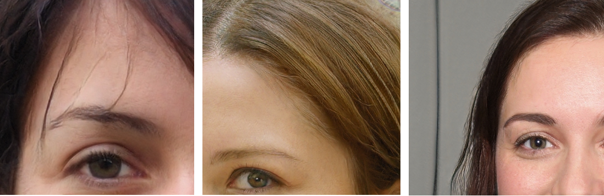
Errors and smudges in how hair are depicted

Slide 9
Besides images, there is other information that is just as important to verify. There are people who do it professionally – fact-checkers. They are journalists who answer questions like this:
Who made the claim? Do they have the expertise and information to know that?
What evidence and sources did they provide to back up their claim? Does the source actually say what they claim it does?
What are other sources saying?

Slide 10
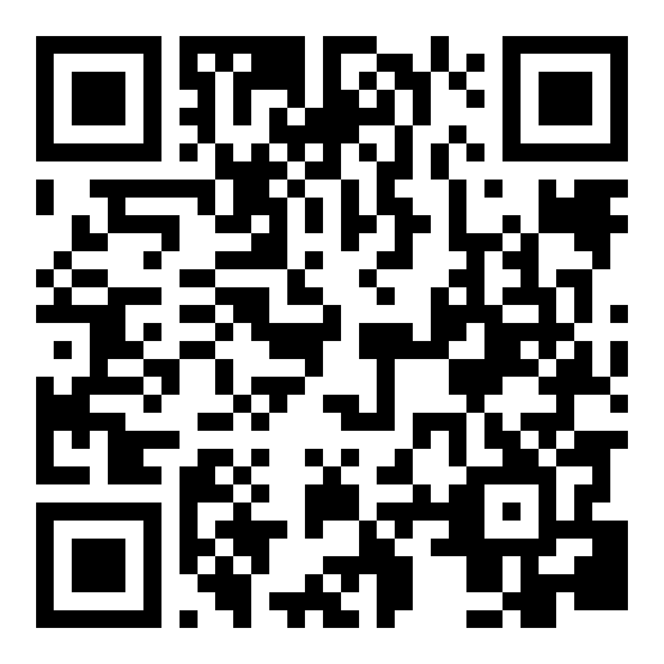
Quiz: Evaluate the Sources
Notes:
https://veryverified.eu/units/unit-4/part-b-manipulation/
Section "Fake Expert Opinion & Advertorial"

Slide 11
Are they an expert?
Sometimes media outlets and social media users attribute unverified information to either fake exerts or people that are not qualified to be called experts. An example:
A network of 500 accounts affiliated with China were removed from Facebook for promoting the claims of a fake biologist from Switzerland named Wilson Edwards. Edwards, who does not actually exist, was used to claim that the US was meddling in efforts to find the origins of Covid-19. His statements were then re-published on Chinese state media.

Slide 12
Tips to tell if someone is an expert on a particular topic
- Can you find their resume? What is their experience?
- Have reputable outlets used them as a source before?
- Look for academic books and articles they have written and if other researchers cite them. This information can be seen, for example, on scholar.google.com.
- What is the reputation of the organization they represent? Are they well known or tied to a lot of scandals?
Notes:
- Their experience as an expert: where have they worked and for how long? Can you find their resume?
– If someone is a reputable expert, it is likely that other media outlets have also used them as a source or they have written articles in different outlets themselves.
– Academic books, textbooks, and articles written by them, as well as the number of citations – the number of times other experts reference their findings in other articles and books. You can find this information, for example, on scholar.google.com. When you search for the name of the expert, you can see if they have written about the topic and how many others have found what they said useful enough to cite it.
– The reputation of the organization they represent: do they appear to be recognized by others for their knowledge or expertise? For example, are they invited to various conferences, discussions, and other speaking events? Is their name tied to any scandals that have been reported in the media?

Slide 13
Practice
Group 1: Who is Paul A. Offit? What does he specialize in? Does it make sense to ask his opinion about vaccines?
Group 2: Who is Neil deGrasse Tyson? What is his education? If you were a journalist, would you pick him as an expert to ask about a monkeypox outbreak?
Group 3: Who is Katharine Hayhoe? Does she work in a well-known institution? Does It make sense to ask her opinion on climate change?
Notes:
Divide the students in 3 groups. Ask them to use the tips discussed previously to answer these questions. Group 1: Who is Paul A. Offit? What does he specialize in? Does it make sense to ask his opinion about vaccines? Group 2: Who is Neil de Grasse Tyson? What is his education? If you were a journalist, would you pick him as an expert to ask about a monkeypox outbreak? Group 3: Who is Katharine Hayhoe? Does she work in a well-known institution? Does it make sense to ask her opinion on climate change?
Ask one representative of each group to briefly answer what their findings were. Emphasize that even if someone is a great scientist in a particular field, they are not an expert on everything. Also, emphasize how all of these are very well-known experts and it is easy to find information about them. If someone truly is a well-known expert, it should never be hard to find information about them. (This applies to Neil de Grasse Tyson question)

Slide 14
Manipulation with sources. Case study.
Notes:
https://veryverified.eu/units/unit-4/part-b-manipulation/
Fact-checking section

Slide 15
Conclusion
Familiarize yourself with the fact-checking section of Very Verified. You will find information about some tools that might help you fact-check.
Notes:
Fact-checking section
https://veryverified.eu/units/unit-4/part-b-manipulation/

Slide 16


