Slide 1
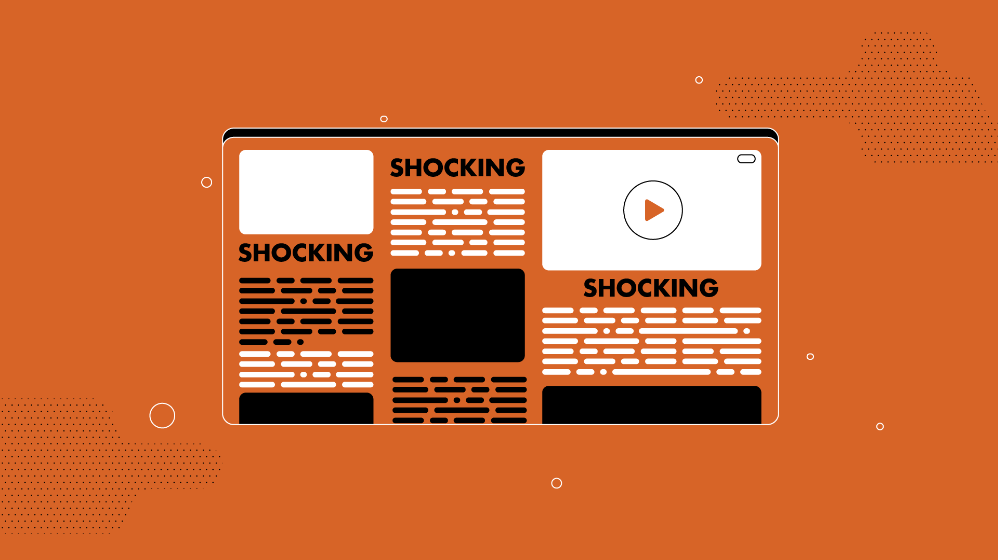

Lesson 6. Manipulation: Disinformation, Manipulative Headlines and Photos
Unit 4 Part A, B

Slide 2
Game: How Well Do You Follow Instructions?
Read the instructions carefully
You will only have 3 minutes to finish
The first person who will finish everything will get an award!

Slide 3
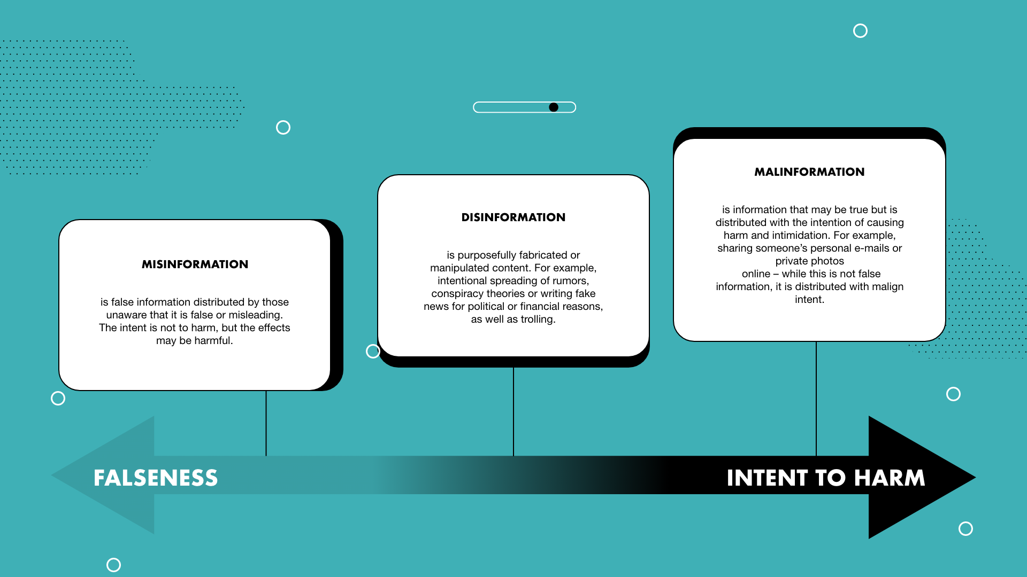
Notes:
Misinformation is untrue, but the person spreading it meant no harm and did not know it is not true. For example, people sometimes spread untrue rumors about each other but they don't always do it wishing that they would harm someone. They often do it just because they think it is fun, although wrong, without realising the information itself is false.
Disinformation is false information that is spread with the knowledge that it's misleading. It includes both a country or a political party purposefully spreading false information that will get people angry, as well as individuals who purposefully spread false information to gain popularity online.
Malinformation might be true, but it's done to harm someone's reputation (by, for example, spreading intimate photos).

Slide 4
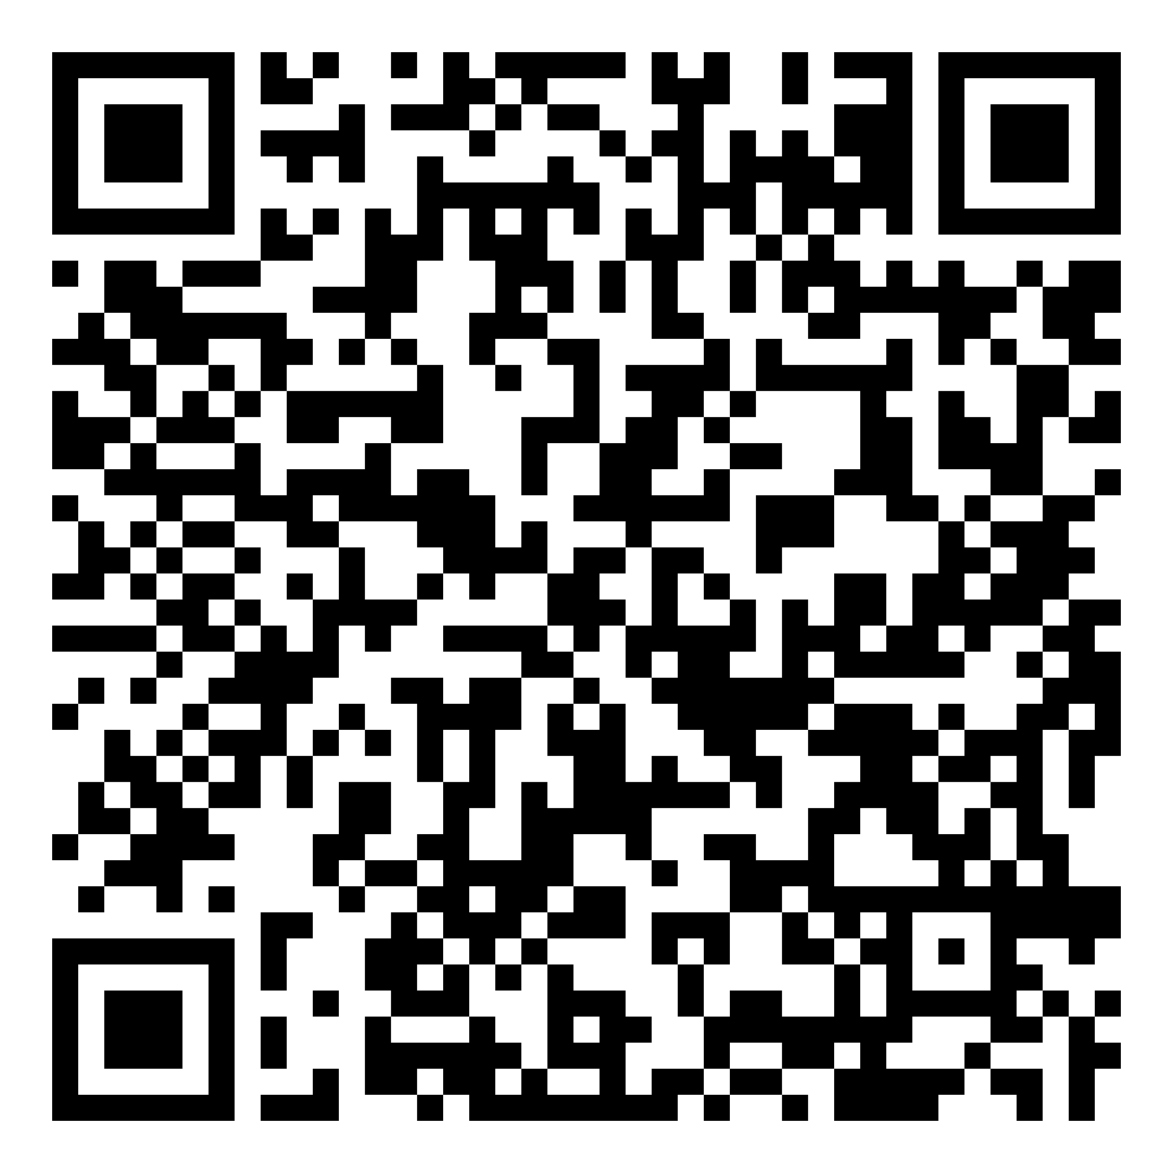
Question: Does this headline tell it all?

Slide 5
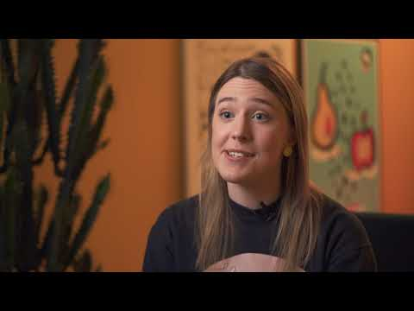
Notes:
Headlines and Manipulated Visuals https://youtu.be/2UEAfB_L1zU
If needed, before watching the video you can name the most important questions addressed in the video:
What is the main objective of headlines?
What are the main risks created by using misleading headlines?
Why is it important for the media outlet for the headline to be able to attract attention?

Slide 6
Three main types of manipulative photos
1. A real photo of a place or person presented as an image of an entirely different place or person.
2. Doctored photos altered in a graphics editor (like Photoshop) to add or remove some elements.
3. Cropped photos that show just part of an image out of context.

Slide 7
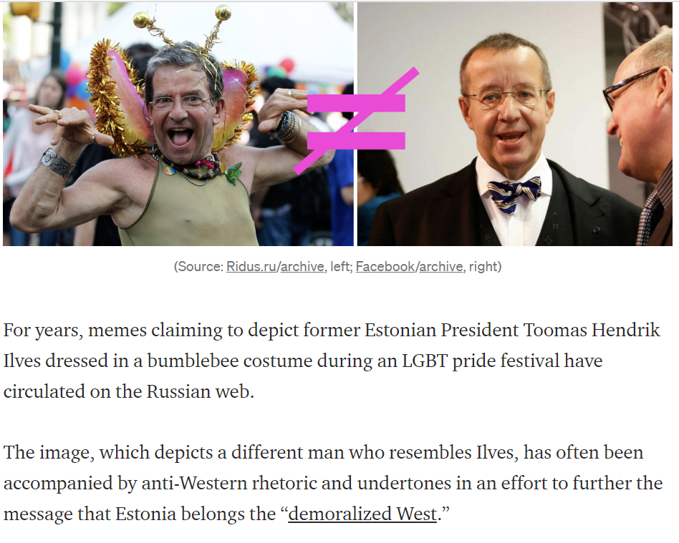
1.
SOURCE
Notes:
Tell students that on this slide they can see an image of a man in a bumble bee costume that is often used to claim that it is the ex-president of Estonia Toomas Hendrik Ilves as if to show that Estonia is now a part of the "demoralized West".

Slide 8
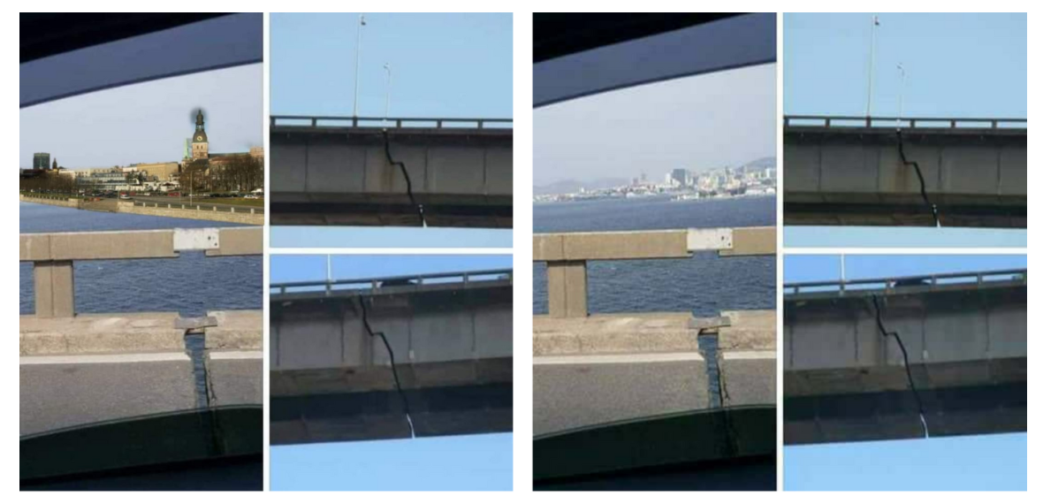
2.
SOURCE
Notes:
On slide 8 they can see an image of a bridge in with a crack. On the left, the background has been edited to depict Riga, although the bridge is actually in Brazil.

Slide 9
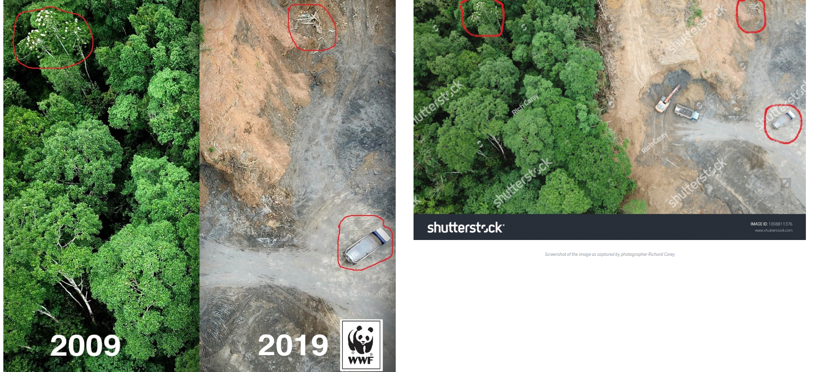
3.
SOURCE
Notes:
On the 9th slide, there's an example that supposedly shows the impact of deforestation, although both images are cropped from the same photo.

Slide 10
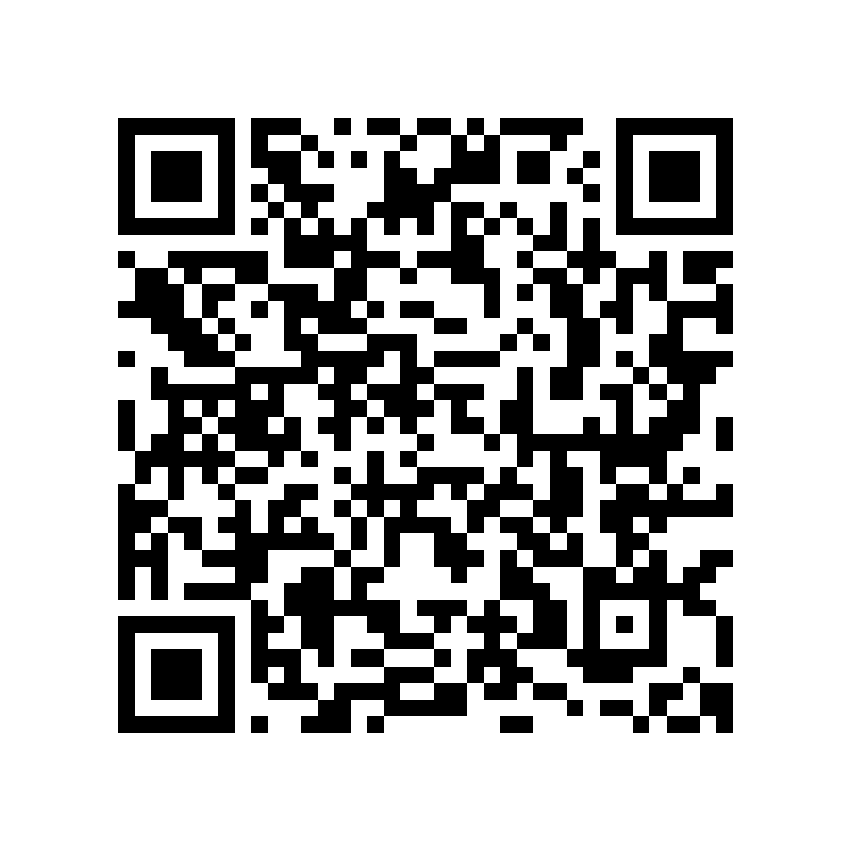
How to verify images?
1. Scan the QR code to see an image that has been used on social media to claim it depicts the harmful effects of wearing face masks.
2. Go to images.google.com
3. Click on the "search by image icon" on the right side of the search bar (if you use your phone, you can also use Google Lens or tap on the tree dots on the right corner of the browser and switch to "Desktop site" if you're using Google Chrome)
4. Paste the link of the image in the search or upload the image you downloaded. Click on "search by image".
Notes:
https://test.veryverified.eu/wp-content/uploads/2022/07/4.10-2.png

Slide 11
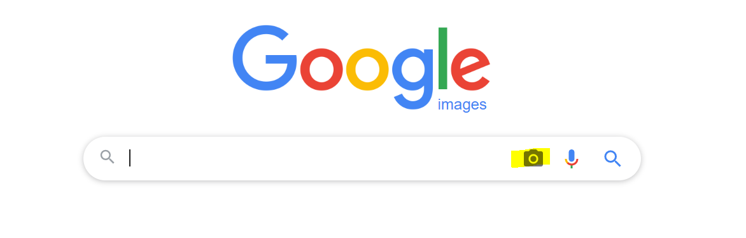
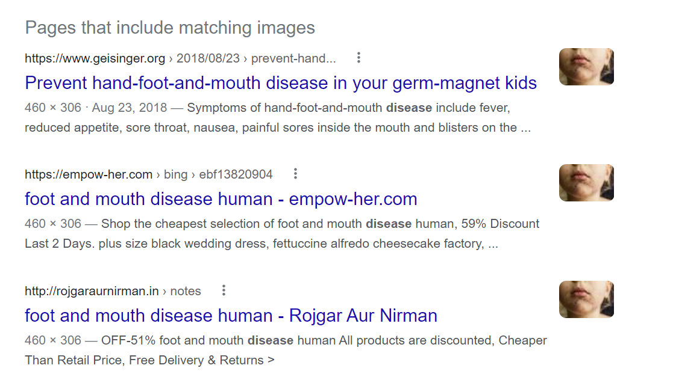
Look at the pages that includes matching images. Although the search results might differ between people, you can find that the image has been used way before the Covid-19 pandemic.

Slide 12
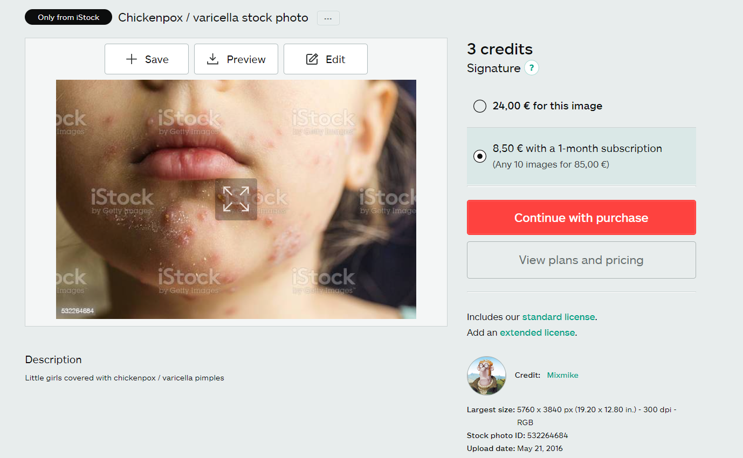
You can, for example, find a result that shows it's a stock image uploaded in 2016 to illustrate chickenpox

Slide 13
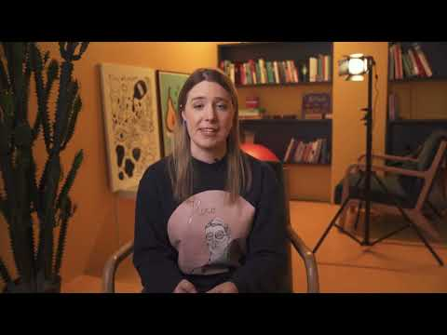
Notes:
Deepfakes and Cheapfakes https://youtu.be/aAiskxviTds

Slide 14
Conclusion
To be a responsible social media user, you always have to verify images and information if they come from unfamiliar sources and can't be verified from others that are more reliable.
If you don't know how to check the information, never share it!

Slide 15


