Slide 1
Lesson 5. Cognitive Distortions
Unit 3 Part B
Lesson 2: Media Ownership
Unit 2 Part A

Slide 2
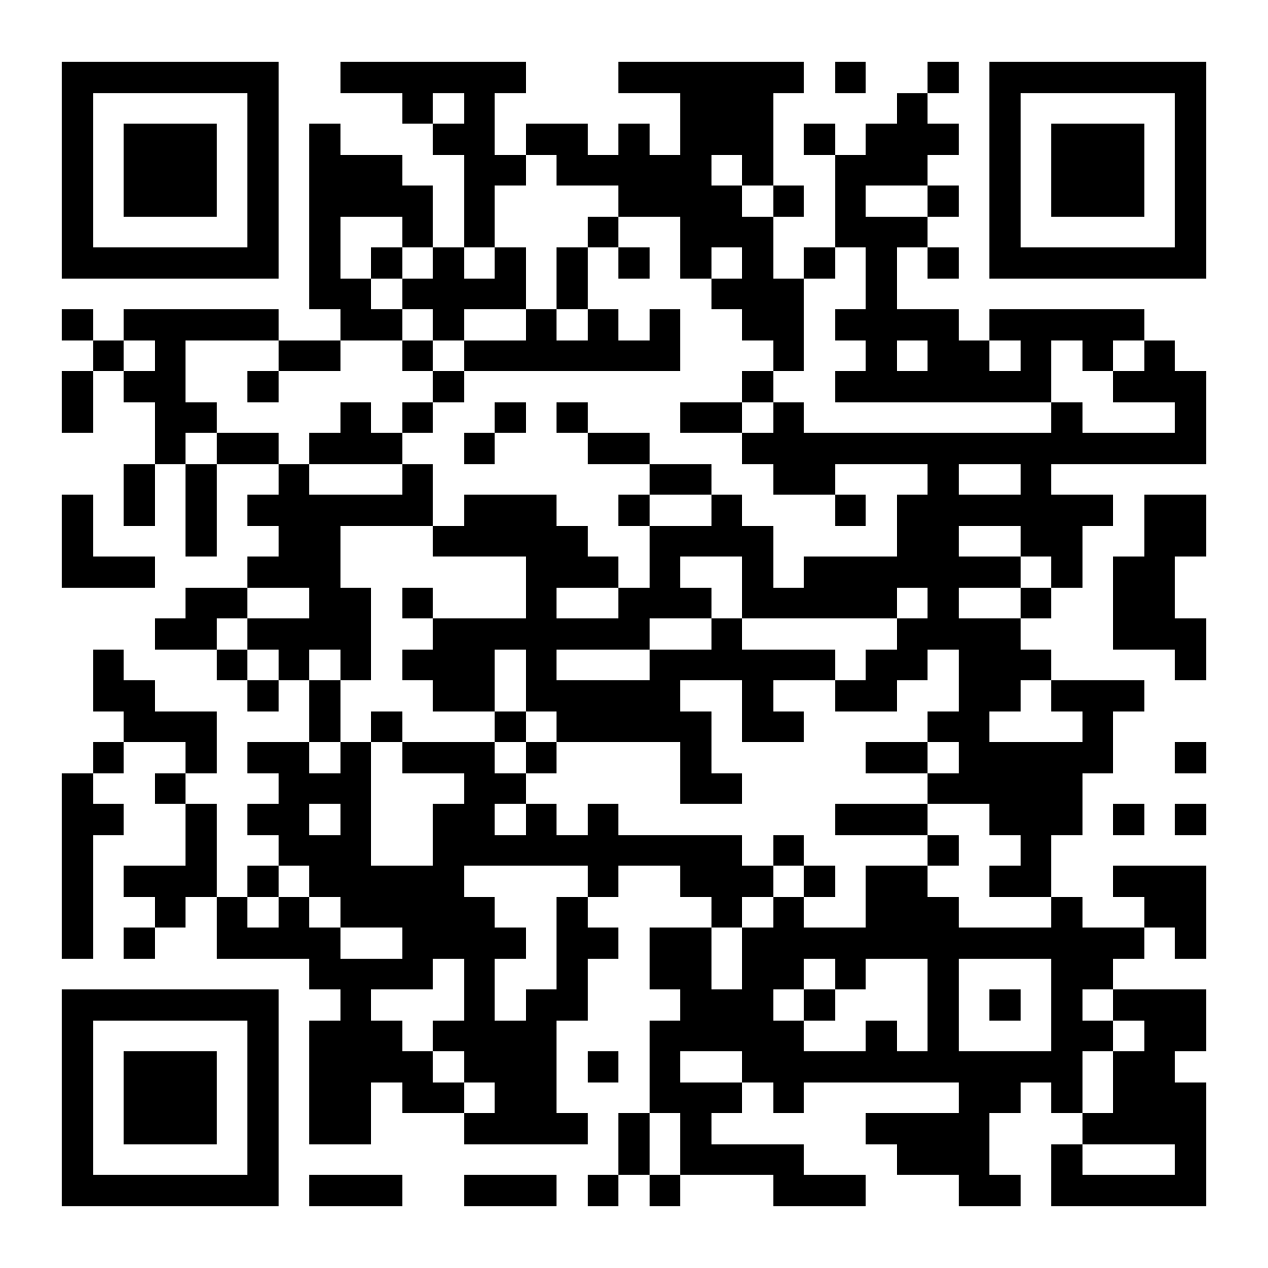
Homework
Make sure you have done the “Mind Games” quiz! QR code:
Discussion:
What is your experience with your mind “tricking” you sometimes? Can you provide some examples?

Slide 3
“Cognitive Distortions” animation
Notes:
https://www.youtube.com/watch?v=BtjSv4pMgoM Cognitive Distortions
Ask students if they can relate to the issues discussed in the video. Where do they experience Barnum effect or Cognitive distortions in their lives?

Slide 4
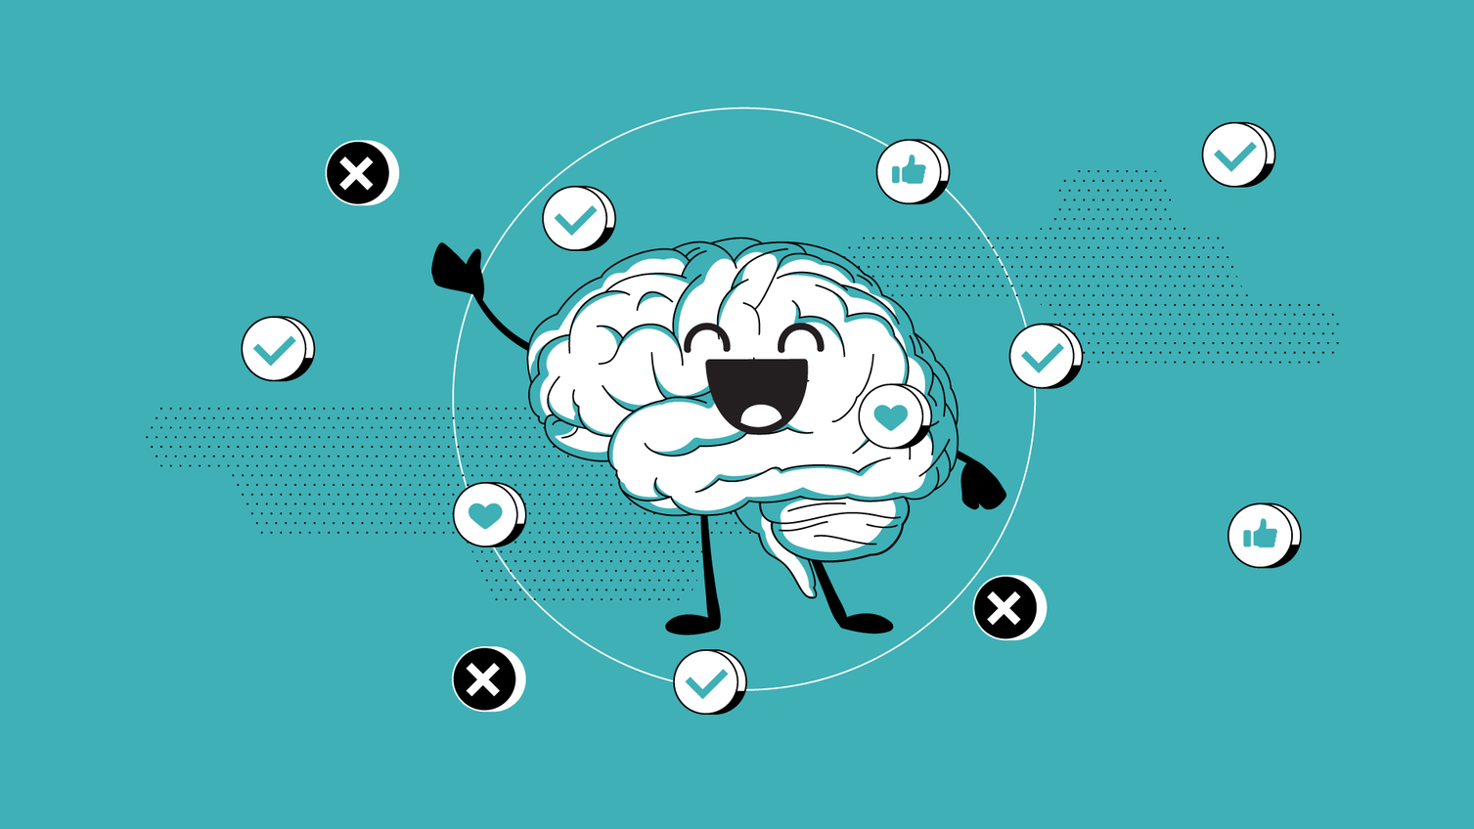
Group task: True of False?
Please, share your group opinion as well!
Is the statement that "people use only 10% of their brain" true or false?
Notes:
https://www.discovermagazine.com/mind/the-10-percent-of-your-brain-myth-that-just-wont-die

Slide 5
Confirmation Bias:
you have certain beliefs and you are motivated to notice, interpret, and favor information that allows you to confirm them.

Slide 6
Motivated Reasoning
If you find information that supports your beliefs (for example, that you have untapped reserves of brain power), you are very likely to accept it without really questioning its validity. However, if you see something that contradicts it, you become skeptical and scrutinize it more. This phenomenon is called motivated reasoning.

Slide 7
Negativity Bias
The idea that something negative has more impact on cognition and behavior than something positive is called negativity bias. Bad news, trauma, or negative emotions tend to lead people to dwell on the information more than for something positive.

Slide 8
Familiarity Bias
means that we are more likely to trust or believe something we recognize or have seen or heard before. This is one of the ways advertising works.

Slide 9
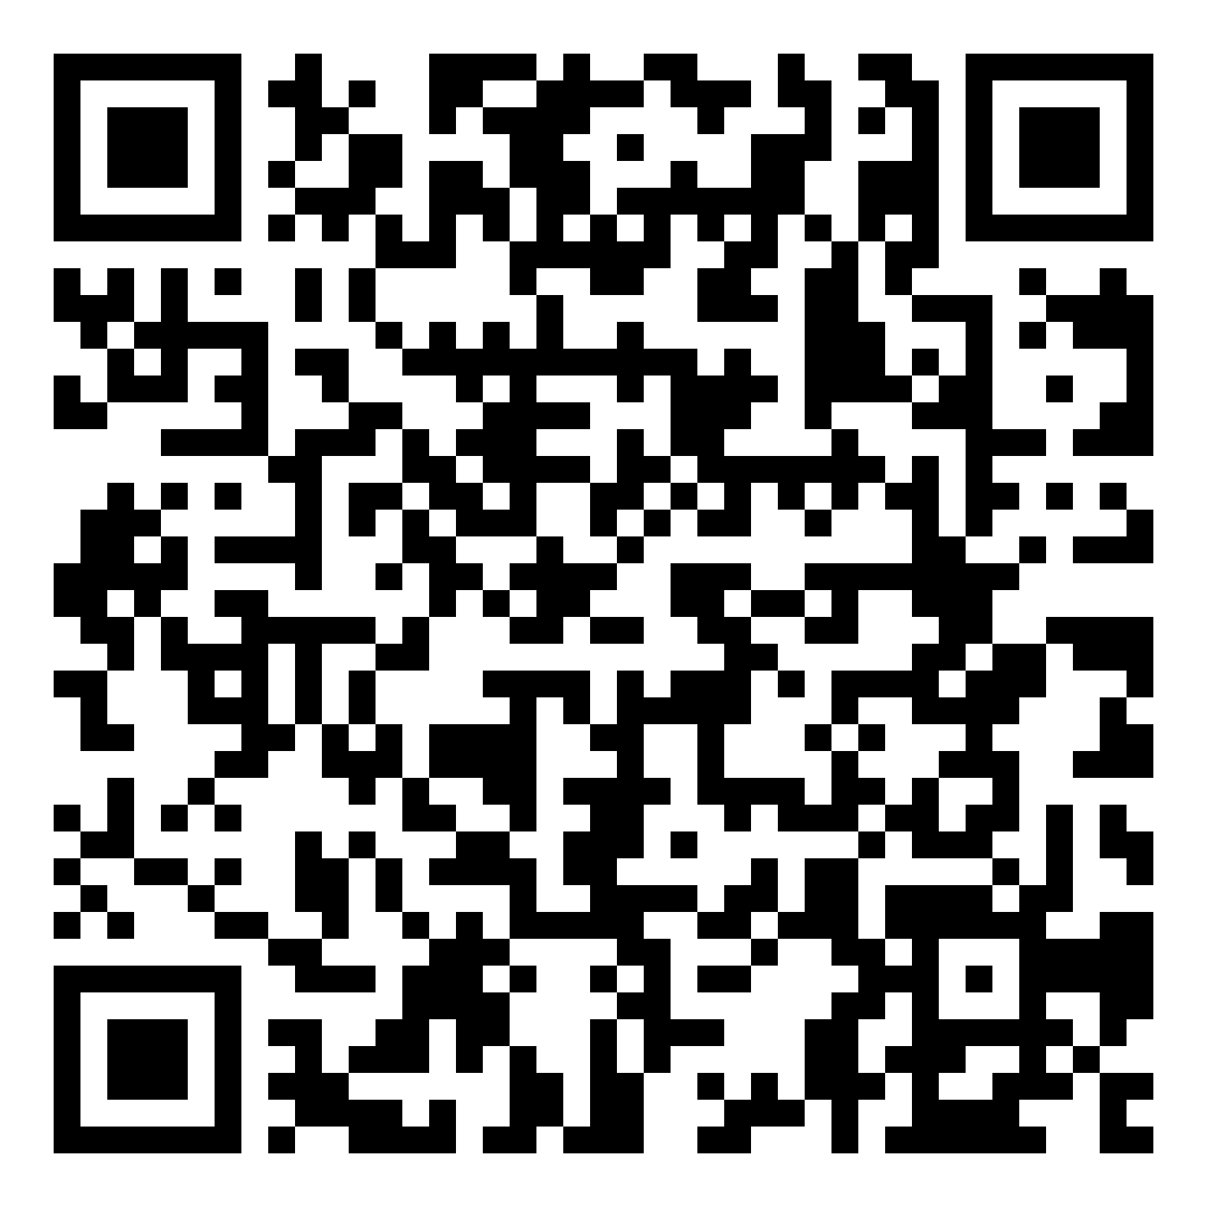
Quiz: Your Own Choice or an Ad?
QR code to the quiz:

Slide 10
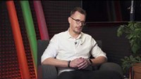
Interview with advertising specialist here
Notes:
https://www.youtube.com/watch?v=4NfwdYFOWxM Interview with an Advertising Specialist

Slide 11
Conclusion: How can we overcome cognitive biases?
Being aware of them is the first important step.
Stay critical and don’t assume something is true just because it would be nice if it was.
Don’t ignore the news stories that contradict your instincts and suspicions. Examine them and try to verify the facts like always, but don’t ignore them (there will be more advice on how to fact-check in Unit 4).
Don’t assume what you don’t know – don’t fill in the gaps with your assumptions.
Be open to changing your mind. It’s never too late to grow and learn.

