Slide 1
Lesson 4. How Social Media Works
Unit 3 Part A
Notes:
https://veryverified.eu/units/unit-3/part-a-how-social-media-works/

Slide 2
Homework – analyze your timeline
- What were the topics you noticed? Was there a large diversity of topics you saw or were there only a few that were repeating?
- How many of all the posts were ads?
- What emotions were evoked most frequently?
Notes:
Ask:
- What were the topics you noticed? Was there a large diversity of topics you saw or were there only a few that were repeating?
- How many of all posts were ads?
- What emotions were evoked most frequently?
Discussing these questions should help prompt the student to start thinking about social media as a news source - whether a person can read relevant news stories about a diverse set of topics if they only use social media; are a lot of the topics on their timeline there to inform them (or rather to persuade them, get them to buy something); and if the posts they see mostly tend to be unserious or evoking sharp emotions.

Slide 3
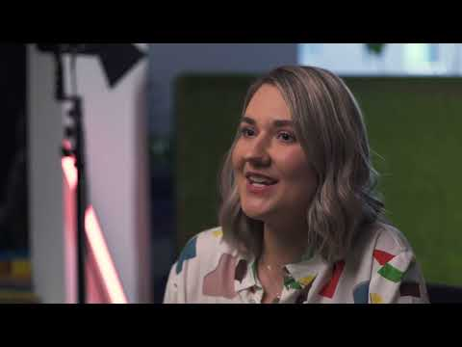
Notes:
Social Media as a News Source https://youtu.be/yzgLvTy17co
If needed, before watching the video you can name the most important questions addressed in the video and ask the participants to pay close attention and try to find the answers:
Who creates the content on social media? Is there anyone to check its accuracy?
How do the algorithms on social media work?
What are the risks that content selection by algorithms create to social media users?

Slide 4
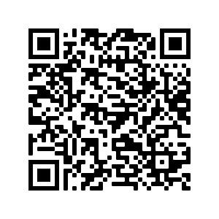
The Markup: Split Screen project
LINK
Notes:
https://themarkup.org/citizen-browser/2021/03/11/split-screen?feed=biden_trump

Slide 5
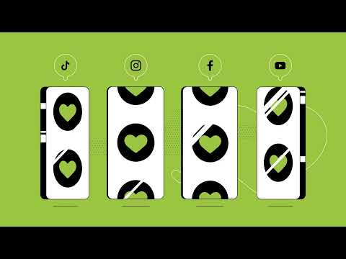
Notes:
Filter Bubble https://youtu.be/fDLzwFdeC4o

Slide 6
Discussion in groups of three or four
Is social media a good news source?
Based on the analysis of your social media feed and what you learned in this lesson, what could be the consequences, the pros and cons of using social media for news?
Write a short list of pros and cons.

Slide 7
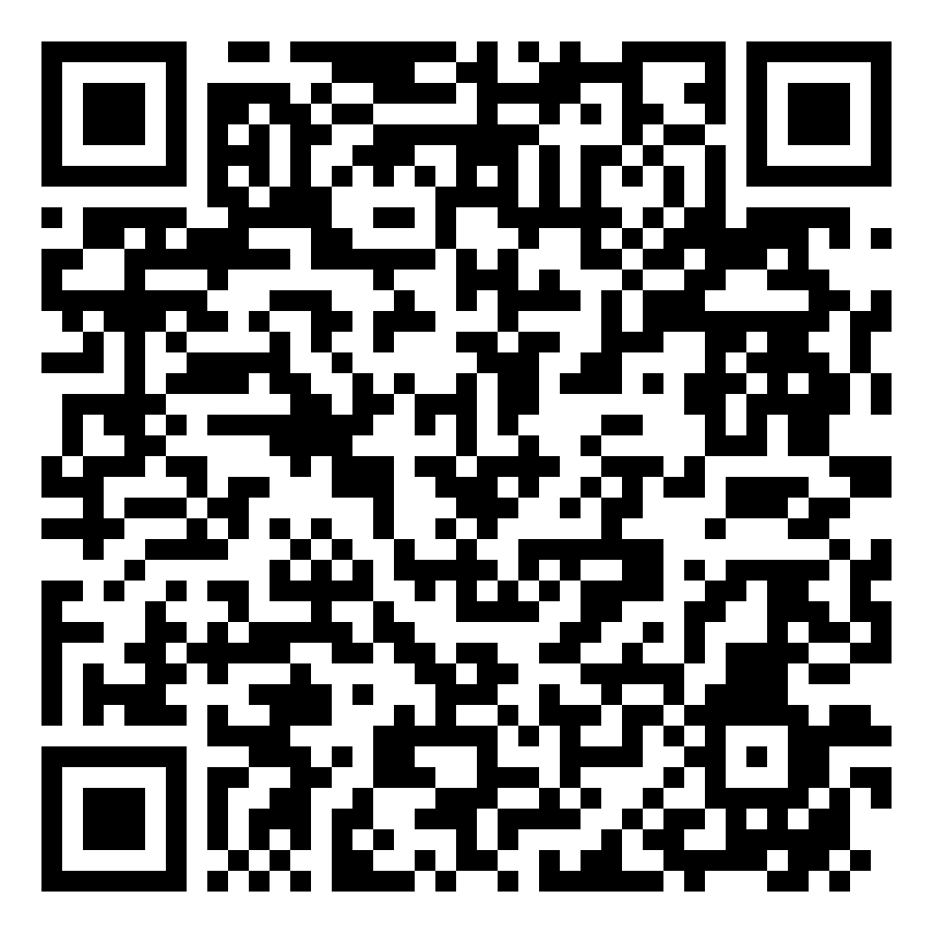
Quiz: Algorithms in Social Media
Notes:
https://veryverified.eu/units/unit-3/part-a-how-social-media-works/algorithms-in-social-media

Slide 8
Social media vs. Reality
Pair up in groups of two. Try to pick someone you don't know very well
Look at each other's social media profile (platform of your choice)
Tell the other person what you can assume about them based on their profile
The profile owner has to confirm whether it's accurate or not

Slide 9
Conclusion
What social media use habits would you like to change?
You are welcome to read a short article on the basics of data security. Link: https://veryverified.eu/units/unit-3/part-a-how-social-media-works/who-creates-popular-content-on-social-media
Watch interviews about the behind-the-scenes of the work of influencers on your own time. Link: https://veryverified.eu/units/unit-3/part-a-how-social-media-works/data-protection-and-safety-online
Find it on Very Verified Unit 3 Part A

