Slide 1


Lesson 3. Agenda Setting
Unit 2 Part B
Lesson 2: Media Ownership
Unit 2 Part A

Slide 2

Homework
Make sure you have done the “Behind the news” quiz! QR code:
Discussion:
Who makes decisions on what gets published/broadcast on the news? Do you know how news is selected, what criteria are used and why?

Slide 3
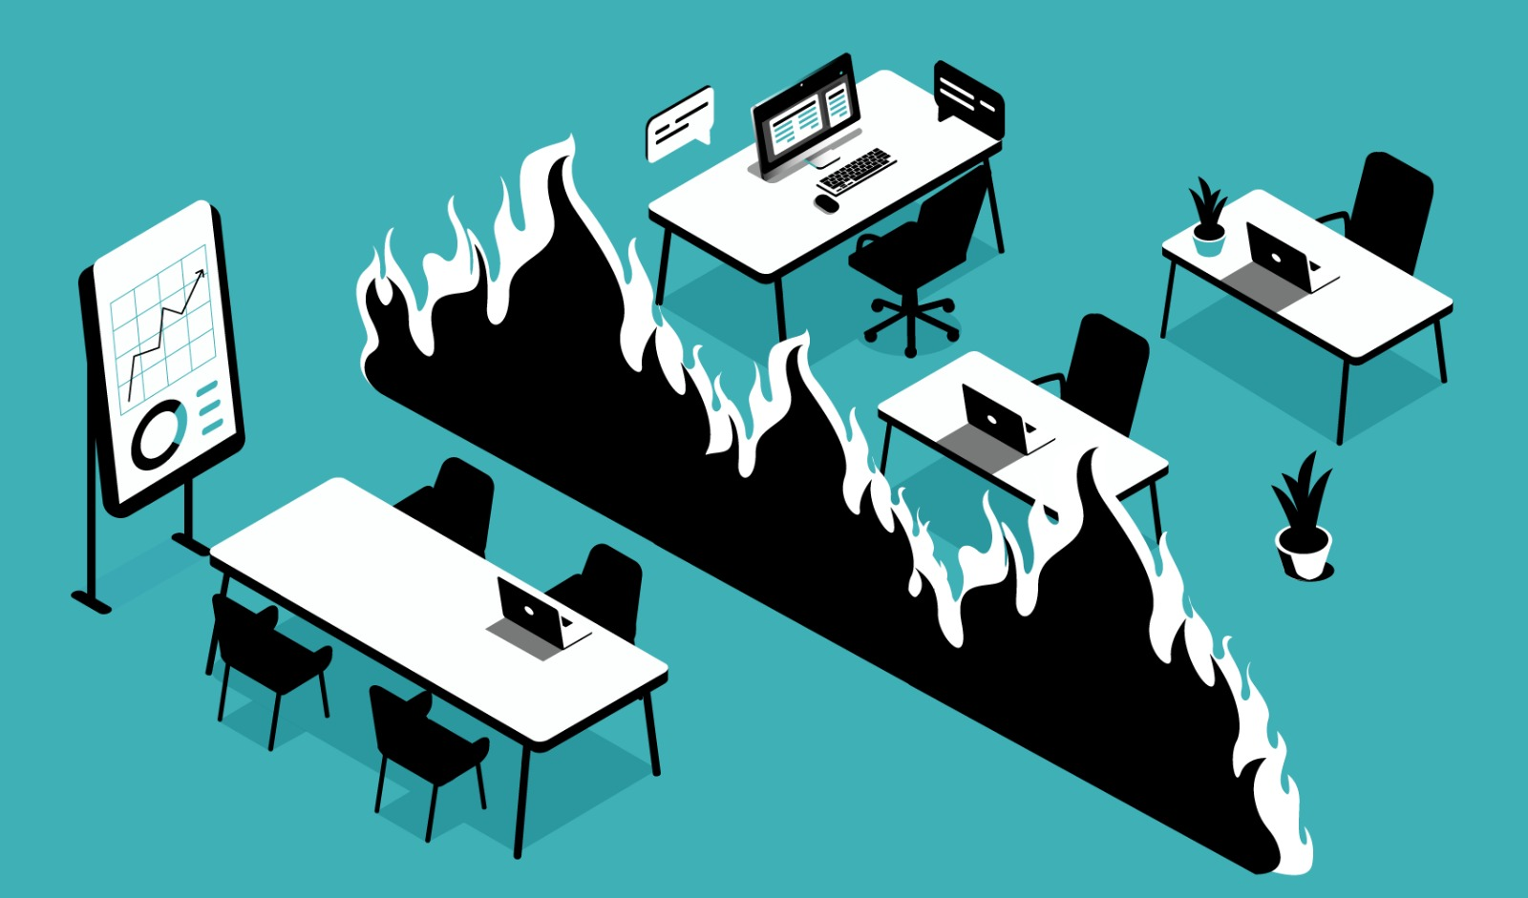
How does a story get to us?
Notes:
Newsrooms usually have several different departments, and some of those departments have “firewalls” between them. A firewall is an invisible barrier that keeps two sides separate from each other. For example, the influence of a news outlet’s owners and the marketing department should be kept separate from its editorial board. Journalists and editors should be able to make decisions on what to publish freely and independently from the interests of the advertising department and owners.

Slide 4
Departments at media outlets:
Reporters who cover different “beats” (or topics), such as crime, sports, national politics and foreign affairs
Editors and producers who direct the tone and content of the outlet’s publications
Design team
Social media and self-promotion
Advertising
Management and administration
Notes:
Ultimately, editors should be responsible for selecting the stories that their outlet covers.
How does an editor decide which stories to publish?
There are many complex and intersecting factors that contribute to how journalists and news outlets decide what news to cover and how to cover it. Understanding this can help us be more aware of what we see and why.
While balancing expectations, civic duty, and readers’ preferences, the editors serve as a filter and watchdog for information from those who want to have a controlled and positive image in the media (like politicians who want to emphasize their accomplishments), and those who want to uncover or cover hidden activities. Editors decide what to include in the media’s agenda and what is left without attention. Here are some criteria they take into consideration:

Slide 5
News selection criteria
Reader preference and shareability
Societal relevance
Proximity
Cultural or historical influence
Rarity
Conflict and drama
Impact/severity
Celebrity and power
Competition
Exclusivity
Timeliness
Audio-visuals
Entertainment
News organization’s agenda
Notes:
Reader preference and shareability
Media outlets want to ensure that people consume and engage with their content. When that content is online, media outlets want people to click on and share their stories. Each publication has a certain audience in mind and that audience expects certain content from the publication. Therefore, some outlets try to fill their own, specific niche. For example, a fashion magazine might dedicate an entire issue to Paris Fashion Week, while a business magazine might not even report it.
Societal relevance
Journalists who cover important local, national, and global events often feel that they have a duty to inform their readers and help identify crises and issues we might face. This is one important reason why major outlets write about natural disasters, political crises, misdeeds by people in power, pandemics, wars, and other important events or issues.
Proximity
Media outlets tend to report mostly about what’s happening in their country or region. Local media mostly report about their city.
Cultural or historical influence
Stories about groups or nations are perceived to be influential or culturally and historically familiar to the audience. This is the reason why the US is covered more extensively in the Baltic media than, for example, Slovakia, despite its proximity.
Rarity
Unusual events with an element of surprise get more coverage than ordinary events. The old saying goes that “Man Bites Dog” will get more coverage than “Dog Bites Man.” This is why stories with particularly bad or good overtones are likely to get covered.
Conflict and drama
Stories about controversies, arguments, splits, strikes, fights, insurrections, and warfare, as well as stories concerning unfolding drama such as escapes, accidents, searches, sieges, rescues, battles, or court cases are more likely to get covered.
Impact/severity
An earthquake that kills 10,000 people will get greater coverage than one that kills 10.
Celebrity and power
If a well-known politician or a famous actor does something, the story is far more likely to be covered than if your neighbor does the same thing.
Competition
Often, if one outlet covers a story that engages readers, others will follow suit. Sometimes outlets try to distinguish themselves from a unique angle or approach to the story, but they want to cover events others discuss to be a part of important conversations.
Exclusivity
If an outlet knows it has a story that no one else has, and which is sure to get attention, it has a major incentive to publish it and emphasize it did so first to show their readers that their content is worth buying and consuming.
Timeliness
News editors generally prioritize events that happened recently over those that happened weeks or months ago. The 24-hour news cycle moves quickly and can influence what journalists cover and how long they spend on a certain story.
Audio-visuals
Stories that have arresting photographs, video, or audio are of special importance to TV and radio stations.
Entertainment
Some outlets are primarily focused on stories concerning sex, showbusiness, sport, lighter human interest, animals, or that offer opportunities for humorous treatment, witty headlines, or lists.
News organization’s agenda
Stories that set or fit the news organization’s own agenda, whether ideological, commercial, or as part of a specific campaign are likely to be published. For example, Latvian public media decided to invest significant time and resources to covering stories about orphanages and support received by parentless children.

Slide 6
Exercise: What criteria were used for these stories?
Notes:
To be distributed to students, if needed:
https://www.lrt.lt/en/news-in-english/19/1654189/voice-from-mariupol-survive-nadia-we-need-to-survive
https://www.politico.eu/article/china-downgrades-diplomatic-relations-with-lithuania-over-taiwan-representative-office/
https://www.occrp.org/en/daily/15434-latvian-authorities-confiscate-property-worth-250k-in-magnitsky-case
https://www.theguardian.com/world/2021/oct/02/doctors-in-lithuania-find-kilo-of-nails-and-screws-in-mans-stomach
https://www.leta.lv/eng/home/important/FCA3E923-A910-413D-8282-61EE78F88623/
https://news.err.ee/1103321/well-known-actors-to-star-in-new-thriller-filmed-in-estonia

Slide 7
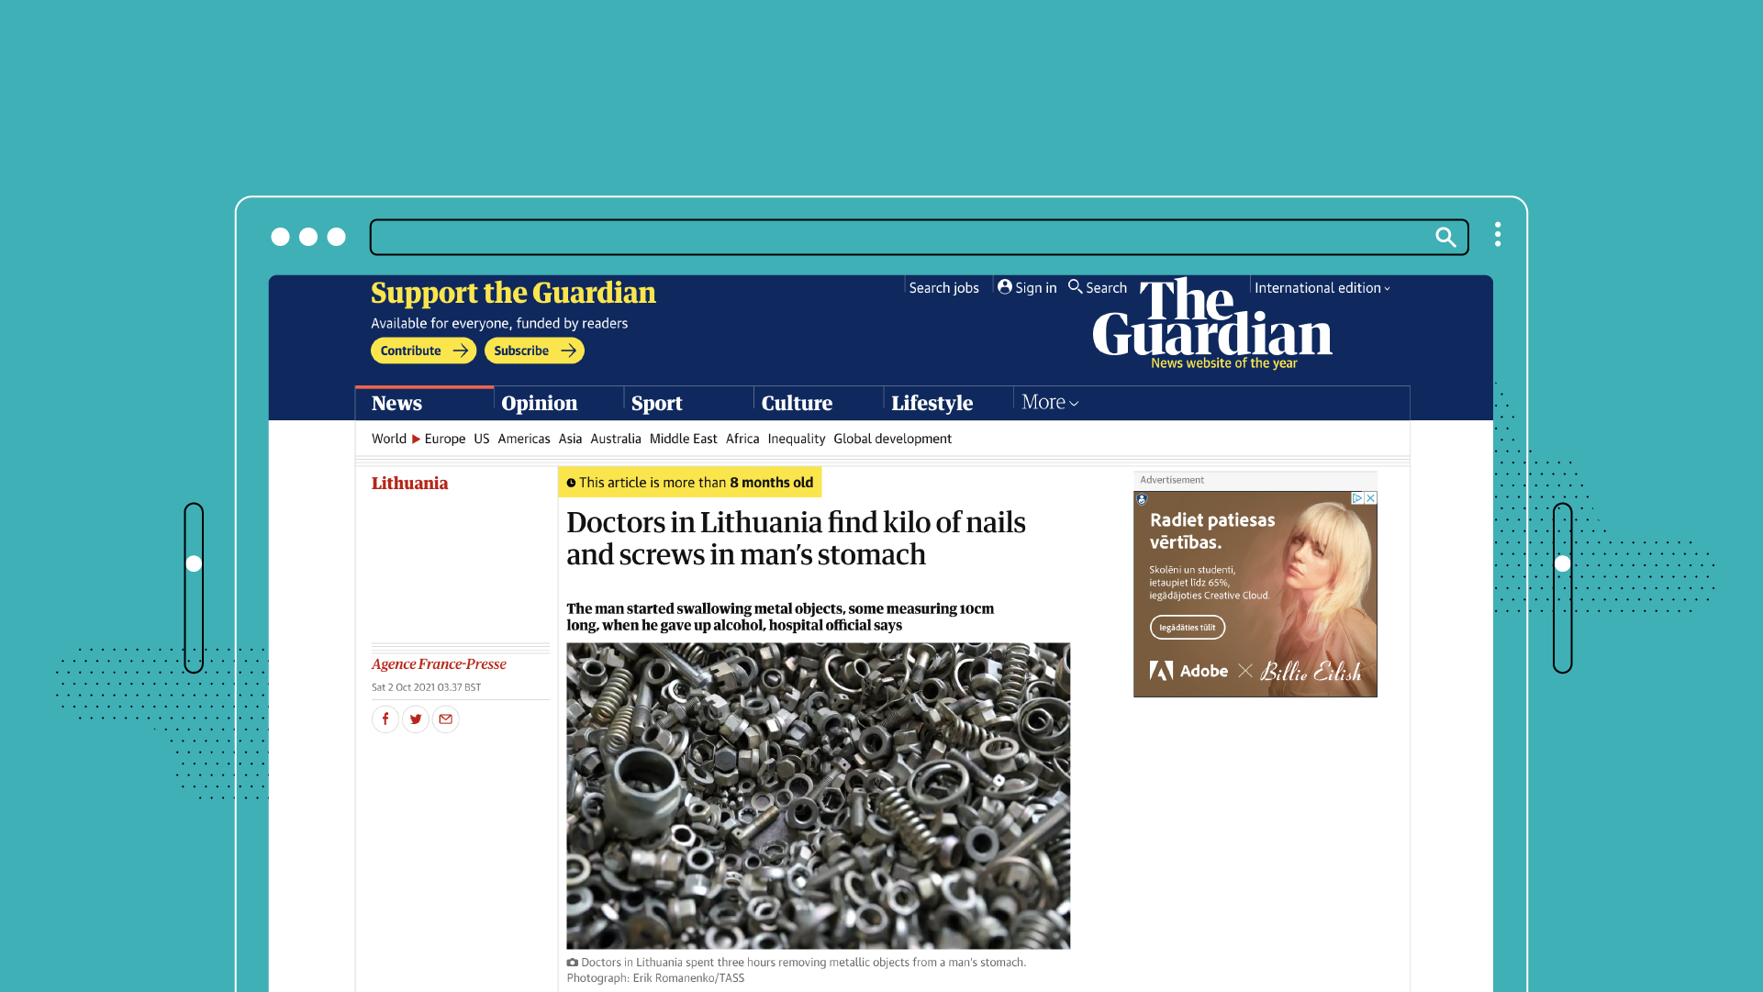

Slide 8
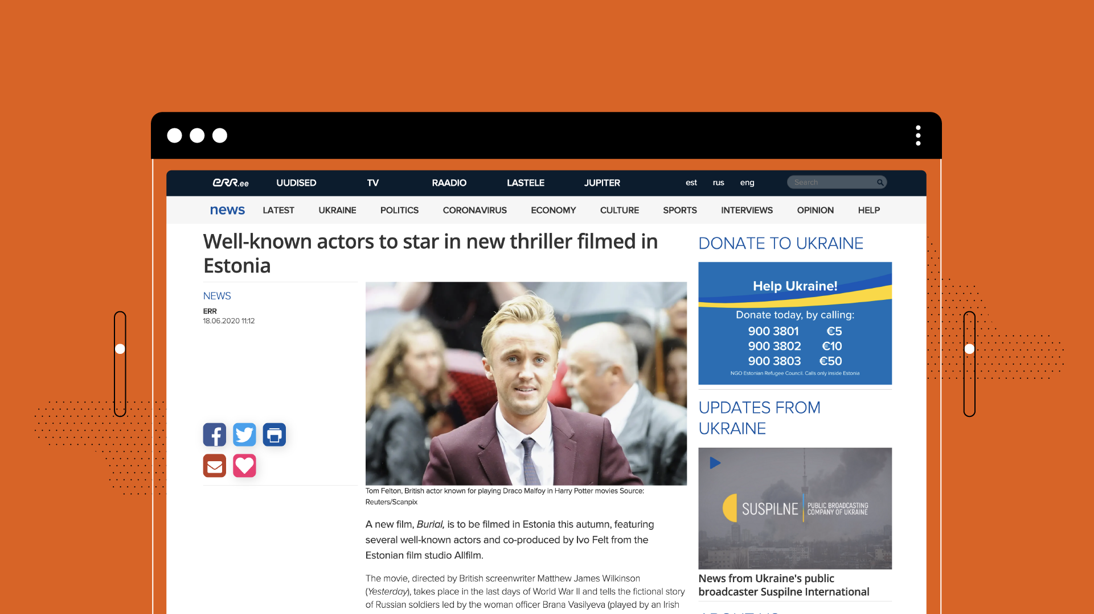

Slide 9


Slide 10
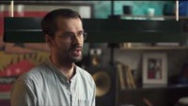
Notes:
https://www.youtube.com/watch?v=UL_LmMXDoyI Editorial policy interview

Slide 11
Journalistic Standards

Slide 12


Slide 13


Slide 14


Slide 15


Slide 16


Slide 17


Slide 18
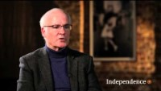
Notes:
https://www.youtube.com/watch?v=uNidQHk5SZs The 5 Core Values of Journalism

Slide 19
Freedom of the Press in the constitutions of the Baltic states

Slide 20
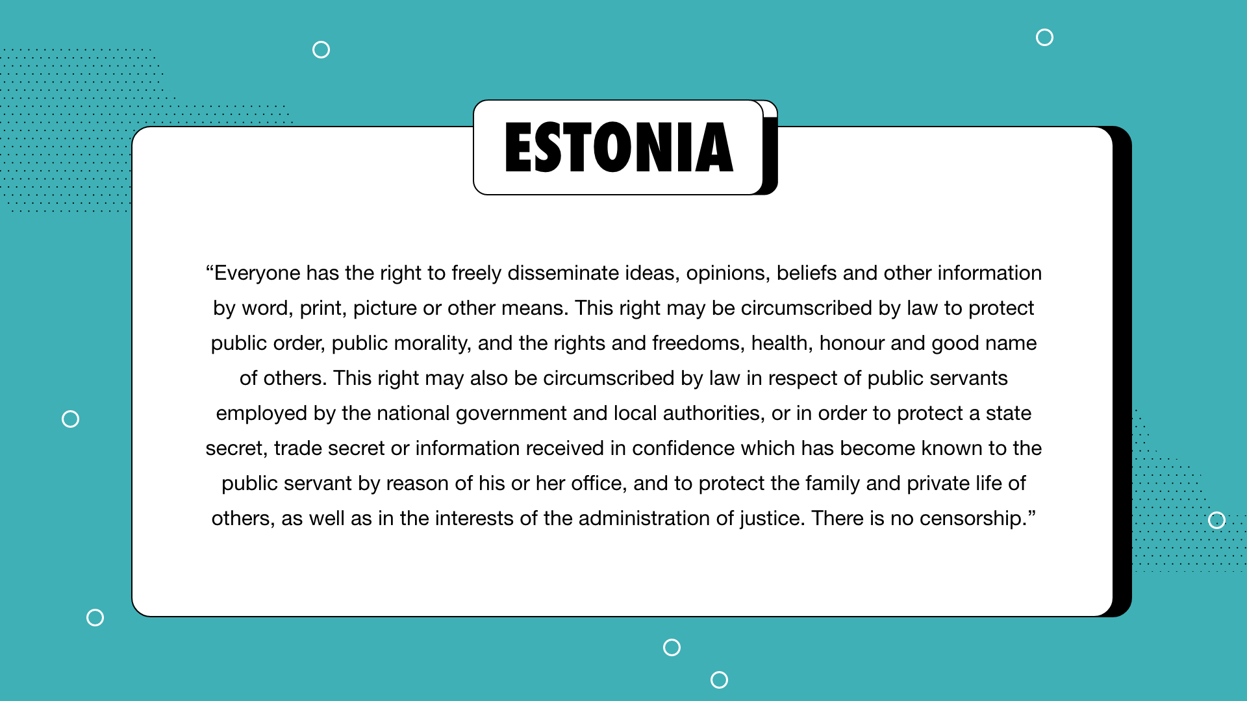

Slide 21
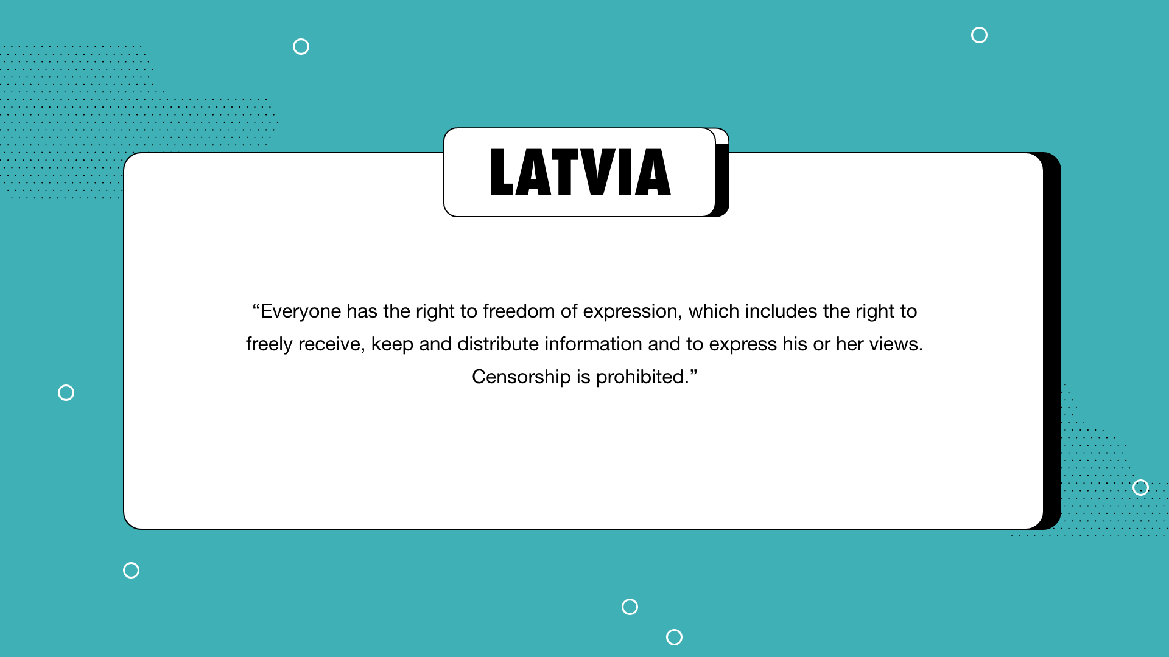

Slide 22
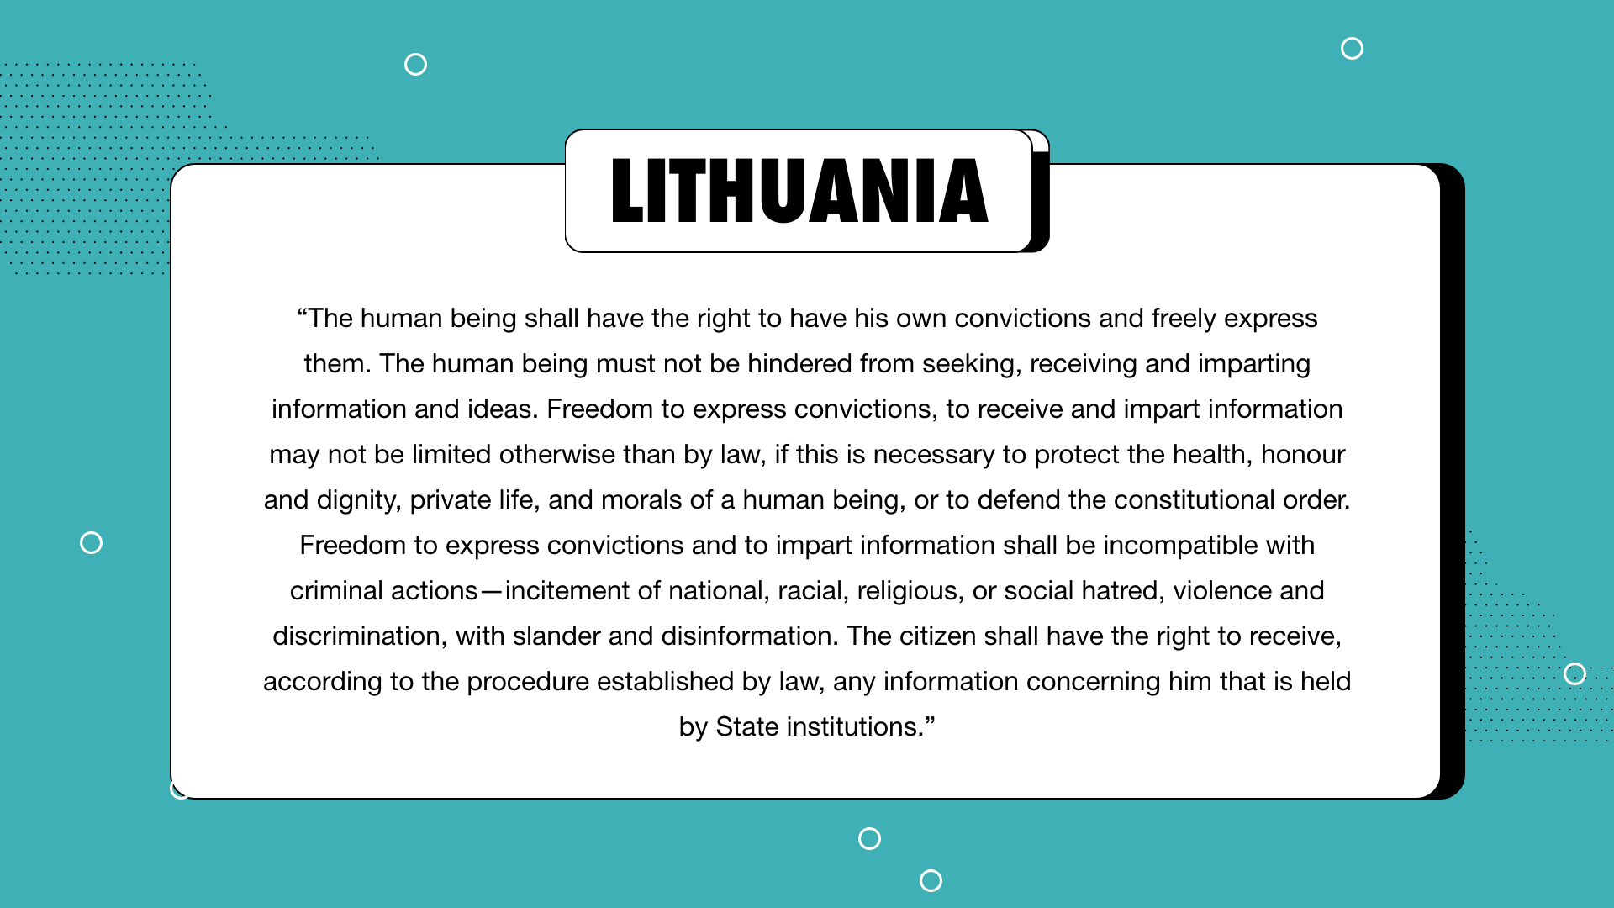

Slide 23


Homework: Freedom of the Press
Compare your country’s rating with another country of your choice from www.rsf.org!
Please, share your findings!
Notes:
www.rsf.org

Slide 24

Conclusion
What did you learn?

Slide 25


