Slide 1


Lesson 2. Media Ownership
Unit 2 Part A
Lesson 2: Media Ownership
Unit 2 Part A

Slide 2
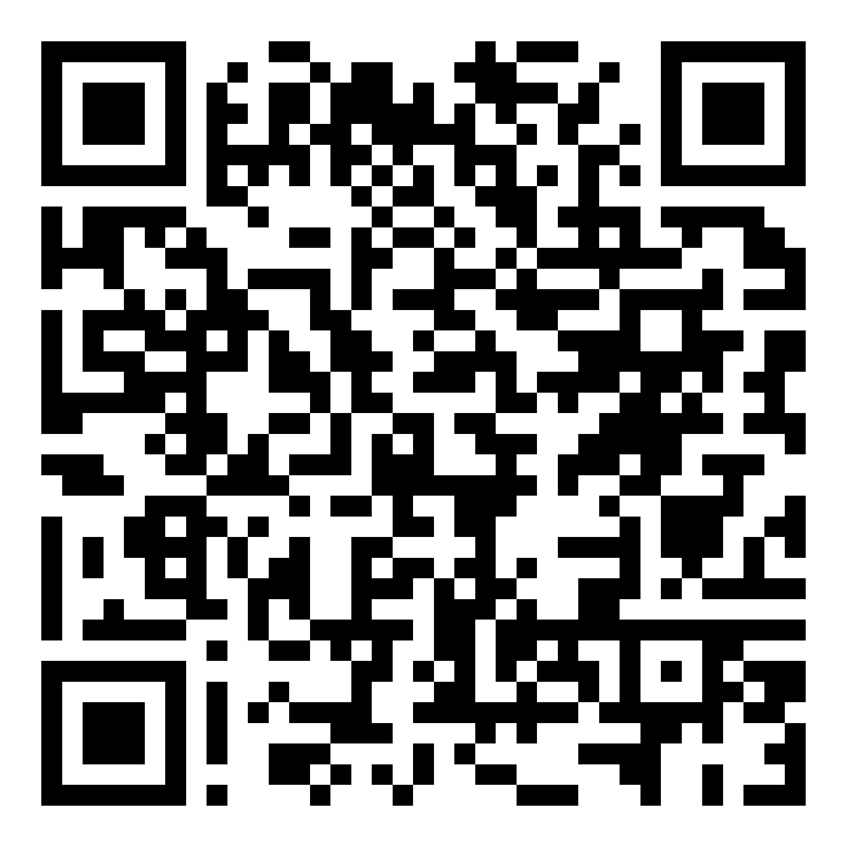
Homework
Make sure you have done the very short quiz! QR code:
Discussion:
Why do we have to know who owns the media we consume? Share one or two reasons you thought of.

Slide 3
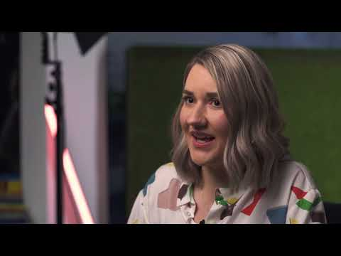
Notes:
Ownership: Private and State-Owned Media https://youtu.be/OTJ45wvn8JA

Slide 4
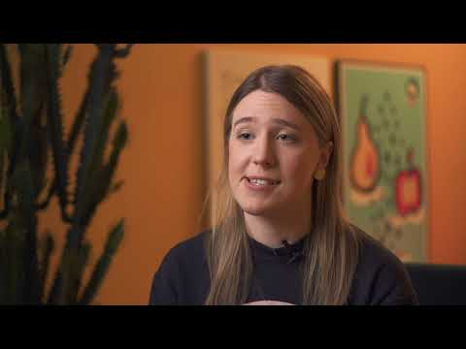
Notes:
Ownership: Public Broadcasting https://youtu.be/E6aLcp1Bl7Q

Slide 5
Task: find the media owner or ownership model
Pick two media outlets and try to find who owns them or what's their ownership model. Was it difficult for you? How did you try to do it?
If you don't know which outlets you want to research, ask your teacher to assign them for you.

Slide 6
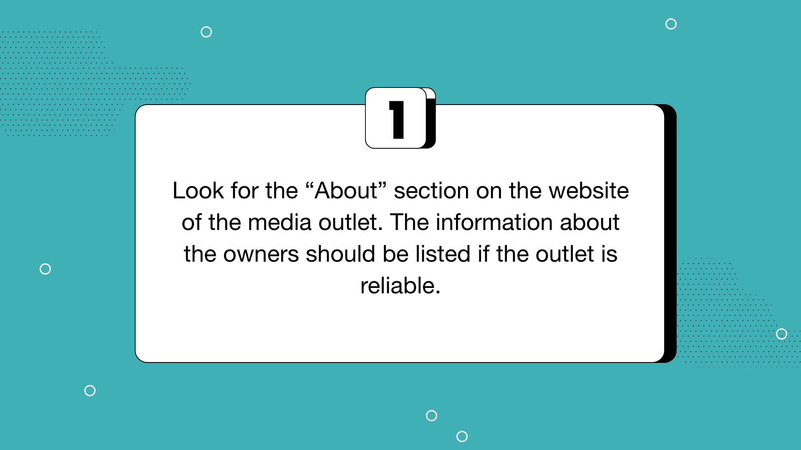

Slide 7
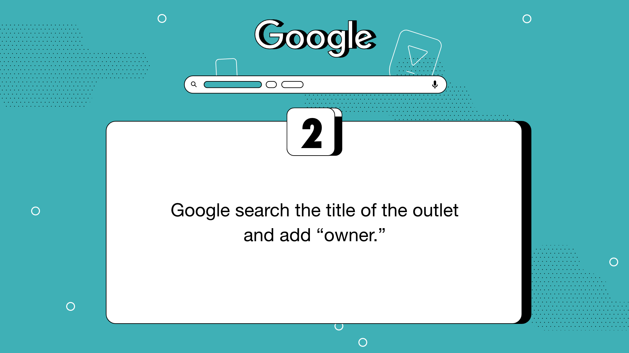

Slide 8
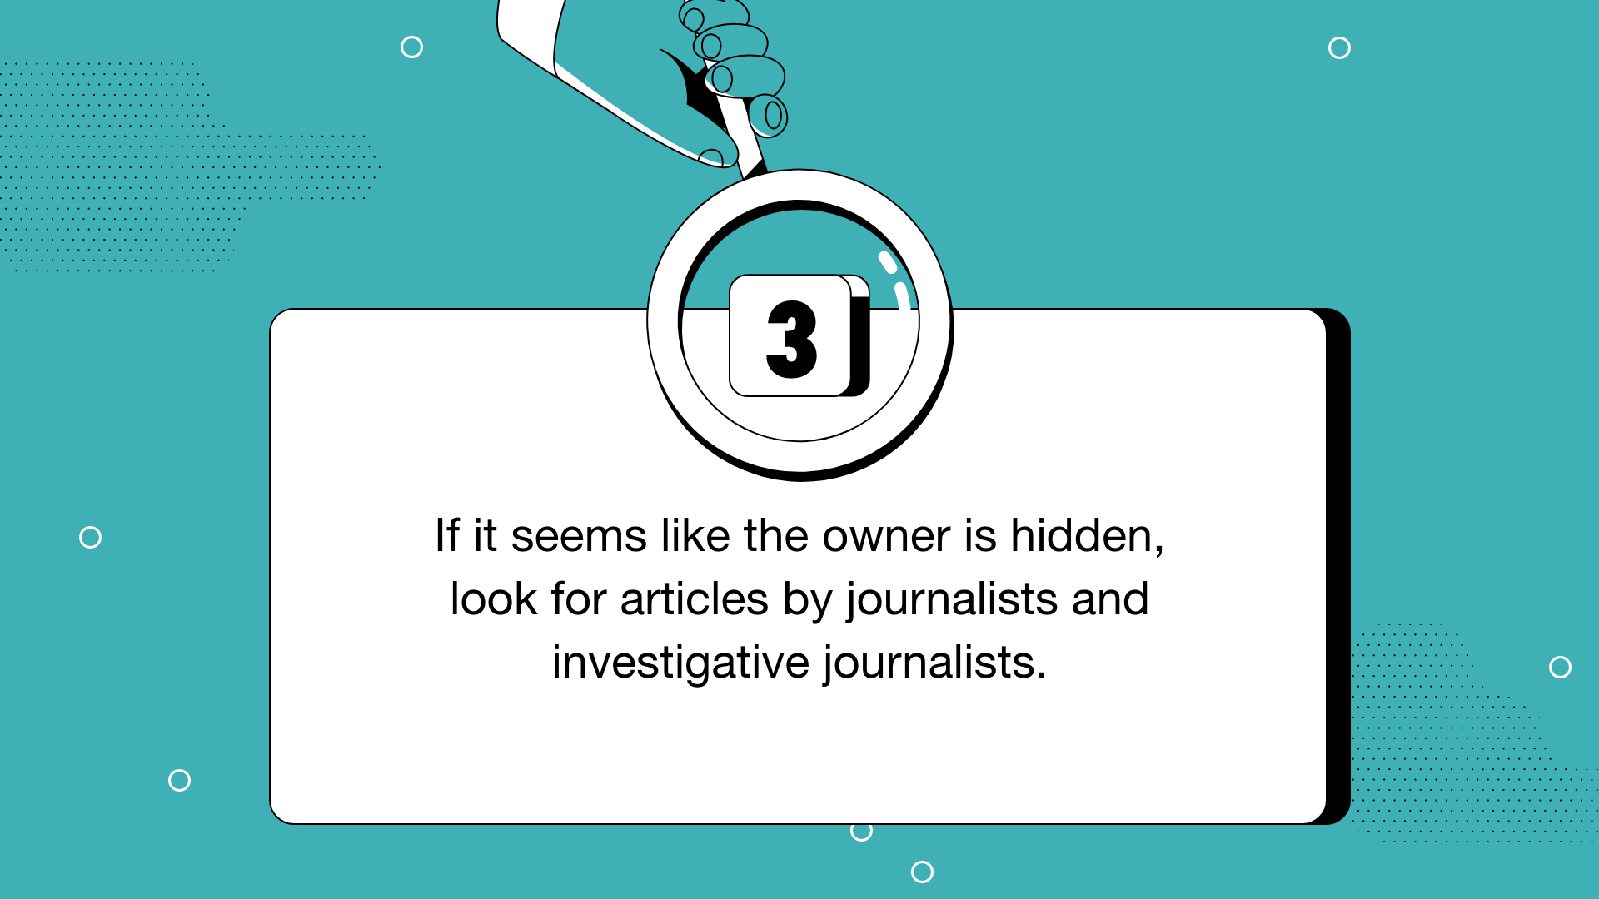

Slide 9
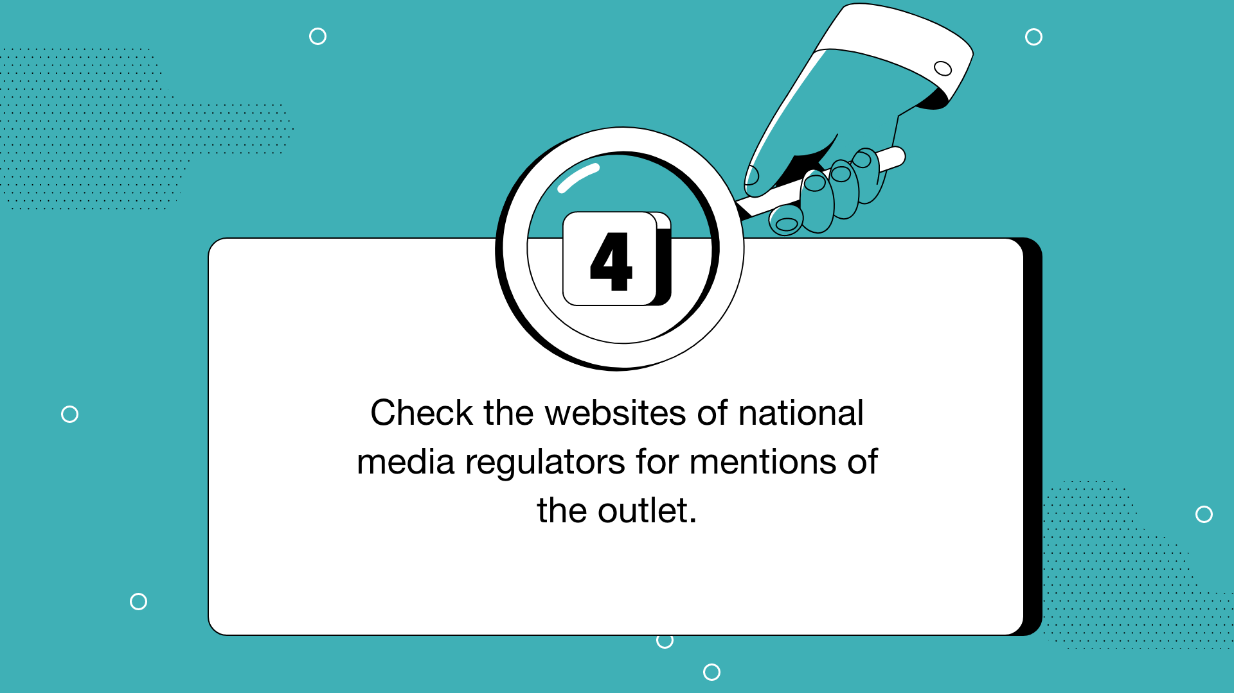

Slide 10
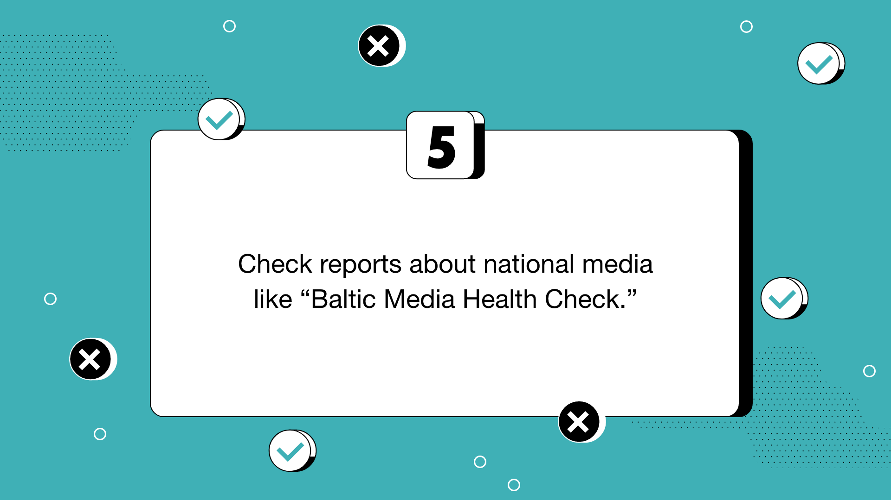

Slide 11
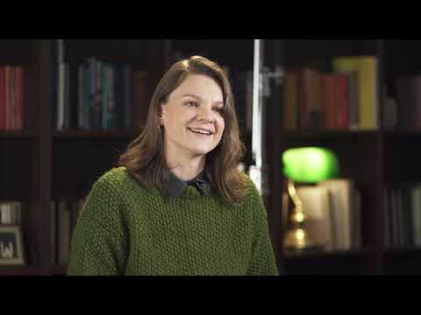
Notes:
Non-profit or Independent Journalism https://youtu.be/699YizGGdzU

Slide 12
Conclusion
If you would like to learn more about why it is important to know who funds the media you consume, watch this TED talk by the editor-in-chief of Latvian magazine “Ir” Nellija Ločmele on your own time.
Link: https://youtu.be/lR4MbDidwPM
Notes:
Ask a few students to share one tip they learned from this training that they’ll use in their lives moving forward.

Slide 13
