Slide 1
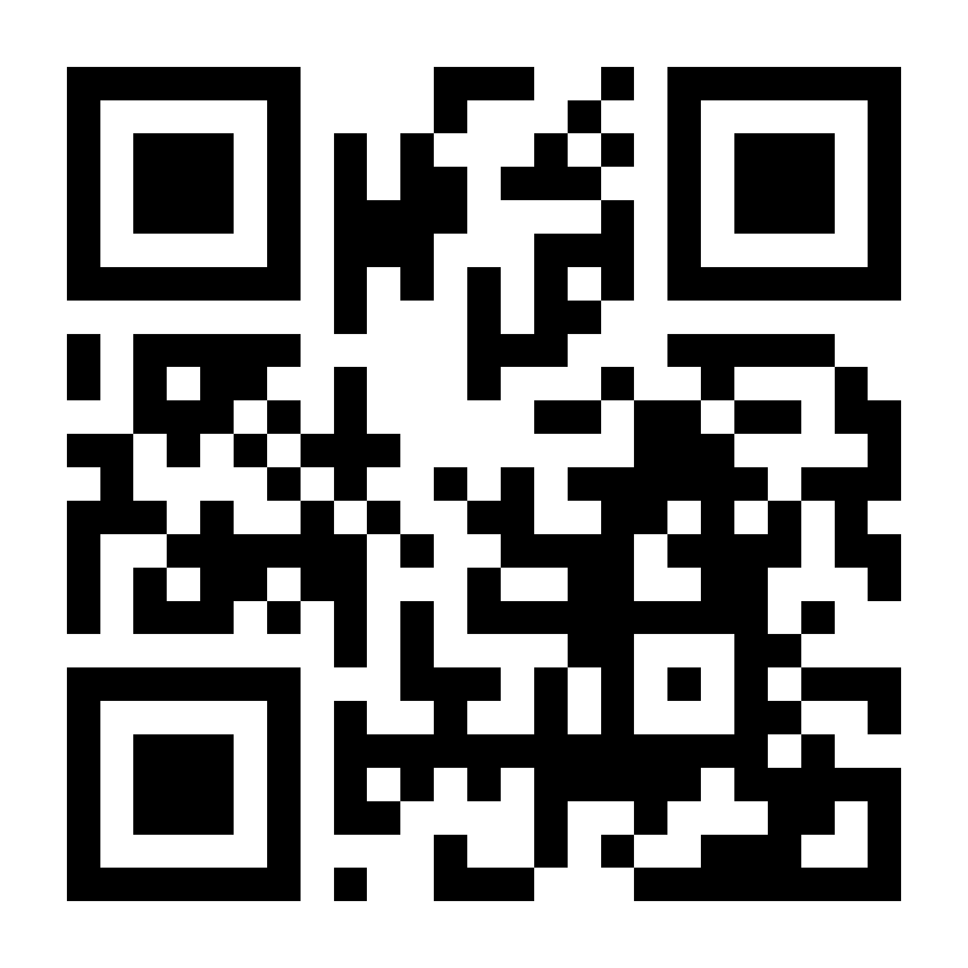

Pre-Work for your Participants – Prior to First Session
- Create your Very Verified Account
Read the Very Verified homepage (About the Course Link)
Answer the first quiz question on the homepage

Slide 2

Lesson 1. Media Landscape
Unit 1

Slide 3
Introductions and Warm Up
Have you…
Liked at least one post on social media already today?
Commented on any post on social media today?
Ever clicked ‘I accept’ on a website without reading the terms and conditions?
Looked at your phone at least once since this training started?
Notes:
Ask students to raise their hand (in-person) or put a Y in chat (virtual) if they have....

Slide 4
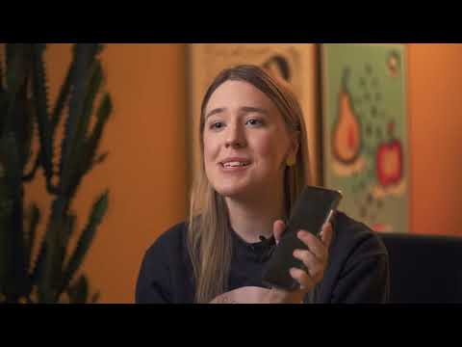
Notes:
Introduction to Very Verified https://youtu.be/DJy6n9J3IMI

Slide 5
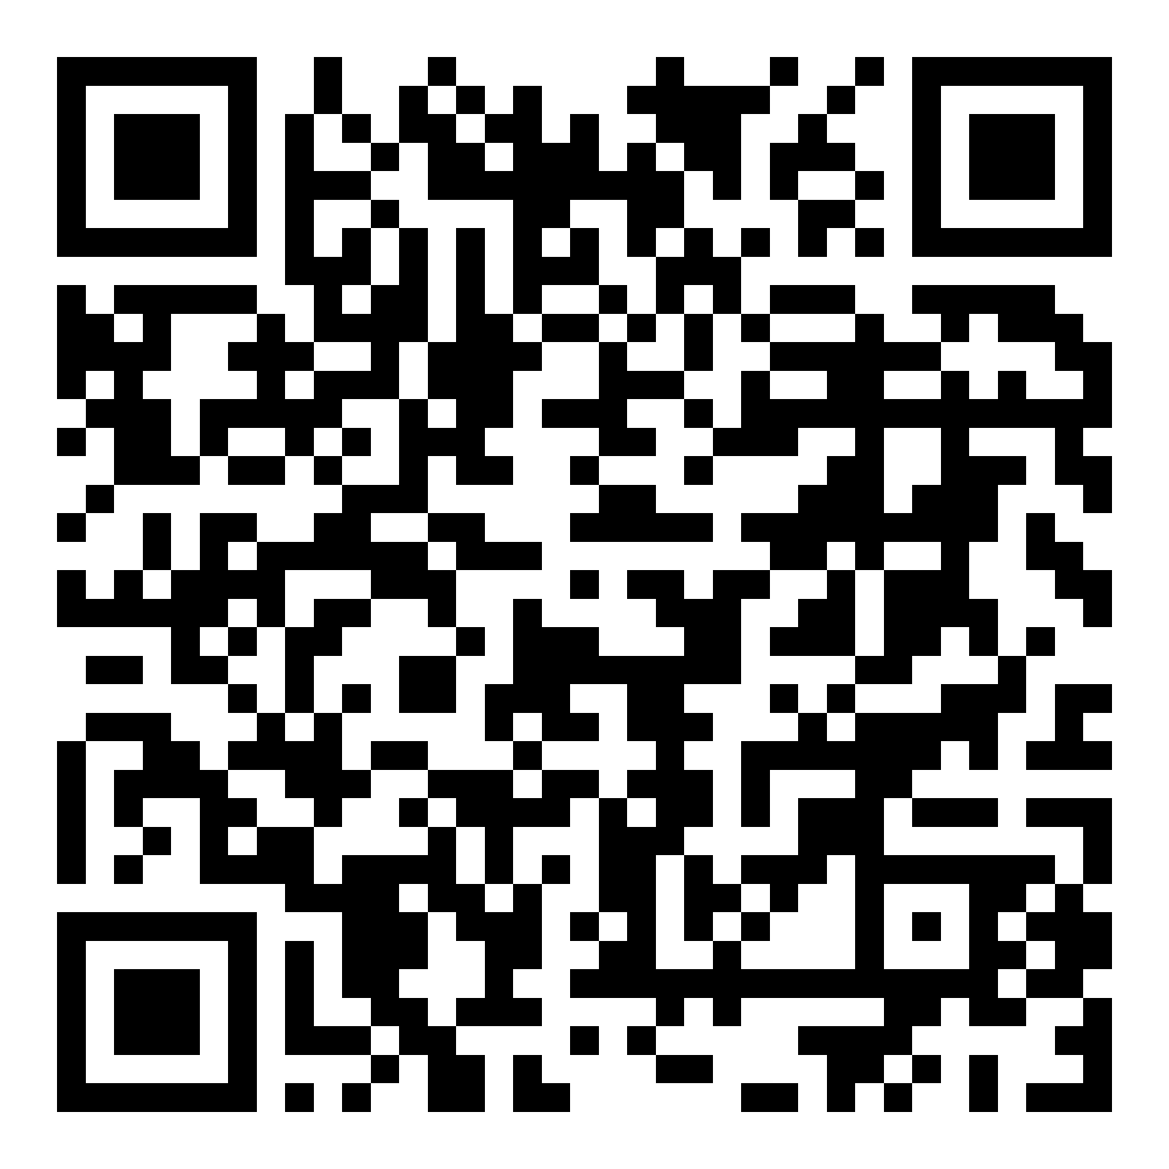
Quiz: Why Was This Published
Notes:
https://veryverified.eu/units/unit-1/quiz-why-was-this-published

Slide 6
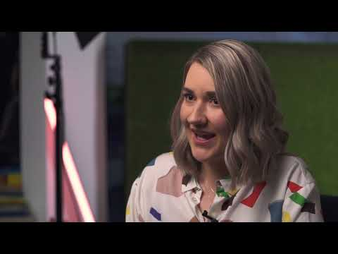
Video and Activity – Types of Content
Notes:
Types of Content https://youtu.be/09DkfD1eURE

Slide 7
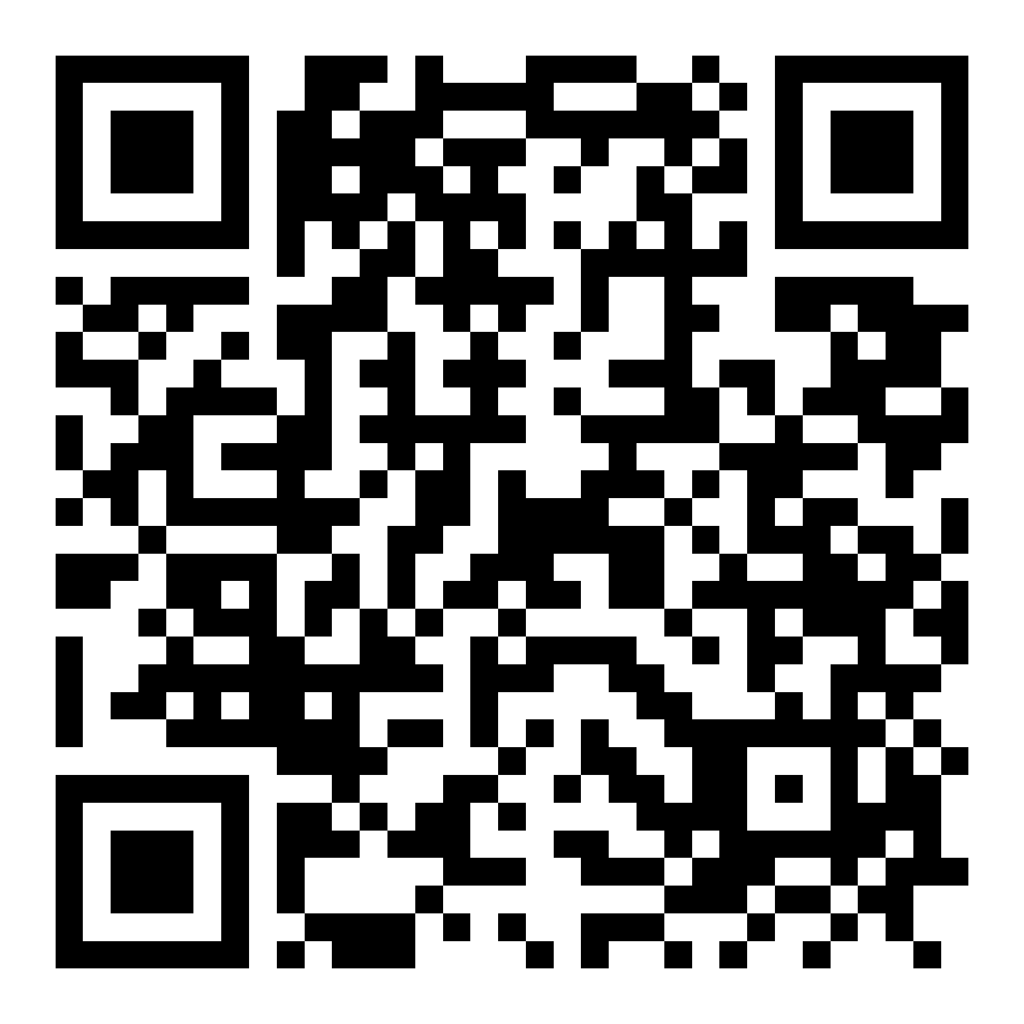
Quiz: Fact Vs Opinion
Notes:
https://veryverified.eu/units/unit-1/fact-vs-opinion

Slide 8
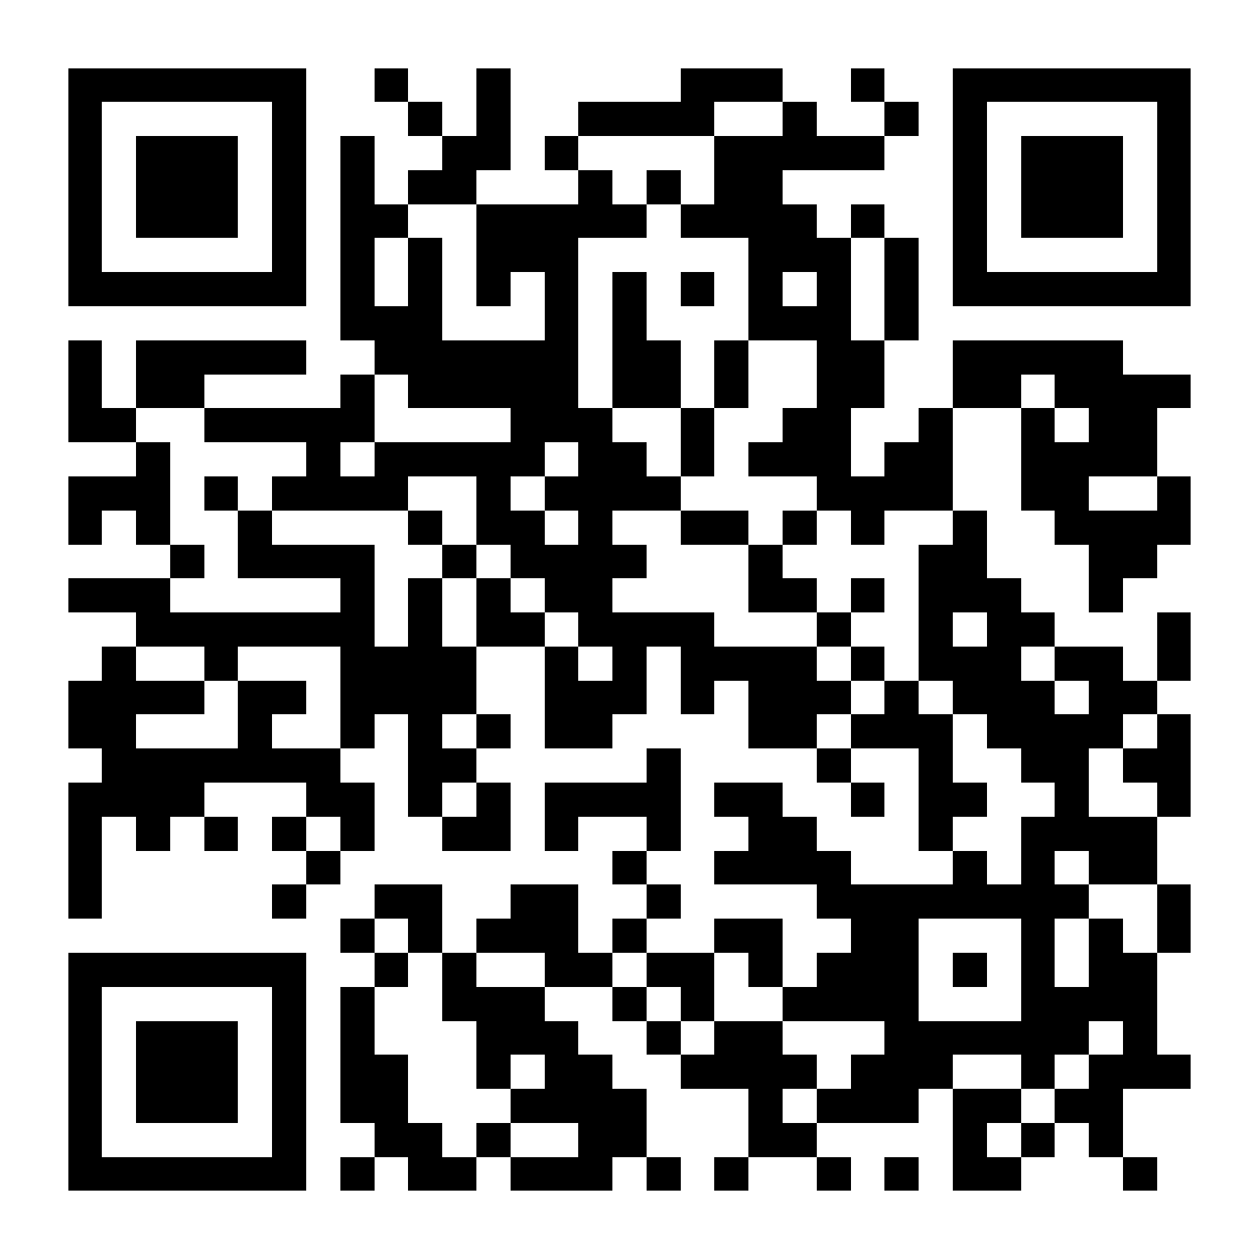
Quiz – Why Do We Share?
Notes:
https://veryverified.eu/units/unit-1/quiz-why-do-we-share

Slide 9
Role of Emotions
When was the last time you saw a headline in your social media feed that made you so angry that you commented on it or shared it with others?
What was it about the headline that made you do this?

Slide 10
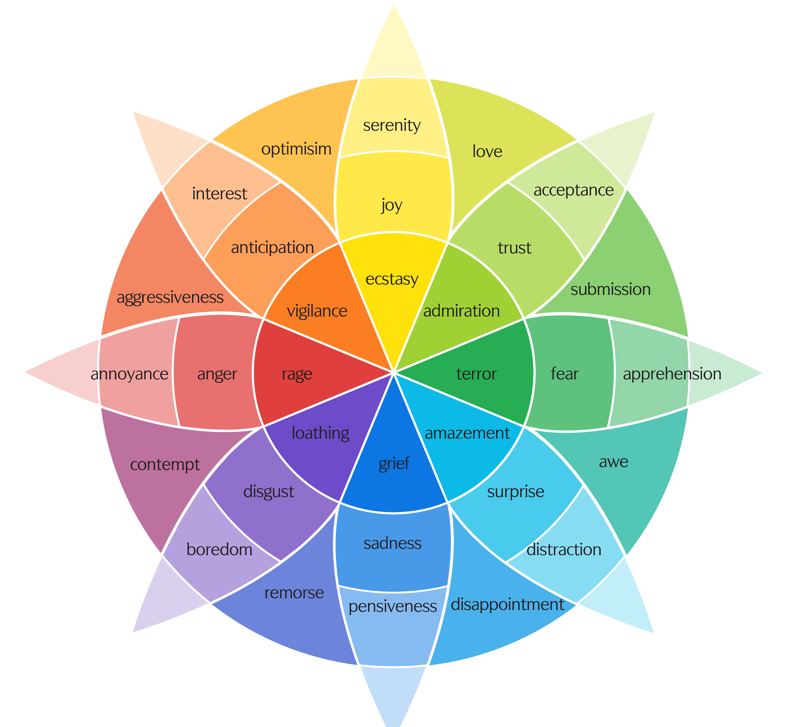
Name it To Tame It
Pause: Turn your head away from the screen after viewing an image or article that provokes you. Take a deep breath.
Ask yourself: How am I feeling?
Say: Name and accept your emotion – regain control of your logical brain!

Slide 11
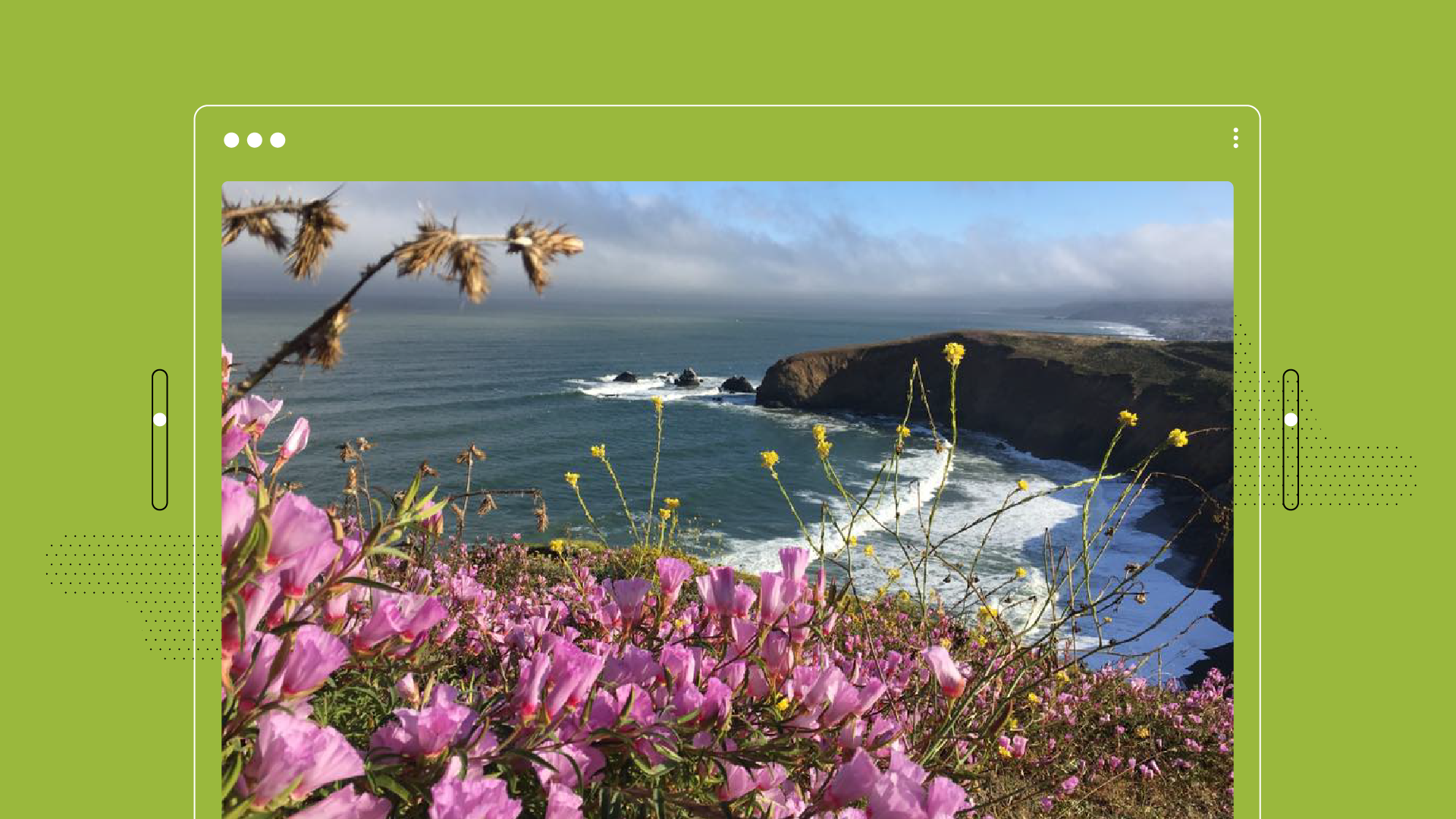
Practice – Name It To Tame It. What are you feeling?

Slide 12
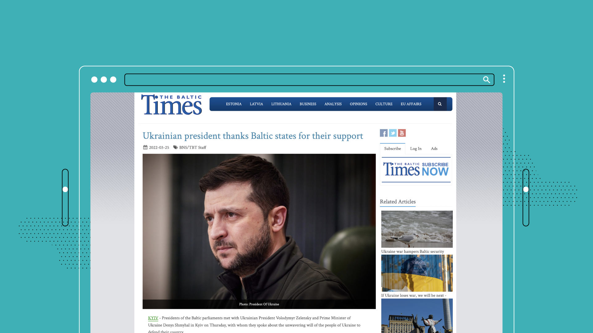
Practice – Name It To Tame It

Slide 13
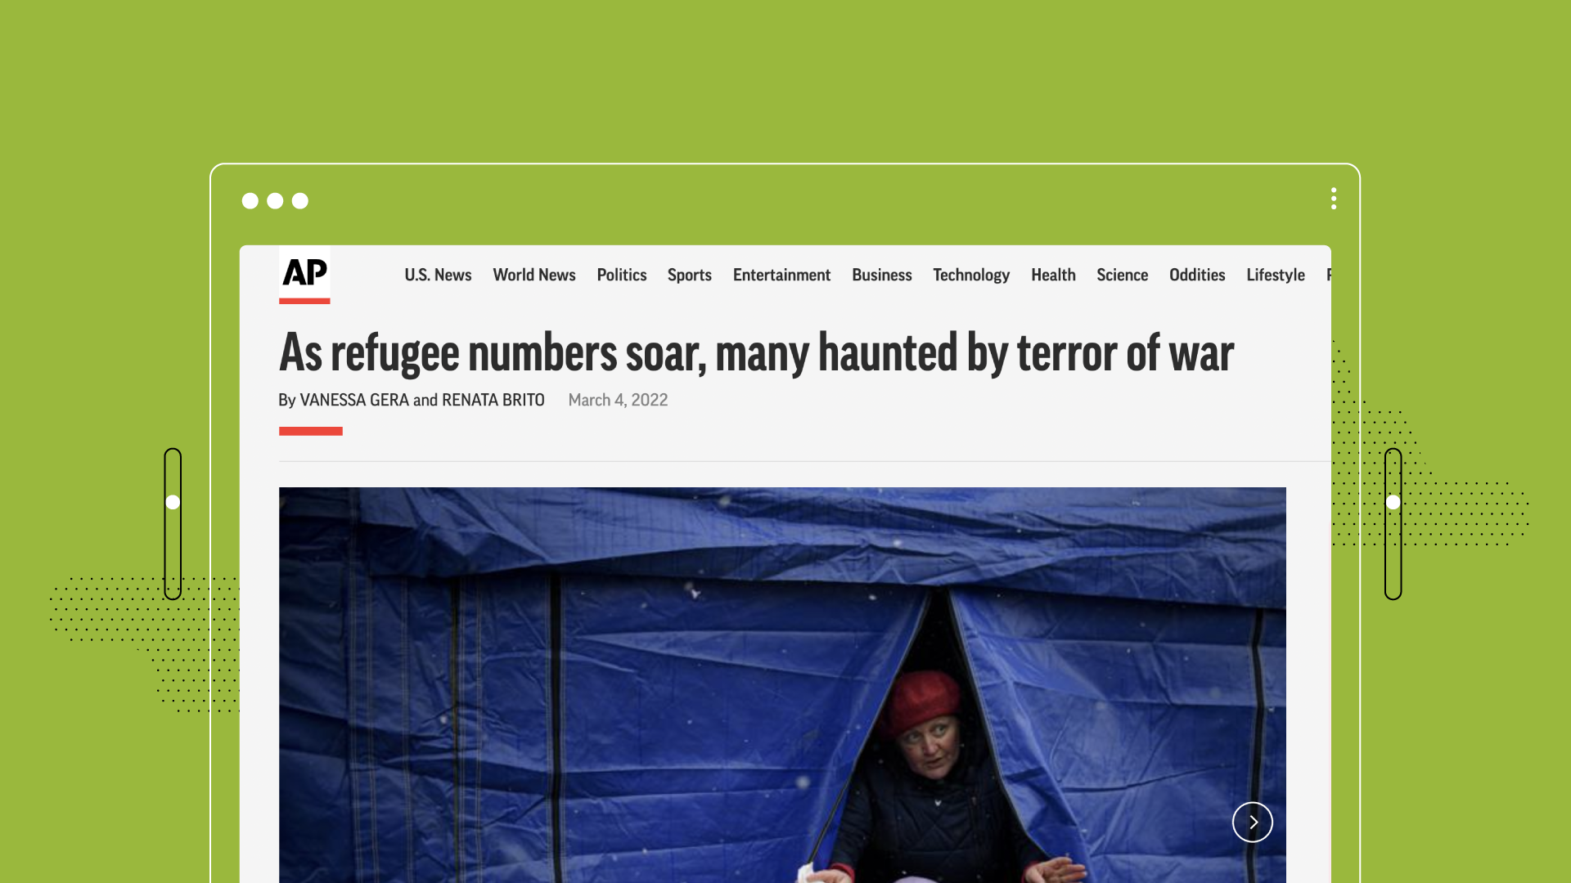
Practice – Name It To Tame It

Slide 14
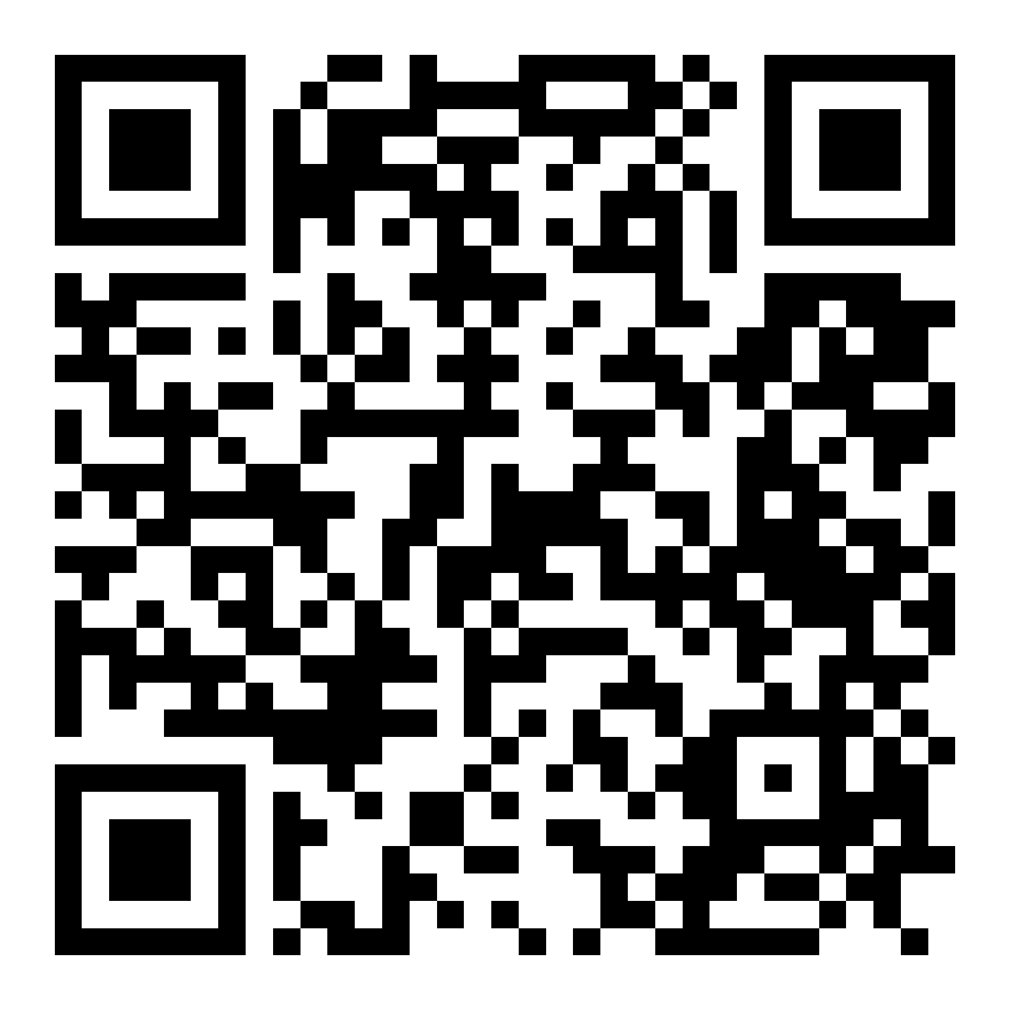
Consumption Log
Notes:
https://test.veryverified.eu/home/units/unit-1/consumption-log

Slide 15
Discussion: Consumption Log
What was surprising when looking at your chart? ​
How do you feel about the media you use? Does this seem like a lot of information coming at you? ​
How does that affect your ability to discern the quality of information? ​
What habits do you want to maintain, and what would you like to change?

Slide 16
Digital Wellness Break

Slide 17
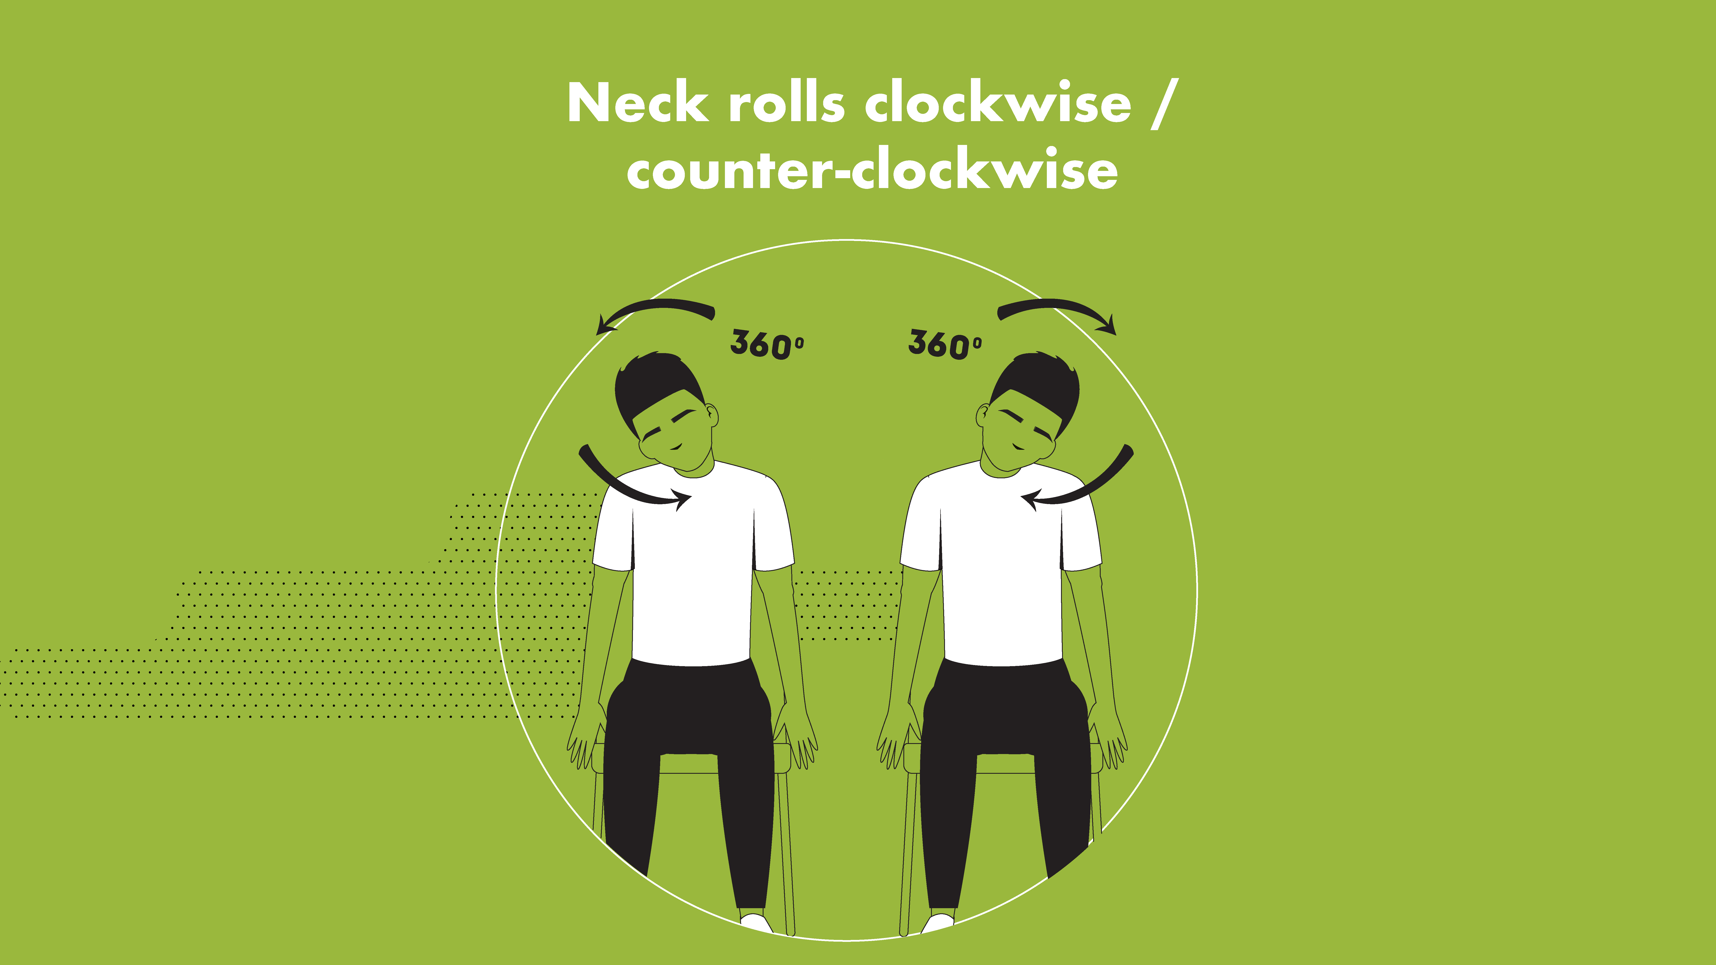
Notes:
Trainer: Sit up tall in your chair, and put both feet firmly on the floor. Now slowly start to circle your neck clockwise, drawing circles with your nose to the right to start. Make the circles small at first, and maybe make them a little bigger if that feels OK for you. Go about 5 times slowly in a clockwise direction, and then switch to counter-clockwise. After 5 on each time come back to your seat.

Slide 18
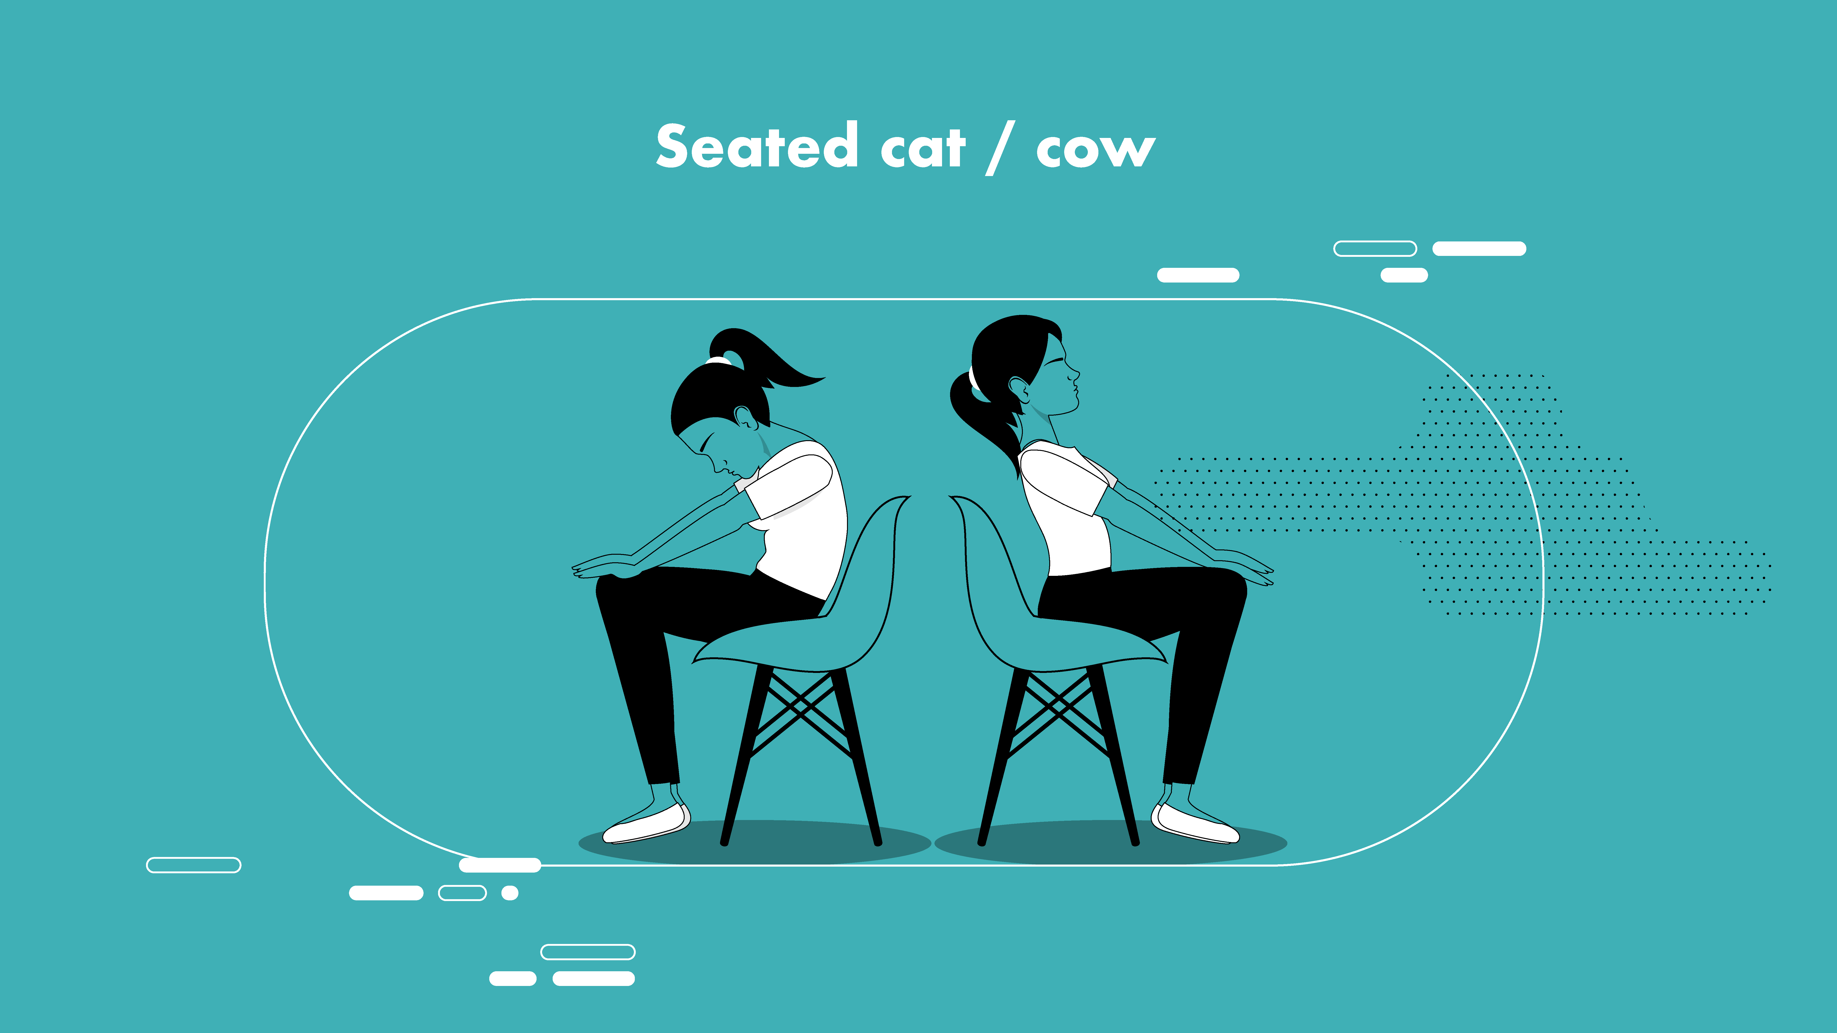
Notes:
This exercise is called ‘cat cow’ and is great for your back, especially if you’re sitting for most of the day. Sit toward the middle or front of your chair. On an inhale, arch your spine and look up, exhale and round your spine, tucking your chin toward your chest. Repeat this 3 or four times for each movement, and then come back to your nice seat.

Slide 19
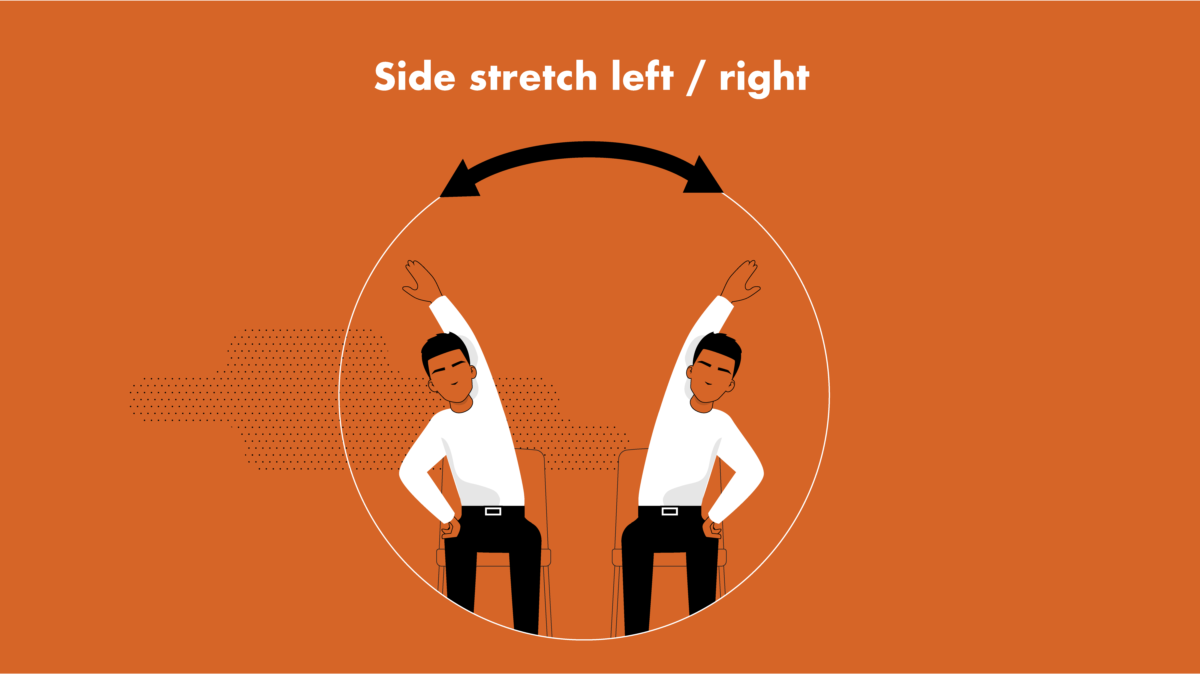
Notes:
Now let’s do some nice side stretches! Take your right hand to your chair or thigh. Stretch your left arm up over your head and to the right, take a few breaths. Then change, do the other side!

Slide 20
Unit 1 Conclusion
Notes:
Ask a few students to share one tip they learned from this part of the training that they’ll use in their lives moving forward.

Slide 21


