Slide 1
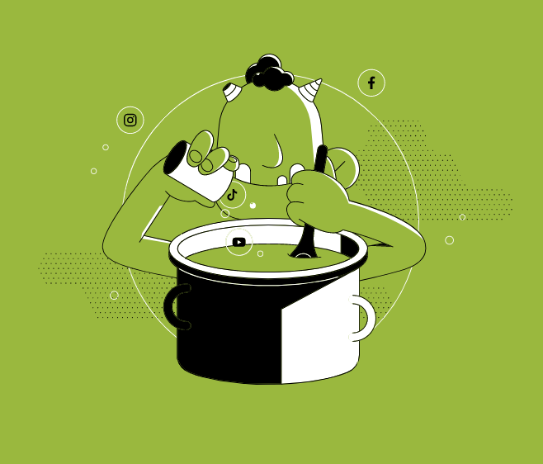

Lesson 8. Stereotypes and Hate Speech
Unit 4 Part C

Slide 2
Discussion
QUESTION 1:
What is hate speech and where does it come from?
Notes:
Ask:
- What were the topics you noticed? Was there a large diversity of topics you saw or were there only a few that were repeating?
- How many of all posts were ads?
- What emotions were evoked most frequently?
Discussing these questions should help prompt the student to start thinking about social media as a news source - whether a person can read relevant news stories about a diverse set of topics if they only use social media; are a lot of the topics on their timeline there to inform them (or rather to persuade them, get them to buy something); and if the posts they see mostly tend to be unserious or evoking sharp emotions.

Slide 3
Discussion
QUESTION 2:
Where is the boundary between freedom of speech and hate speech?
Notes:
Add link and barcode here

Slide 4
Discussion
QUESTION 3:
How is stereotyping connected to hate speech?

Slide 5

Notes:
https://www.youtube.com/watch?v=XjJQBjWYDTs

Slide 6
Discussion
QUESTION 3:
How can stereotyping lead to violence and hate?

Slide 7

VIDEO
Notes:
https://www.youtube.com/watch?v=LbB28T3fIWg

Slide 8
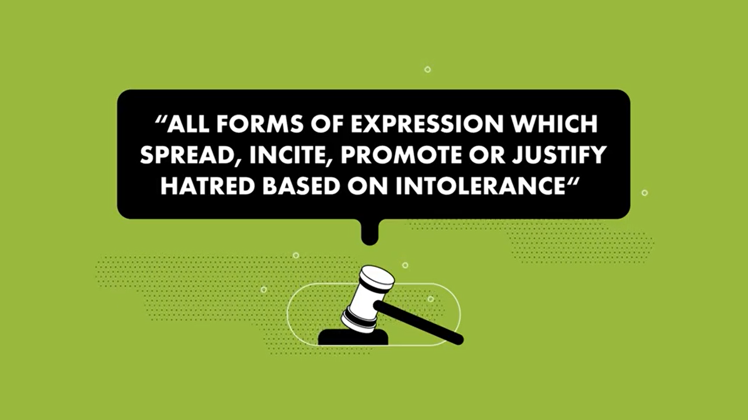
Hate speech
According to the European Court of Human Rights

Slide 9
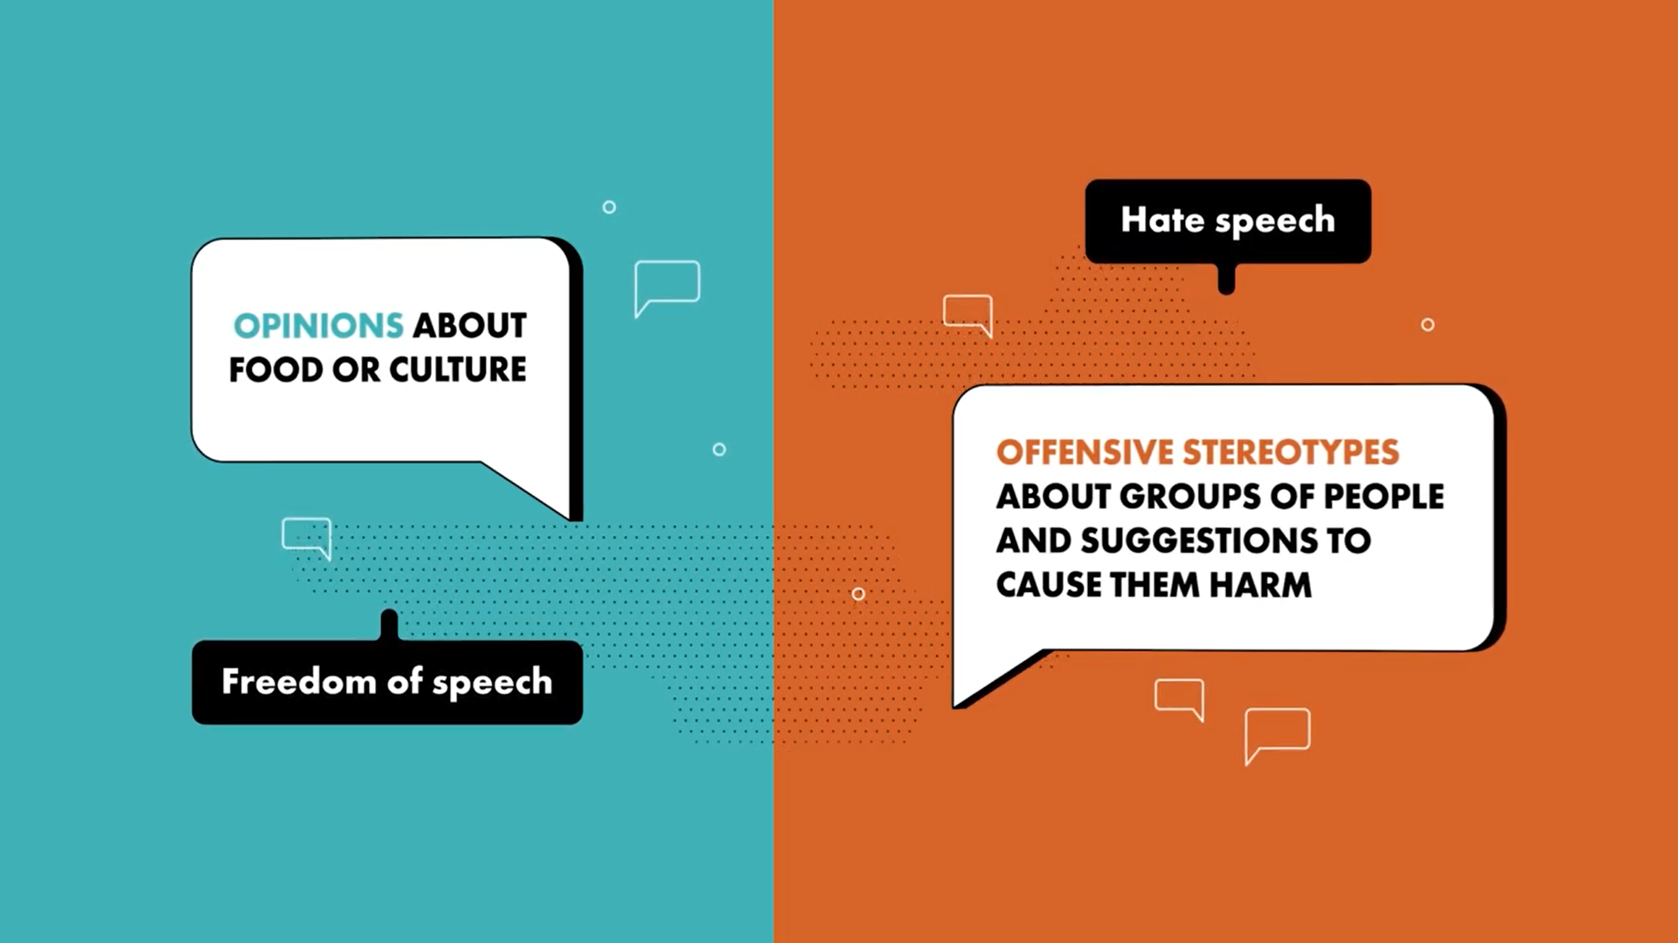

Slide 10
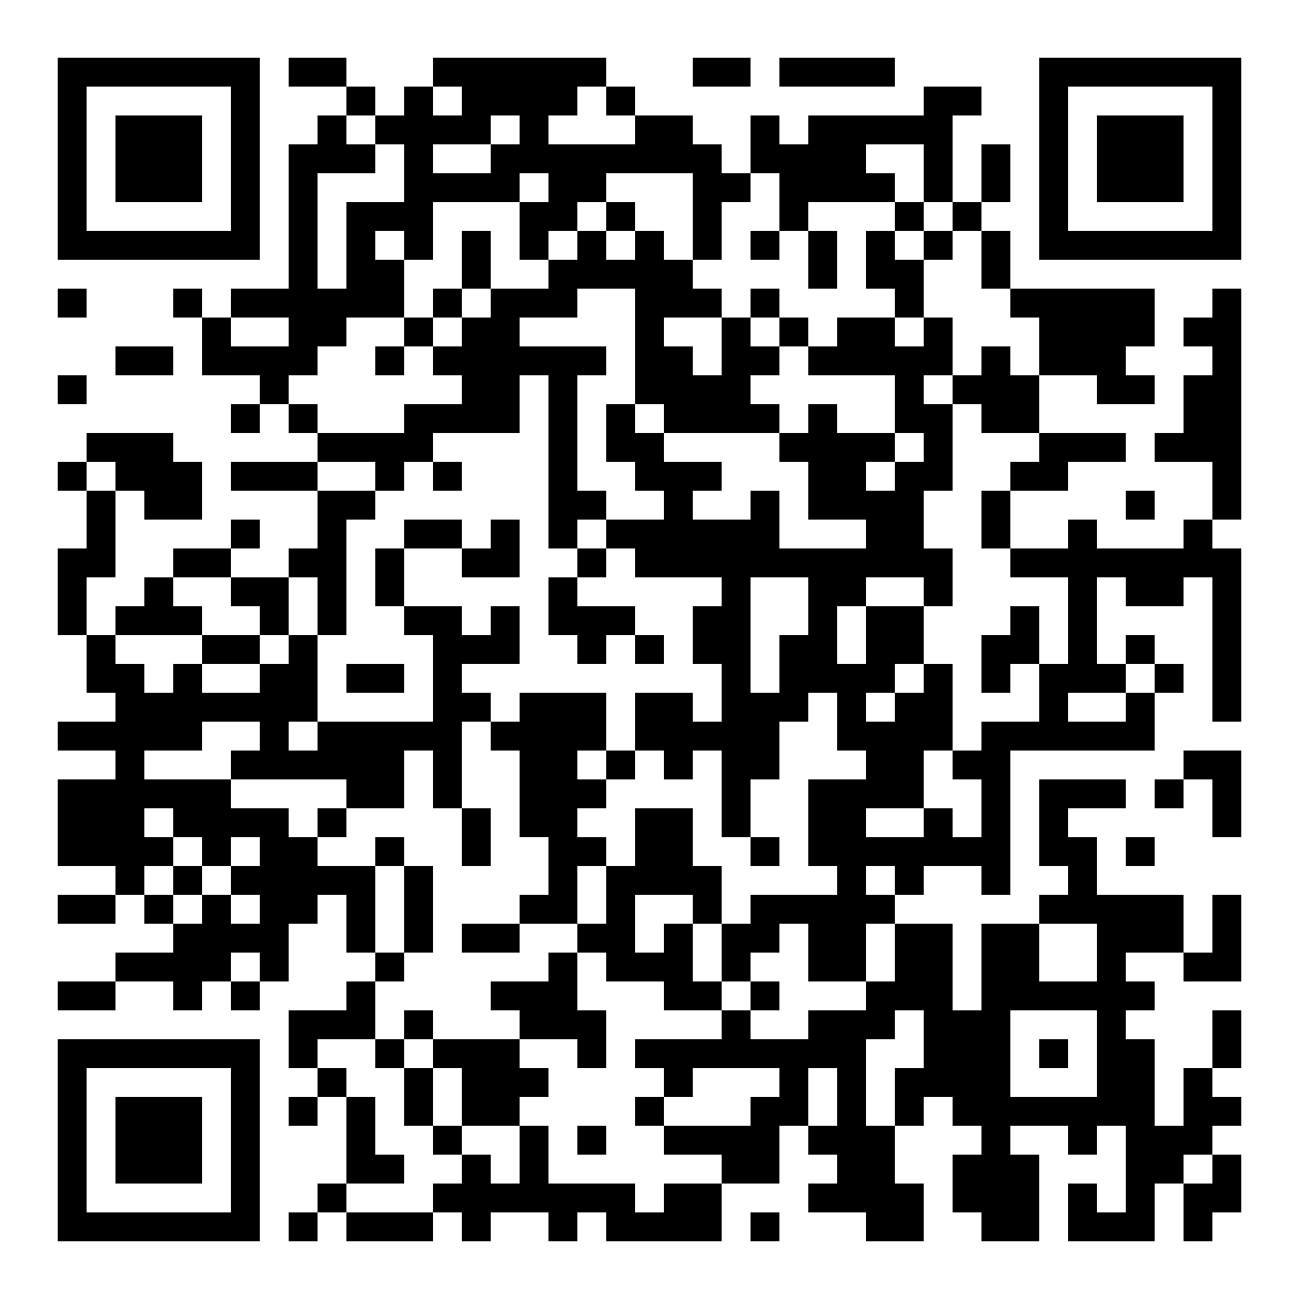
Quiz: Inclusive Language
Please take the quiz! QR code:

Slide 11
WHEN IN DOUBT ASK:
Freedom of speech vs. hate speech
?
What is the purpose?
What does it encourage?
How does it effect society?
What attitude does it show towards minority populations?
Is it humane?
Does it encourage hate crime?

Slide 12
Conclusion

